Slide 1
Identification and abuse characteristics of batch registered gTLD domains
Sam Cheadle - ML Engineer
Security, Stability & Resilience (SSR) Research
ICANN Office of the CTO
RIPE Presentation
May 2025

Slide 2
Structure of presentation
1
2
What are domain registration batches? How to identify them?
How common are batch registrations?
3
4
What are the abuse profiles of batch registered domains?
Conclusions and future work

Slide 3
What Are Domain Registration Batches?

Slide 4
Motivation
Attackers often register domains in bulk to support large-scale malicious campaigns (Vissers et al., 2017, Spooren, 2019) including phishing, malware delivery & botnet C2.
Prior work hypothesizes a preference for APIs or bulk registration tools to streamline and automate these registrations (Nosyk, 2025).
Use of APIs introduces detectable patterns—e.g., bursty, time-bound batches of registrations.
Batch patterns may reveal attacker infrastructure early in the attack lifecycle.
Understanding these patterns enables more effective detection, intervention, and mitigation.

Slide 5
Method
Perform batch registration clustering using limited features:
Registrar
Authoritative Nameservers
Creation date (full timestamp)
Exclude common shared nameservers (e.g. default registrar nameservers)
Density-based spatial clustering of applications with noise (DBSCAN) used as the clustering algorithm

Slide 6
Data sources
gTLDs Registration Data
Bulk registration data access (BRDA data)
Reputation Block Lists (RBLs)
Spamhaus, SURBL, WMCGlobal, Phishtank, Urlscan, APWG, Urlhaus

Slide 7
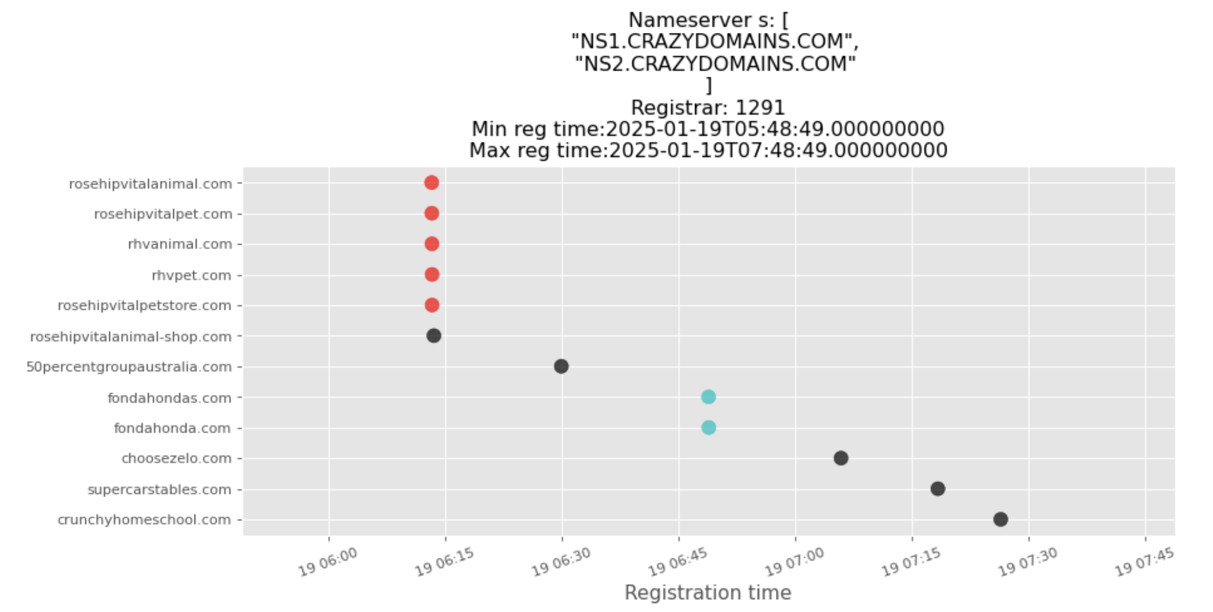
Example batches – Plot A

Slide 8
Example batches – Plot A
Domain registrations split by
Registrar (IANA ID)
Auth Nameservers

Slide 9
Example batches – Plot A
2 hour time window

Slide 10
Example batches – Plot A
Clustered ‘batch registrations’

Slide 11
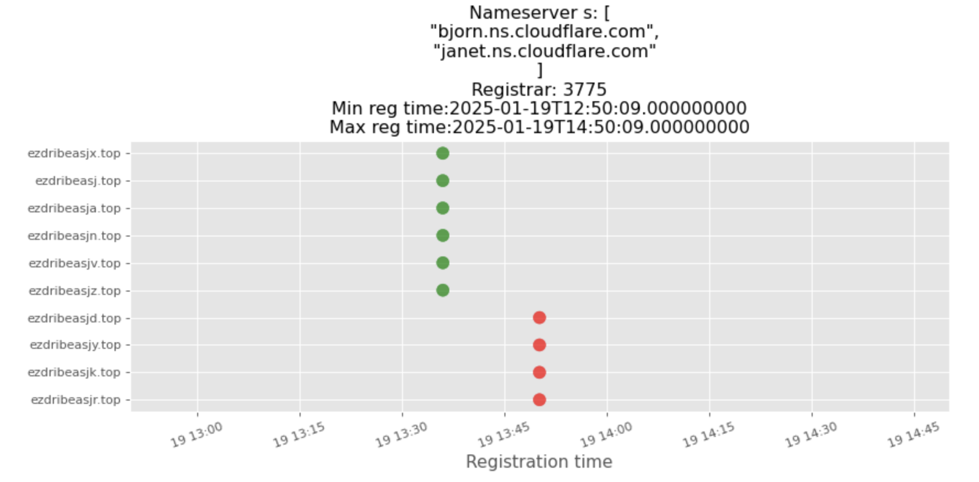
Example batches – Plot B

Slide 12
Example batches – Plot B
Distinct batches, but related ongoing campaign

Slide 13
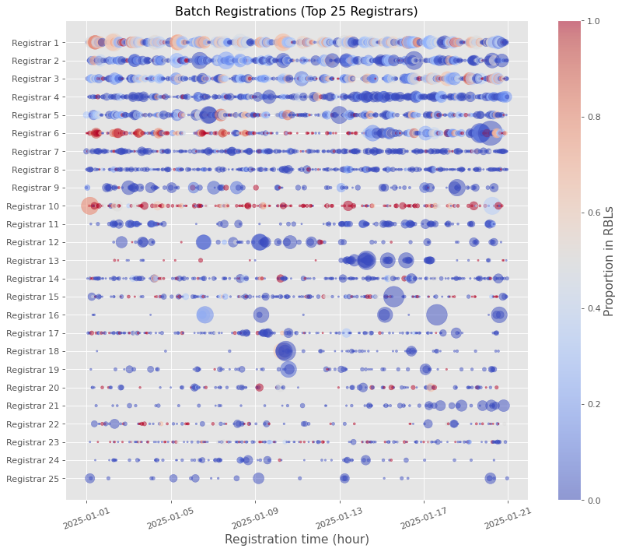
Visualising batch volumes across registrars
Hourly counts of batch registrations, for the top 25 registrars
Highest reputation block list (RBL) overlap is shown in red
3-week time-period

Slide 14
How Common Are Batch Registrations?

Slide 15
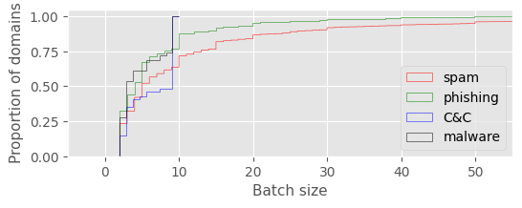
How common are batch registrations?
Analysis period: 2024-12-25 - 2025-02-18
Total number of newly registered gTLD domains (ICANN centralized data): 10,351,522
Total number of batch registered domains: 2,543,473 (25% of all registrations)
Notes:
Approx 25% of all new gTLD registrations within this period

Slide 16
Abuse Profiles of Batch Registered Domains

Slide 17
Overlap with newly registered malicious domains
Total number of RBL* domains: 288,218
Total number of batch registered RBL domains: 171,662 (60% of RBL domains)
* newly registered within the analysis period
Notes:
Approx 25% of all new gTLD registrations within this period

Slide 18
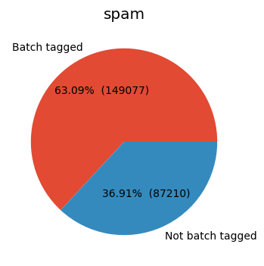
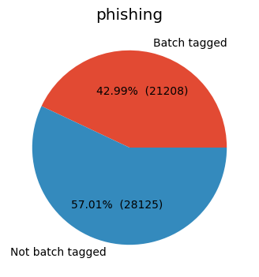
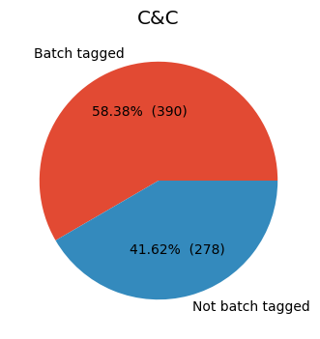
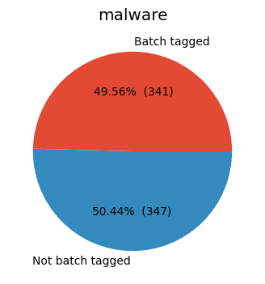
Overlap with newly registered malicious domains
Spam domains - highest % tagged as batch registered (63.1%)
Lowest % for phishing, but still > 40%
Overall 60% of newly registered malicious domains tagged as batch registered

Slide 19
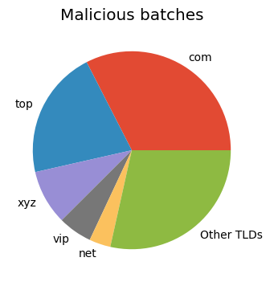
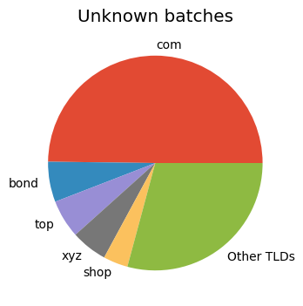
TLD composition breakdown – Top 5
Majority of batch registered domains are under dot com
Dot top is common within batches tagged as malicious
gTLDs with known high abuse rates are common in both groups

Slide 20
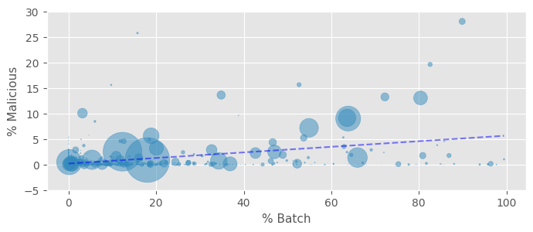
Registrar level analysis
Each dot is a registrar
Size = DUM in sample
What is the relationship between batch and overall abuse rates, per registrar?
Statistically significant positive correlation (Spearman’s r=0.422 p< 0.0001)

Slide 21
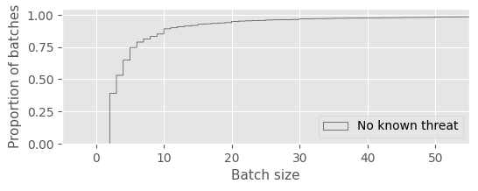
Distribution of batch sizes (CDF plots)
Most batches are small (38% contain only 2 domains). Long tail distribution.
Spam batches larger than phishing batches
Malware, C&C batches – max size of 10, limited coverage
Noticeable spikes at 10, 20, 30 etc

Slide 22
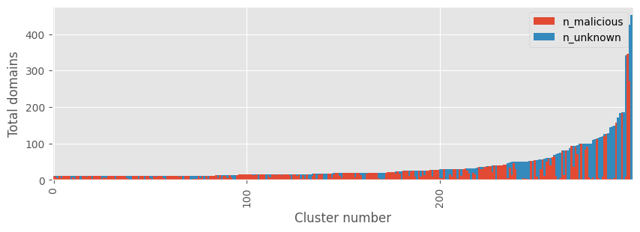
Abuse composition breakdown - individual batches
Plot shows a sample of 300 malicious batches (min size: 10, max size: 500)
Clusters sorted by size
Known malicious / RBL domain count is shown in red

Slide 23
Abuse composition breakdown - individual batches
Expansion analysis
Total number of inferred (additional) malicious domains: 179,344
104% increase on known batch RBL domains

Slide 24
Conclusions
Clustering methods effectively group batch registrations based on limited but meaningful features.
Most batches are small, but certain sizes appear more frequently, consistent with human selection preferences.
Larger batches are more common for certain threat types (spam, phishing).
There is a measurable link between batch registration activity and abuse rates.
Expanding batch registration labels significantly increases the identification of potentially malicious domains.

Slide 25
Future work
Validation / Ground Truth
Work with registrars to validate reliability of the method
E.g. Investigate impact of reseller practices (artificial batches?)
Interested registrars, please get in touch
Broaden coverage to other types of bulk registration patterns
Identifying non time-bound registration patterns - e.g. time series analysis to pick out ongoing malicious campaign registrations
Monitor ongoing patterns of abuse related to batch/bulk registrations
Explore methods of exposing the results to the community

Slide 26
Engage with ICANN – Thank You and Questions
Contact:
sam.cheadle@icann.org
ssr-research@icann.org

Slide 27
Additional slides

Slide 28
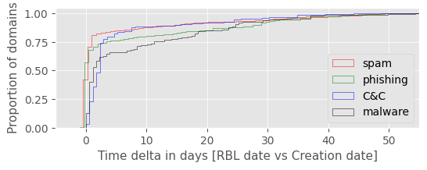
Domain Aging
What is the time delta between domain creation and RBL flagging (weaponization)?
The majority of domains are weaponized within 1-2 days of creation
However, a substantial number of domains (20-30%) remain dormant for days or weeks

Slide 29
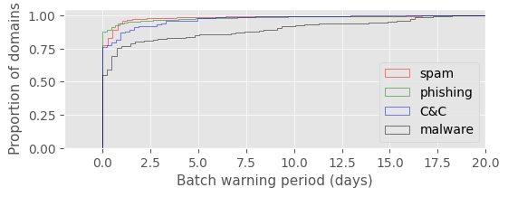
Warning period analysis
How many batch registered RBL domains could have been predicted earlier by batch expansion? (Grace period of 12 hours)
Total number of RBL domains with batch warning of 12 hours or more: 27,138
16.0% of all RBL batch domains

