Slide 1
Annet takes control
of the network
Grigorii Solovev, Yandex Infrastructure | RIPE 90 | 13.05.2025

Slide 2
Annet - network configuration automation tool
Opensource project - https://github.com/annetutil
Widely adopted in several large companies
Supports vendors:
Cisco – Cisco IOS/-XE/-XR, NXOS
Juniper – JunOS
Huawei – VRP5/VRP8
Arista – EOS
Nokia – TiMOS
MikroTik – RouterOS
SONiC – /etc/sonic/config_db.json
Whitebox – Linux (FRR, snmpd, ntpd and etc)
Grigorii Solovev | RIPE 90 | 13.05.2025

Slide 3
Why we decided to develop Annet?
Multivendor networks
Legacy devices
A lot of devices in production (10k+)
Complicated configurations
Transition between configurations
Grigorii Solovev | RIPE 90 | 13.05.2025

Slide 4
Software defined configuration
Full configuration templating
Create reference configuration and deploy it
Advantages:
Configuration checks
Mass changes
Actual documentation
Git, review and tests
Grigorii Solovev | RIPE 90 | 13.05.2025

Slide 5
Configuration methods
Requirements | CLI | NETCONF | Ansible
Machine-readable
Multivendor
Reliable delivery
Human-readable
Comfortable for writing
Versatility
Grigorii Solovev | RIPE 90 | 13.05.2025

Slide 6
Annet uses CLI method
Every device has CLI
CLI is convenient for engineers
CLI is machine-readable in reality
Need to be solved:
Multivendor support
Reliable delivery
Grigorii Solovev | RIPE 90 | 13.05.2025

Slide 7
Annet: fundamental
Declarative
Modularity
Templates on Python
Can support every device (every device has CLI)
There is no one single model of device configuration
Integrated with inventory system
Server less, only CLI client
Grigorii Solovev | RIPE 90 | 13.05.2025

Slide 8
Hands on examples
$ annet gen –g ntp sas-127d2
ntp server disable
ntp ipv6 server disable
ntp server source-interface all disable
ntp ipv6 server source-interface all disable
ntp unicast-server 95.108.129.181 vpn-instance MEth0/0/0
ntp unicast-server 95.108.129.183 vpn-instance MEth0/0/0
ntp unicast-server 37.140.149.198 vpn-instance MEth0/0/0
clock timezone UTC add 00:00:00
Grigorii Solovev | RIPE 90 | 13.05.2025

Slide 9
Hands on examples
$ annet diff –g ntp sas-127d2
- clock timezone FRA add 02:00:00
+ clock timezone UTC add 00:00:00
+ ntp unicast-server 95.108.129.181 vpn-instance MEth0/0/0
+ ntp unicast-server 95.108.129.183 vpn-instance MEth0/0/0
$ annet patch –g ntp sas-127d2
ntp unicast-server 37.140.149.198 vpn-instance MEth0/0/0
ntp unicast-server 37.140.149.199 vpn-instance MEth0/0/0
clock timezone UTC add 00:00:00
$ annet deploy –g ntp sas-127d2
$
Grigorii Solovev | RIPE 90 | 13.05.2025

Slide 10
Architecture
Inventory
…
Models
…
Generators
…
Golden configuration
Rulebook
patch
YAML
Device
SNMP
rul
NetBox
RPL
NTP
Diff
order
Mesh
BGP
deploy
Device configuration
deploy
Grigorii Solovev | RIPE 90 | 13.05.2025

Slide 11
Models: Device
Based on inventory data
Create python class object
>>> device.fqdn
'sas-127d2.yndx.net’
>>> bool(device.hw.Arista)
False
>>> [iface.name for iface in device.interfaces]
['10GE1/0/1', '10GE1/0/2', …, 'Eth-Trunk217’, 'Eth-Trunk218', …, 'LoopBack0', 'MEth0/0/0']
Grigorii Solovev | RIPE 90 | 13.05.2025

Slide 12
Models: RPL
Route policies are described in Python pseudo code
Create python class objects
@routemap def IMPORT_CONNECTED(device, route): with route( number=10, R.protocol == "connected", R.match_v4("LOCAL_NETS", or_longer=(24, 32)) ) as rule: rule.community.set("ADVERTISE") rule.allow() with route(number=20) as rule: rule.deny()
Grigorii Solovev | RIPE 90 | 13.05.2025

Slide 13
Models: RPL
Route policies elements are defined by Python objects
PREFIX_LISTS = [ IpPrefixList(name="LOCAL_NETS", members=["192.168.0.0/16"]) ]
COMMUNITIES = [ CommunityList(name="ADVERTISE", members=["65000:1"]) ]
Grigorii Solovev | RIPE 90 | 13.05.2025

Slide 14
Models: Mesh
Describe device neighbors based on templates
Templates applies to connection in the inventory
Create Python class objects for remote peers
@registry.direct("tor-{pod}-{num}", "spine-{pod}-{plane}")
def tor_to_spine(tor, spine, session):
tor.asnum = BASE_ASNUM + 100 + tor.match.pod * 10 + tor.match.num
tor.addr = f"10.{spine.match.plane}.{tor.match.num}.12/24"
tor.import_policy = "TOR_IMPORT_SPINE"
tor.export_policy = "TOR_EXPORT_SPINE"
spine.asnum = BASE_ASNUM + 200 + spine.match.pod
spine.addr = f"10.{spine.match.plane}.{tor.match.num}.11/24"
spine.import_policy = "SPINE_IMPORT_TOR"
spine.export_policy = "SPINE_EXPORT_TOR"
Grigorii Solovev | RIPE 90 | 13.05.2025

Slide 15
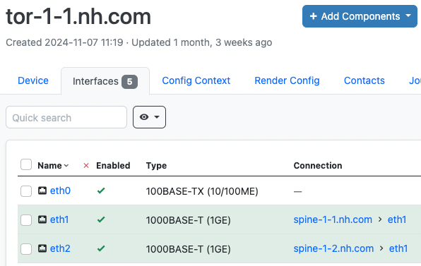
Models: Mesh
>>> [(peer.addr, peer.remote_as) for peer in mesh_data.peers]
[('10.1.1.11', ASN(65201)), ('10.2.1.11', ASN(65201))]
Grigorii Solovev | RIPE 90 | 13.05.2025

Slide 16
Generator
Python generator is class with per vendor methods
Generators has access to inventory data and models
It yields configuration lines
def run_juniper(self, device):
if device.tags[”Frankfurt"]:
servers = NTP_SERVERS_FRA
else:
servers = NTP_SERVERS_GLOBAL
for server in servers:
with self.multiblock("system", "ntp"):
yield "server", server, "version 3"
def run_huawei(self, device):
if device.tags[”Frankfurt"]:
servers = NTP_SERVERS_FRA
else:
servers = NTP_SERVERS_GLOBAL
for server in servers:
yield "ntp unicast-server", server
Grigorii Solovev | RIPE 90 | 13.05.2025

Slide 17
ACL
Limit scope of the generator
Limit configurations lines for diff
Uses for modularity
snmp-agent
ifindex constant
interface
mac-address trap notification
mac-address notification learning
set if-mib discard-statistics enable
acl number 410
acl ipv6 number 610
Grigorii Solovev | RIPE 90 | 13.05.2025

Slide 18
Rulebook
Redefine no/undo/delete commands to expected format
Very flexible logic
Order of configurations lines in patch
Response on questions
interface 100GE0/1/39 - port-queue ef wfq weight 3 outbound + port-queue ef wfq weight 5 outbound
interface 100GE0/1/39 undo port-queue ef wfq outbound port-queue ef wfq weight 5 outbound quit
Grigorii Solovev | RIPE 90 | 13.05.2025

Slide 19
Deploy
Opensource library - gnetcli
Written on Golang
Annet uses gnetcli for connection to devices
Grigorii Solovev | RIPE 90 | 13.05.2025

Slide 20
gnetcli
Pagination
Interactive interaction
NETCONF
Various network operating systems
CLI tool
GRPC server
Python SDK
Grigorii Solovev | RIPE 90 | 13.05.2025

Slide 21
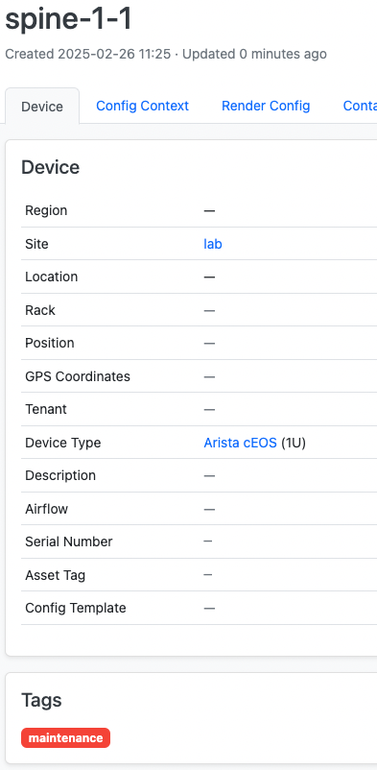
Real world example - drain spine in DC fabric
Assign tag to the device
Update route policy
$ annet diff –g rpl spine-1-1
route-map SPINE_EXPORT_TOR permit 10
+ set community 65535:0 additive
$ annet deploy –g rpl spine-1-1
$
The task is done
Grigorii Solovev | RIPE 90 | 13.05.2025

Slide 22
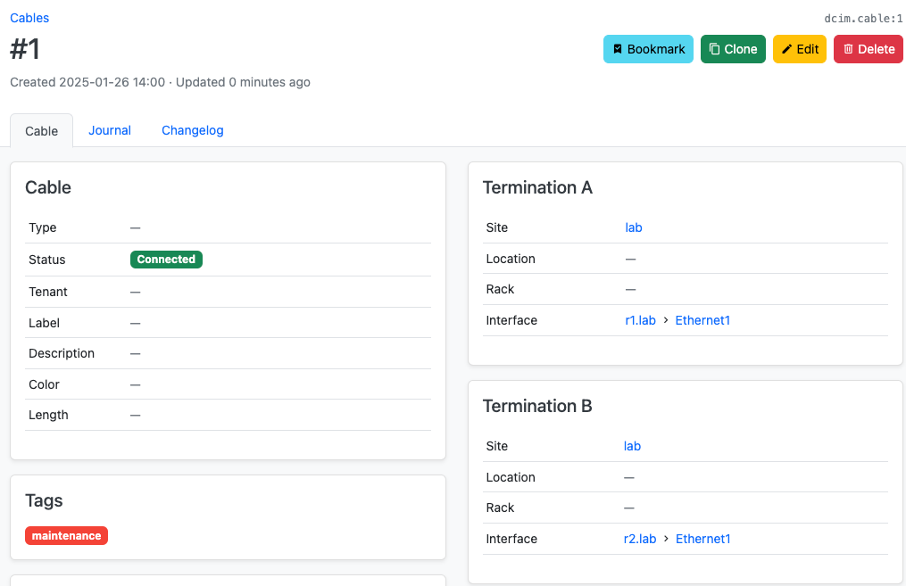
Real world example - drain link between devices
Assign tag to the cable
Update bgp configuration
$ annet diff –g bgp r1
router bgp 65001
+ neighbor 10.1.2.12 shutdown
$ annet deploy –g bgp r1
$
The task is done
Grigorii Solovev | RIPE 90 | 13.05.2025

Slide 23
Annet – feel free to add new ones
Supports vendors:
Cisco – Cisco IOS/-XE/-XR, NXOS
Juniper – JunOS
Huawei – VRP5/VRP8
Arista – EOS
Nokia – TiMOS
MikroTik – RouterOS
SONiC – /etc/sonic/config_db.json
Whitebox – Linux (FRR, snmpd, ntpd and etc)
Grigorii Solovev | RIPE 90 | 13.05.2025

Slide 24
Annet – how to try
Project repository - https://github.com/annetutil
Labs
Tutorial
Telegram chat
Grigorii Solovev | RIPE 90 | 13.05.2025

Slide 25
Grigorii Solovev | RIPE 90 | 13.05.2025

