Slide 1



ACM Web Conference 2025
Pontus: A Memory-Efficient and High-Accuracy Approach for
Persistence-Based Item Lookup in High-Velocity Data Streams
Weihe Li¹, Zukai Li¹, Beyza Bütün², Alec F. Diallo¹, Marco Fiore², Paul Patras¹
¹University of Edinburgh, Edinburgh, United Kingdom
²IMDEA Networks Institute, Madrid, Spain

Slide 2
Data Stream Processing
User behavior analysis important to improve user experience
Persistently accessed websites (persistent items) user preferences

Slide 3
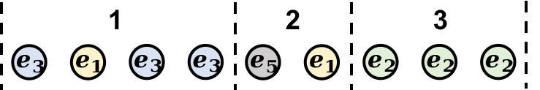




Persistence
Appeared, persistence = 1
Appeared, persistence = 2
Appeared
persistence = 1
Item | Persistence
 | 2
 | 1
 | 1
 | 1

Slide 4
Challenges
Fast processing speed​
e.g. 10 Gb/s data stream: each item every 67 ns ​
​
Limited fast memory ​
L1 Cache: around 64KB^{[1]​}
Infeasible to store information for all items
High Speed & Large Volume
v.s.
Limited Space
[1] Li, W. and Patras, P. Tight-sketch: A high-performance sketch for heavy item-oriented data stream mining with limited memory size. ACM CIKM 2023.

Slide 5


Sketches
Sketches: compact data structure by hashing
  Idea: hash data into limited space
On , 0
$d$ arrays
$l$ counters
[1] Zhang, Yinda, et al. "On-off sketch: A fast and accurate sketch on persistence." Proceedings of the VLDB Endowment 14.2 (2020): 128-140.

Slide 6




Sketches
$$e_{3}$$
$$h_{1}$$
$$h_{2}$$
$$h_{3}$$
On , 5
……
$d$ arrays
Off , 7
$l$ counters

Slide 7

Sketches
$$e_{3}$$
$$h_{1}$$
$$h_{2}$$
$$h_{3}$$
Off , 6
……
$d$ arrays
Off , 7
$l$ counters

Slide 8
Sketches
$$e_{3}$$
$$h_{1}$$
$$h_{2}$$
$$h_{3}$$
Off , 6
……
$d$ arrays
Off , 7
Not changed
$l$ counters

Slide 9

Sketches
$$e_{3}$$
$$\hat{p_{i}}=\min_{1≤j≤d}{C_{j}[h_{j}(e_{i})]}$$
$$h_{1}$$
$$h_{2}$$
$$h_{3}$$
Off , 6
……
$d$ arrays
Off , 7
$l$ counters

Slide 10
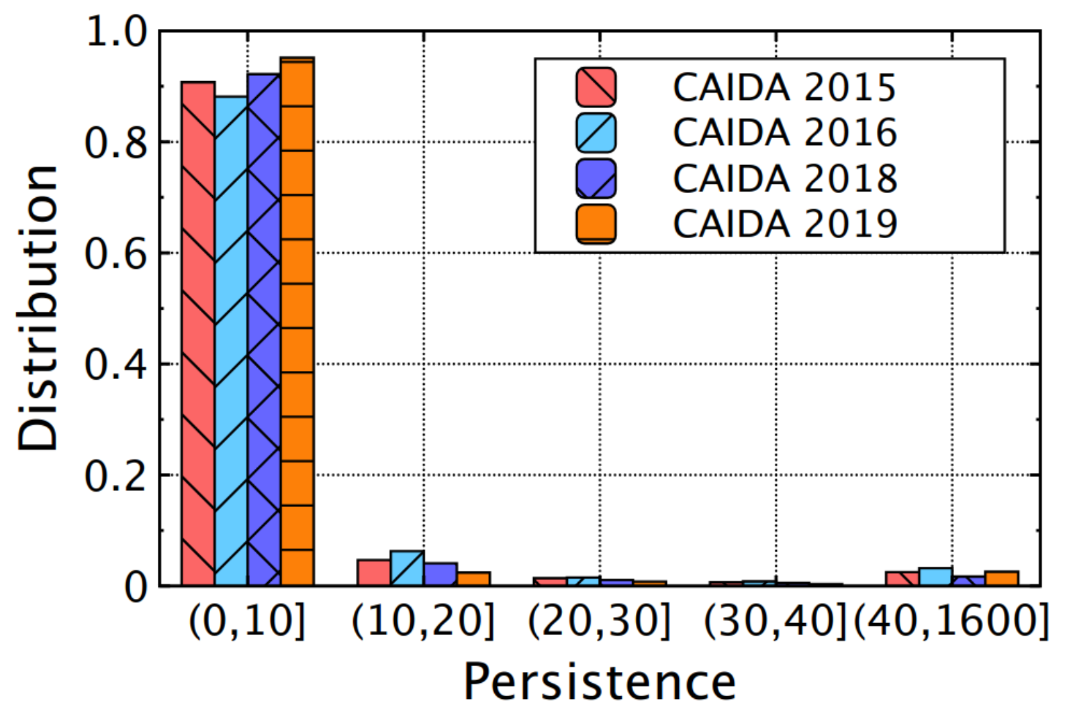
Limitations of Existing Sketch Methods
Low detection accuracy under limited memory budgets
  Persistent flows being evicted from the bucket by non-persistent ones due to the highly skewed traffic distribution.
More than 85%

Slide 11
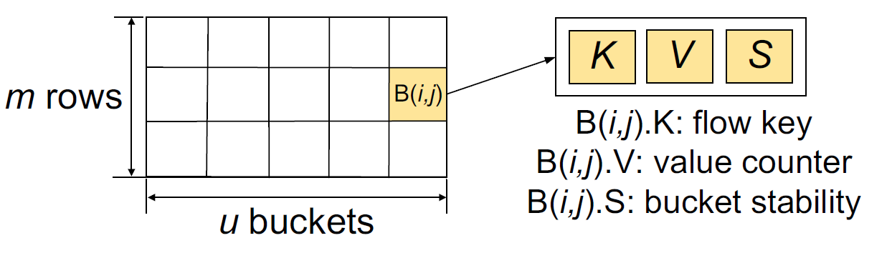
Limitations of Existing Sketch Methods
Low Memory Efficiency
  Track multiple features per item to better protect persistent items.
Extra Metric (2-byte)
[2] Li, W. and Patras, P. Stable-sketch: A versatile sketch for accurate, fast, web-scale data stream processing. ACM WWW 2024.

Slide 12
Our Contributions
Pontus
  A novel method for persistent item lookup
  High accuracy, high memory-efficiency and fast processing speed
  Deployable on the practical hardware, Tofino programmable switch

Slide 13
Data Structure
Collision decay flag (only 1-bit)
Item Key
Persistence
Arrival flag

Slide 14
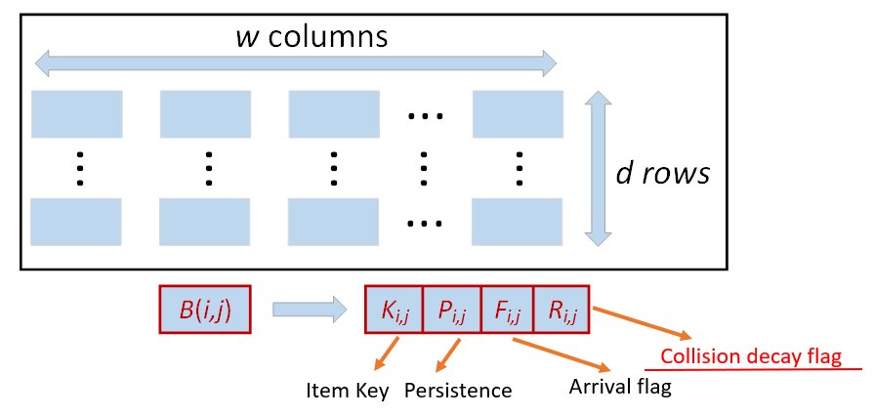


Update
Case 1:
hash1

Slide 15


Update
Case 2:
hash1
Decay rate: $\frac{1}{P+1}=\frac{1}{5}$
hash2
The incoming item can replace the tracked item only if its counter has decayed to zero.

Slide 16
Update
Case 3:
hash1
Been decayed by another incoming item
hash2
Increment by 2 instead of 1

Slide 17
Query
Only a single scan of all buckets is required to determine which bucket contains a value higher than the predefined threshold.

Slide 18
Evaluation
Software -- CPU Platform (Intel(R) Core(TM) i5-1135G7 @ 2.40GHz processor, C++)
Hardware -- Tofino Switch (P4)
Traces -- CAIDA 2018 and 2019^{[3]}
[3] CAIDA. Anonymized Internet Traces. https://catalog.caida.org/dataset.

Slide 19
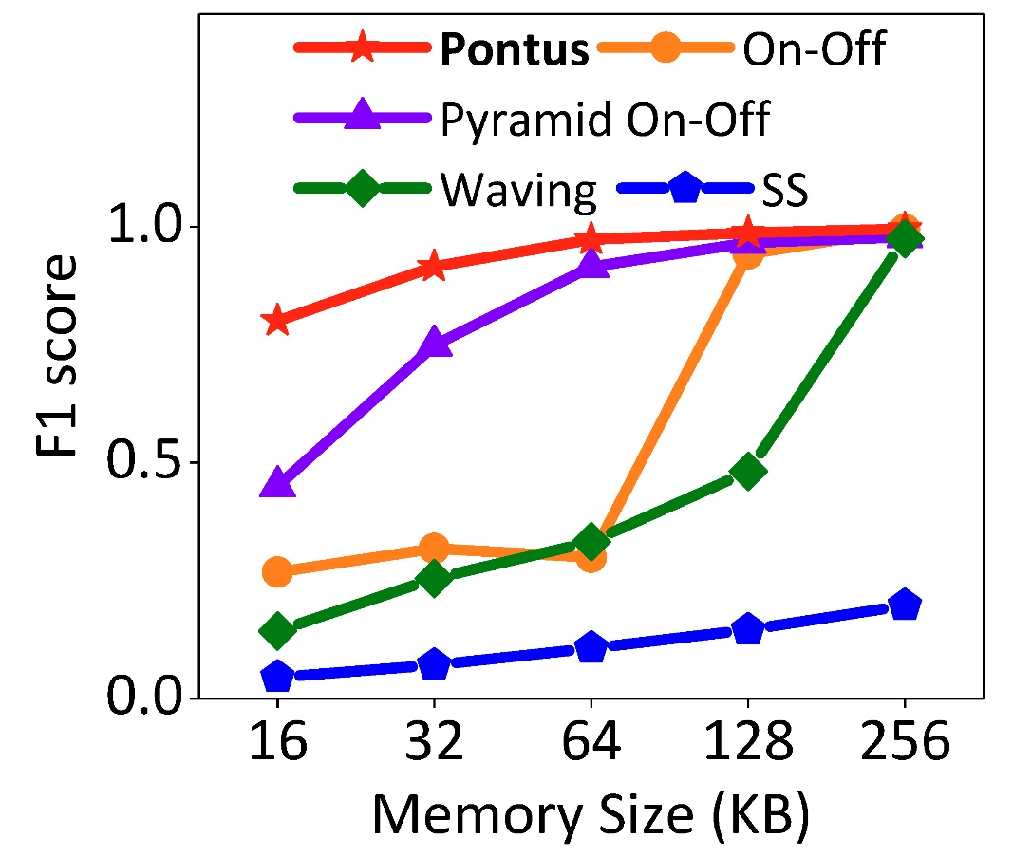
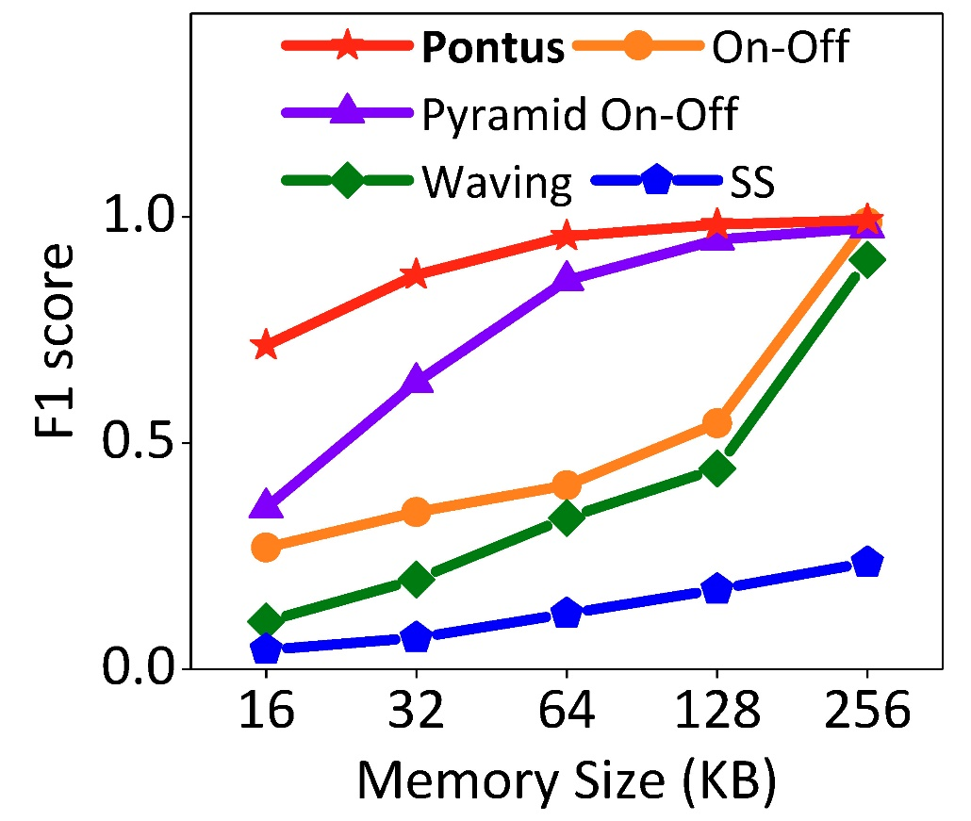
Evaluation – Accuracy (CPU)
Highest F1 score!
19.7% higher than Pyramid On-Off
Highest F1 score!
15.1% higher than Pyramid On-Off
CAIDA 2018
CAIDA 2019

Slide 20
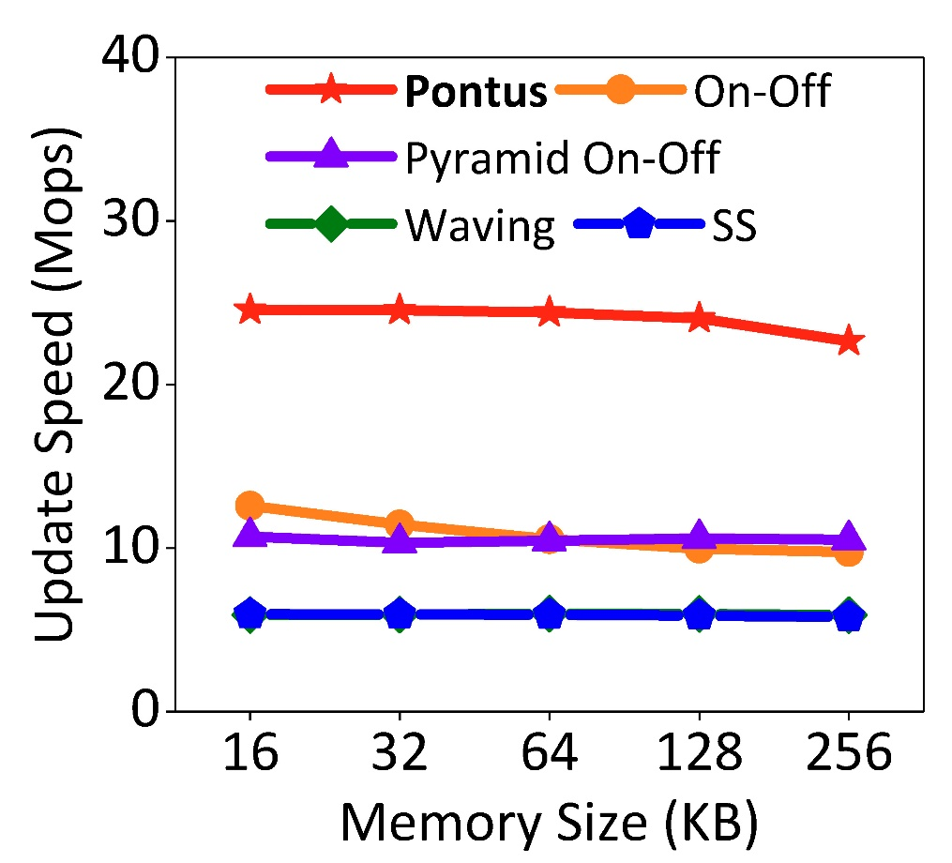
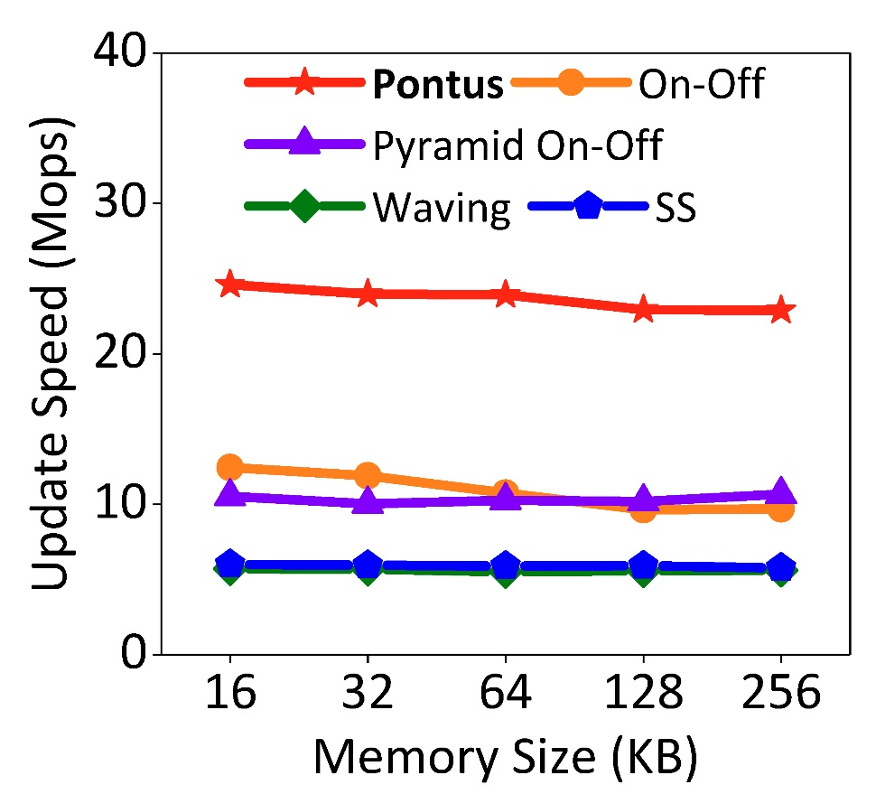
Evaluation – Speed (CPU)
Higher Speed!
121.4% higher than On-Off
Higher Speed!
117.3% higher than On-Off
CAIDA 2018
CAIDA 2019

Slide 21
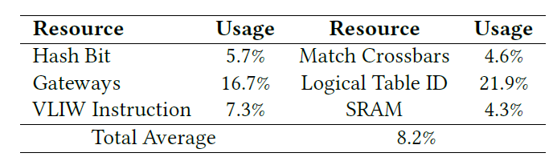
Evaluation – Resource Usage (Tofino)
Limited Overhead

Slide 22
More results
    Formal analysis
    Evaluation on more tasks, like persistence estimation
    More results on the CPU platform and Tofino switch
Code: https://github.com/Mobile-Intelligence-Lab/Pontus
This research was supported by the SNS JU and the European Union’s Horizon Europe research and innovation program under Grant Agreement No. 101139270 (ORIGAMI). Beyza Bütün is a Comunidad de Madrid predoctoral fellow (PIPF-2022/COM-24867). Weihe Li was partially supported by Cisco through the Cisco University Research Program Fund (Grant no. 2019-197006).

