Slide 1
Evolving MANRS: New Development Process and Document Review

Slide 2
A collaborative approach:
Mutually Agreed Norms for Routing Security (MANRS, https://manrs.org/ )
An undisputed minimum security baseline – the norm.
  Defined through MANRS Actions
Demonstrated commitment by the participants
  Measured by the Observatory and published on https://www.manrs.org

Slide 3
The foundational pieces
Charter
Defines roles and responsibilities of various entities in the MANRS ecosystem and the governance structure
NetOps Program Actions
Define the baseline requirements for the participants of the program
IXP Program Actions
Define the baseline requirements for the participants of the program
CDN&Cloud Program Actions
Define the baseline requirements for the participants of the program
Vendor Program Actions
Define the baseline requirements for the participants of the program
NetOps Implementation Guide
Provides guidance on how to deploy the measures required by MANRS and is targeted at stub networks and small providers.
IXP Implementation Guide
Provides guidance on how to deploy the measures required by MANRS and is targeted at Internet eXchange Points.
Common ROA Management Requirements and Security Standards for Operators of RPKI Services
Provides guidance for the operators of RPKI services (ORS)

Slide 4
MANRS is maturing
In developing MANRS we as a community have always strived for transparency, inclusion and consensus: working groups, task forces, community last calls
To expand its impact further we need a formal process of how MANRS documents – normative (e.g. MANRS Actions) and informational (e.g. MANRS Implementation Guides) – are developed, adopted and maintained.
Increase credibility, transparency and inclusiveness
  A formal documented process for developing and modifying MANRS documents – MANRS Actions, MANRS Charter, etc.
Introduce a formal document series
  Provides stable references and version control, making it easier to refer to it in external documents
Participants==Community
Participants==Community

Slide 5
How we develop, adopt and maintain MANRS documents:
The MANRS Development Process

Slide 6
The MDP in a nutshell
Proposal
Announcement
Development
Public Comment
Approval and
Publication
https://manrs.org/manrs-development-process/

Slide 7
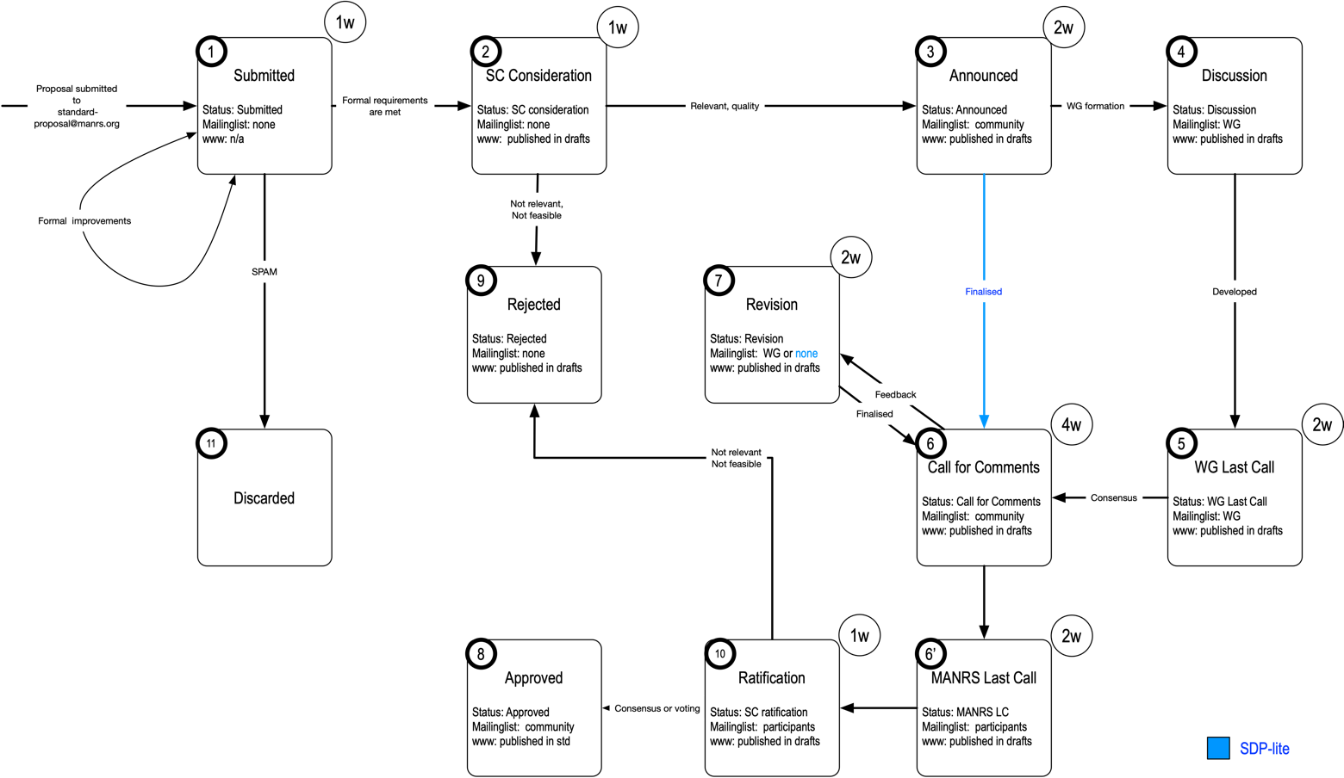
A more detailed view

Slide 8
Time to review

Slide 9
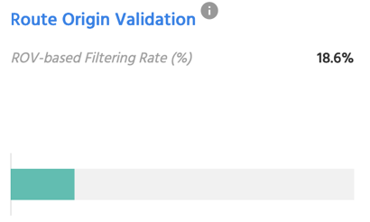
MANRS Actions – areas for update
NetOps Action 1 – explicitly require ROV?
NetOps Action 4 RPKI – mandatory?
IXP Action 1 – require using auth IRRs?
Pick up some requirements from the MANRS+ Control Matrix?
  BGP session protection
  Peerlock
  More elaborate audit requirements
  Spoofed traffic trace-back

Slide 10
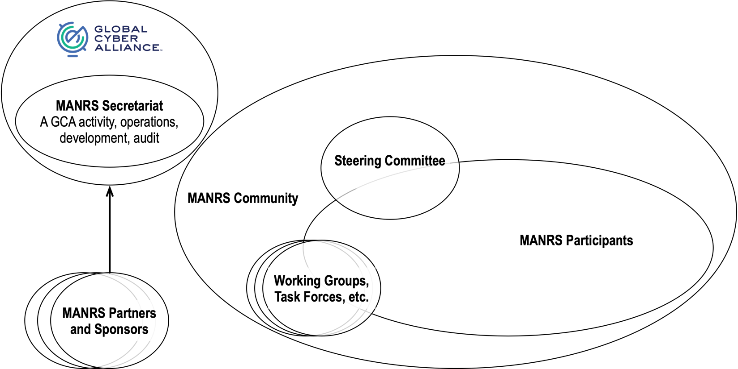
The MANRS Ecosystem

Slide 11





Stay tuned and participate:
https://www.manrs.org
FOLLOW US:
/RoutingMANRS

