Slide 1
NRO NC
RIPE 90 BoF Outcomes
Reporting Back
15 May 2025
Notes:
‹#›
‹#›
‹#›

Slide 2
Quick Recap
The consultation on the draft “RIR Governance Document” opened on 14 April and will close on Tuesday, 27 May (yes, next Tuesday!)
There was a RIPE NCC Open House on 29 April
We held a BoF on ICP-2 on Monday, 12 May to hear your feedback
We also presented the document during the Address Policy Working Group session on Wednesday, 15 May
So what are we doing here?
‹#›

Slide 3
What We Heard at RIPE 90
There was feedback on the language and tone of the document
Concerns about the level of detail and implementation
And larger philosophical approaches to this topic
‹#›

Slide 4
Document Structure and Language
The document needs to have goals
It reads more like a contract
It varies between high level principles and mechanics at a more operational level
The language is inconsistent (musts/shoulds) and could be softened, some parts should be more precise (“geographic area”)
The prescriptive tone contradicts the community-driven nature of RIRs
‹#›

Slide 5
Decision-Making Concerns
The opinions on unanimity are not unanimous
Several of you suggested using majority-based models
The current model assumes good faith by all parties, this assumption of acting in good faith is being questioned
There needs to be greater clarity on decision-making criteria: which criteria should apply to each decision point
‹#›

Slide 6
Applicability Across Regions
There are currently regional differences, we need to consider a basic set of features that are common to all registries or to be recognised as a registry (e.g. whether a natural person can be a member)
The prescriptive language could lead a casual reader to assume that there are new obligations being imposed from outside the regional bottom-up, community-driven process
Challenging to reconcile the historic view of the community grounding with the language of the document
‹#›

Slide 7
Implementation
Business continuity plans are important, details like escrow are less so
How would a handover from one RIR to another work?
  Whose policies will apply?
  How will policy differences be addressed?
  Who will actually take charge?
What are the decision-making thresholds? How do we gauge support?
How is impact measured?
‹#›

Slide 8
The Big Picture
The document needs to reflect and safeguard the values of the RIR communities - stability, stewardship, fairness, community, bottom-up, inclusive, representative…
The role and relationship between the RIRs, the NRO, and ICANN needs to be clarified
Be clear about what it is that we want from this document
‹#›

Slide 9
What Next
Take your feedback to the NRO NC
Summarise, cluster and and categorise the feedback
The NRO NC will discuss the feedback during ICANN 83, 9-12 June
  We will discuss your concerns
  Work on the second draft
The aim is to share the second draft ahead of the RIR meetings in the latter half of the year
‹#›

Slide 10
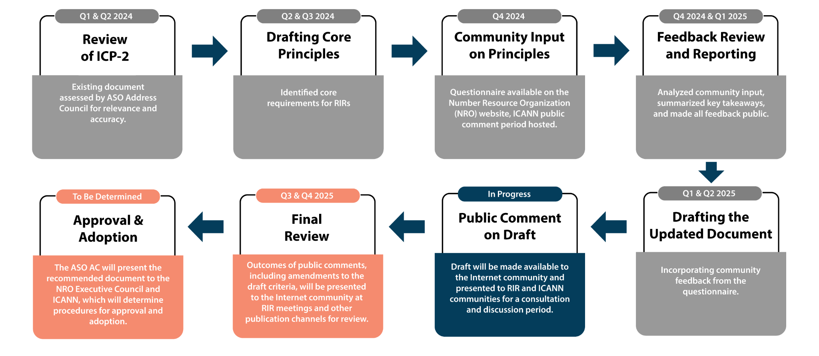


ICP-2 Review Timeline
‹#›

Slide 11

Draft “RIR Governance Document”
https://www.nro.net/policy/internet-coordination-policy-2/rir-governance-document/
‹#›
‹#›
Notes:
‹#›
‹#›

Slide 12
Guidance for Feedback
Please share feedback that is specific to this draft
We are particularly interested in hearing your views on the new requirements in the draft
Whether the draft provides sufficient clarity regarding the ongoing obligations of an RIR and the remediation steps if the obligations are not met
This document does not address the implementation of the RIR criteria; comments on implementation will be considered out of scope
Constructive comments are highly appreciated
‹#›
‹#›
Notes:
‹#›
‹#›

Slide 13
ICP-2 Review Timeline (reminder)
The Draft “RIR Governance Document” Consultation
14 April 2025 |  | Draft “RIR RIR Governance Document” published RIR consultations in each region and ICANN Public Comment proceeding launched
27 May 2025 |  | Public consultation closes
9-12 June 2025 |  | ASO AC will review feedback received
September 2025 |  | The revised “RIR Governance” document will be published
Q4 2025 |  | Final review and revision of updated document Begin NRO and ICANN approval and adoption process
‹#›

Slide 14

Thank You
‹#›

