Slide 1




Policy Certification and Verification for Cybersecurity in the IoT
Anna Maria Mandalari

Slide 2
Agenda
Problem: IoT Devices Expose Information Over the Internet
Privacy and Security Certification/Regulation
IoT Automating Testing and Compliance
01
02
03
Reasons you shouldn’t watch TV
Reasons you shouldn’t use smart medical devices.
EU Cyber Resilience Act (CRA)
GDPR
IoTrim ++
Black box assessment
Standards
Gaps
Conclusion
04
05
06
Standardization request
ETSI/CEN-CENELC WGs
IoT Manufactures
SMEs
What’s next?

Slide 3
Agenda
Problem: IoT Devices Expose Information Over the Internet
Privacy and Security Certification/Regulation
IoT Automating Testing and Compliance
01
02
03
Reasons you shouldn’t watch TV
Reasons you shouldn’t use smart medical devices.
EU Cyber Resilience Act (CRA)
GDPR
IoTrim ++
Black box assessment
Standards
Gaps
Conclusion
04
05
06
Standardization request
ETSI/CEN-CENELC WGs
IoT Manufactures
SMEs
What’s next?

Slide 4
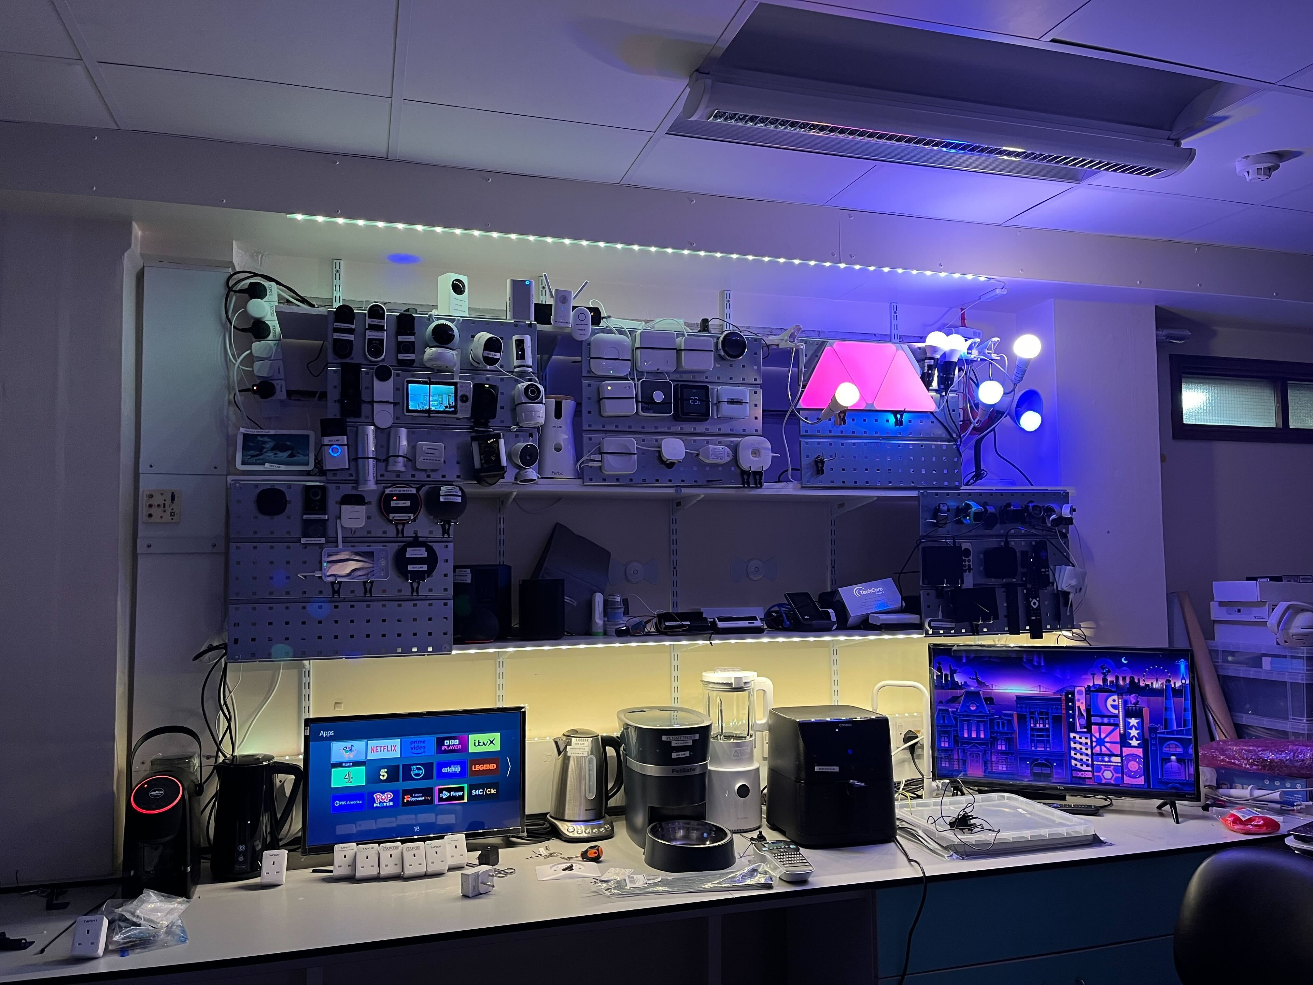
210 devices in
different countries

Slide 5
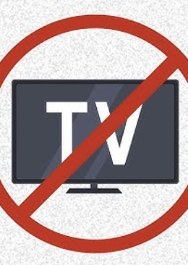
Reasons You Shouldn’t Watch TV
01

Slide 6


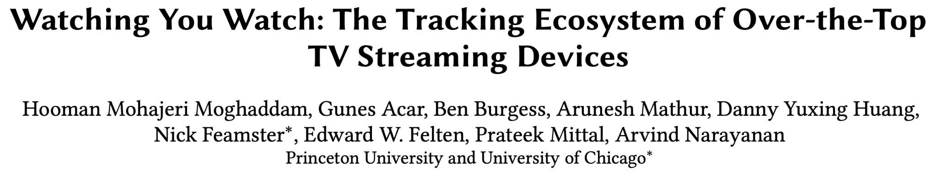
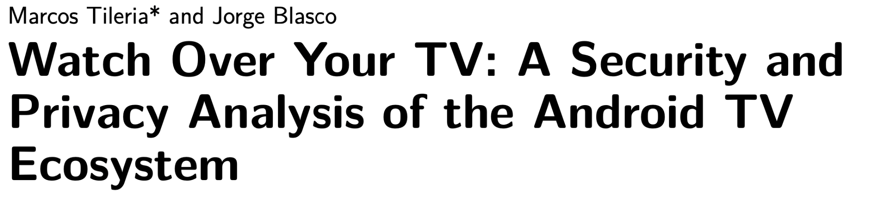
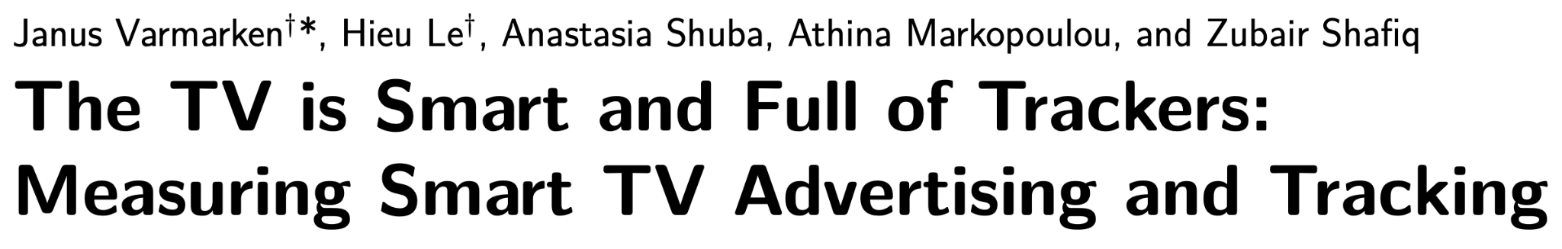
Motivation
Notes:
Over the past few years, there has been ample research in the literature to study the Smart TV tracking ecosystem.

Slide 7
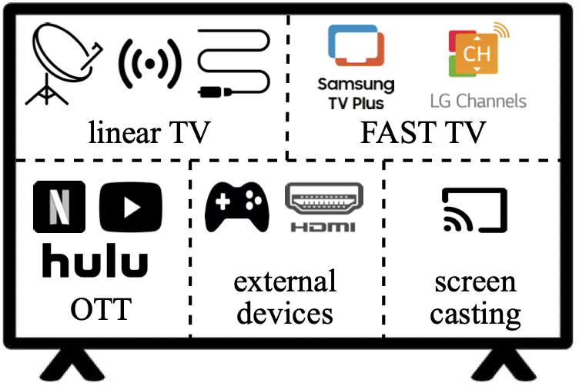

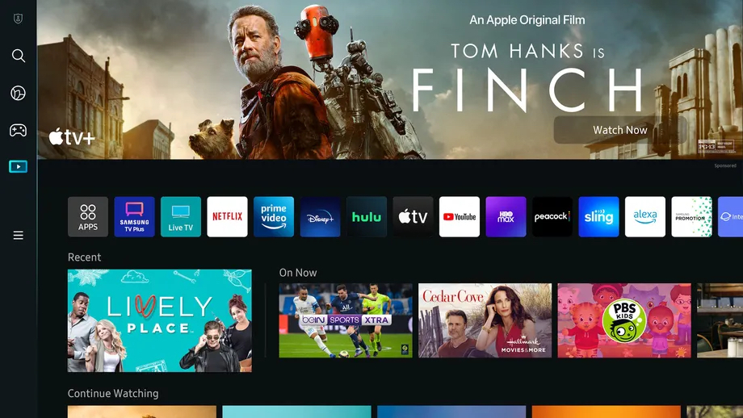








3P apps or services
Notes:
However, all these works are solely focused on understanding the tracking conducted on Smart TVs by 3rd party trackers embedded within apps available on the Smart TVs – completely ignoring the 2nd-party. In this research, we study the 2nd-party tracking directly conducted by the Smart TV manufacturers using a mechanism referred to as ACR.

Slide 8
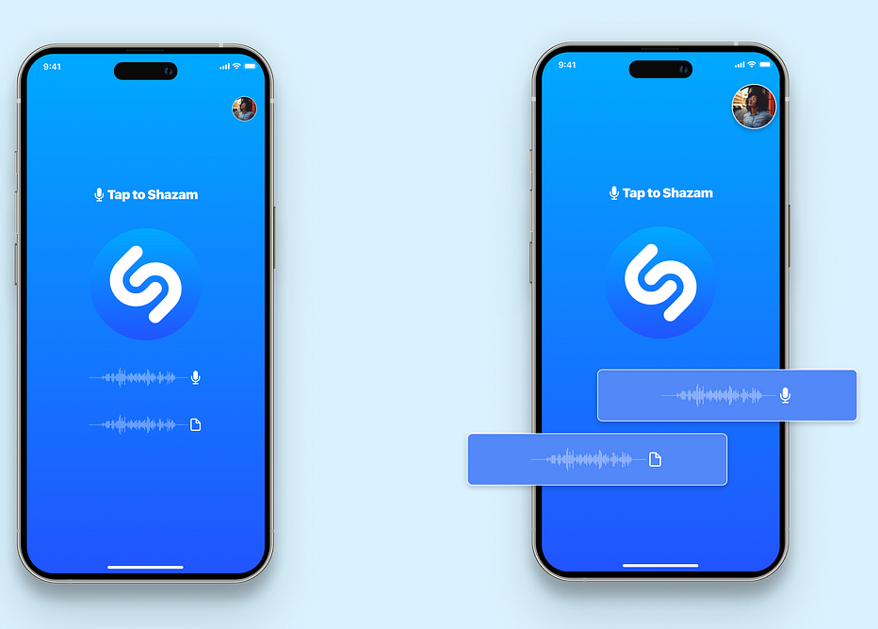
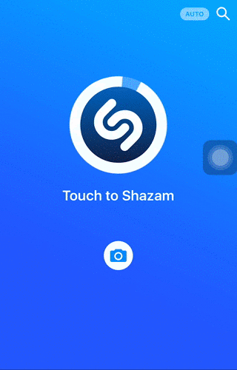
ACR = OS-integrated Shazam-like technology
Notes:
ACR stands for Automatic Content Recognition. Similar to the popular music recognition software – Shazam that can listen to any song to identify the song being played, ACR works on similar principles. Its a technology that is directly integrated into the Smart TV OS. As a result, since most popular smart TVs come with their own OS, exact implementation of the ACR can vary from manufacturer to manufacturer.

Slide 9
Smart TV Functionalities
Notes:
Before diving into how ACR works on Smart TVs, let’s take a look at different major functionalities that Smart TVs offer in relation to our RQ1.
Linear TV corresponds to streaming channels broadcasted via TV antenna or cable.
FAST stands for “Free Ad-supported Streaming Television” comprising internet-based streaming of free content on wide range of channels. Its essentially Linear TV with ads.
OTT consists of “Over-The-Top” subscription-based streaming of curated content with full-flexibility to choose content to watch from a wide range of options.
Smart TVs also provide functionality to connect your external devices like laptop or gaming consoles to the TV via HDMI to stream content of play games on a bigger screen.
Lastly, users can cast the content from their personal devices to the TV using screen casting option.

Slide 10
Automatic Content Recognition (ACR)
Notes:
Having looked at different Smart TV functionalities, I will now explain how ACR works on Smart TVs. User’s smart TV acts as an ACR Client. Let’s suppose user is watching NFL. As the user streams content on their smart TV, OS-integrated ACR tech continually captures the snapshots of the content being streamed. Depending on the ACR implementation used, these snapshots could correspond to audio samples or video screenshots or both. Next, the captured snapshots are combined using a proprietary algorithm to generate a content fingerprint that is periodically sent out to the ACR server controlled by the Smart TV manufacturers.
The ACR Server maintains its own content fingerprint database by generating and storing content fingerprints from live broadcast feed as well as media library of all content that can be streamed on the Smart TV using the same same proprietary algorithm. For each content fingerprint that the server receives from a given ACR client, it searches its database for a match to identify the content being streamed. For example, here, Server recognizes that the user is watching football and hence is interested in Sports. Over a period of time, as and when user streams different content at different times, Smart TVs profile users using ACR to generate their audience segments. These audience segments are further associated with TV’s advertising ID, device ID, IP address and other details to target ads to the user.

Slide 11
ACR Client
Notes:
Having looked at different Smart TV functionalities, I will now explain how ACR works on Smart TVs. User’s smart TV acts as an ACR Client. Let’s suppose user is watching NFL. As the user streams content on their smart TV, OS-integrated ACR tech continually captures the snapshots of the content being streamed. Depending on the ACR implementation used, these snapshots could correspond to audio samples or video screenshots or both. Next, the captured snapshots are combined using a proprietary algorithm to generate a content fingerprint that is periodically sent out to the ACR server controlled by the Smart TV manufacturers.
The ACR Server maintains its own content fingerprint database by generating and storing content fingerprints from live broadcast feed as well as media library of all content that can be streamed on the Smart TV using the same same proprietary algorithm. For each content fingerprint that the server receives from a given ACR client, it searches its database for a match to identify the content being streamed. For example, here, Server recognizes that the user is watching football and hence is interested in Sports. Over a period of time, as and when user streams different content at different times, Smart TVs profile users using ACR to generate their audience segments. These audience segments are further associated with TV’s advertising ID, device ID, IP address and other details to target ads to the user.

Slide 12
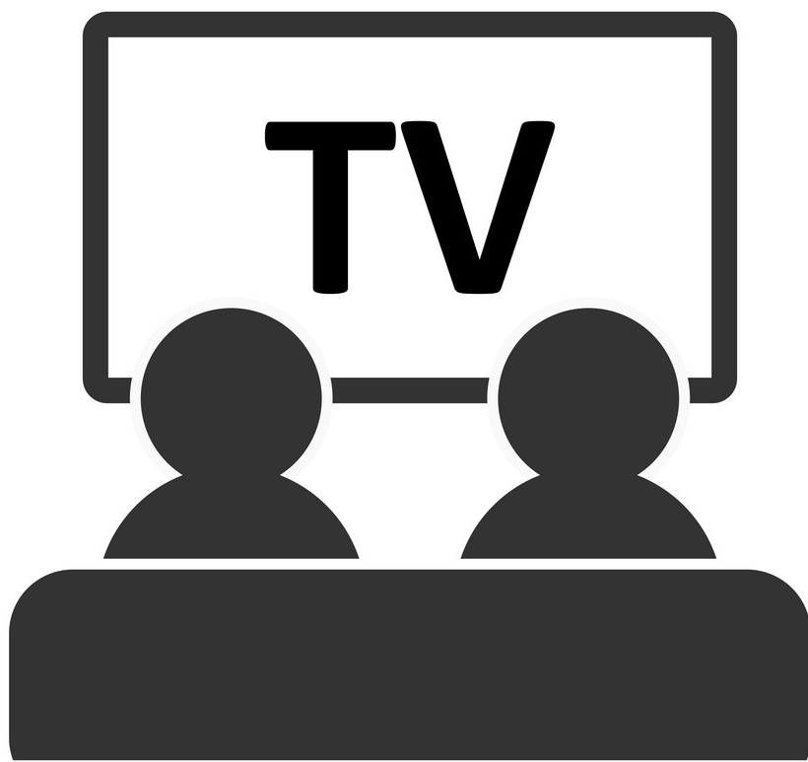
ACR Client
Notes:
Having looked at different Smart TV functionalities, I will now explain how ACR works on Smart TVs. User’s smart TV acts as an ACR Client. Let’s suppose user is watching NFL. As the user streams content on their smart TV, OS-integrated ACR tech continually captures the snapshots of the content being streamed. Depending on the ACR implementation used, these snapshots could correspond to audio samples or video screenshots or both. Next, the captured snapshots are combined using a proprietary algorithm to generate a content fingerprint that is periodically sent out to the ACR server controlled by the Smart TV manufacturers.
The ACR Server maintains its own content fingerprint database by generating and storing content fingerprints from live broadcast feed as well as media library of all content that can be streamed on the Smart TV using the same same proprietary algorithm. For each content fingerprint that the server receives from a given ACR client, it searches its database for a match to identify the content being streamed. For example, here, Server recognizes that the user is watching football and hence is interested in Sports. Over a period of time, as and when user streams different content at different times, Smart TVs profile users using ACR to generate their audience segments. These audience segments are further associated with TV’s advertising ID, device ID, IP address and other details to target ads to the user.

Slide 13
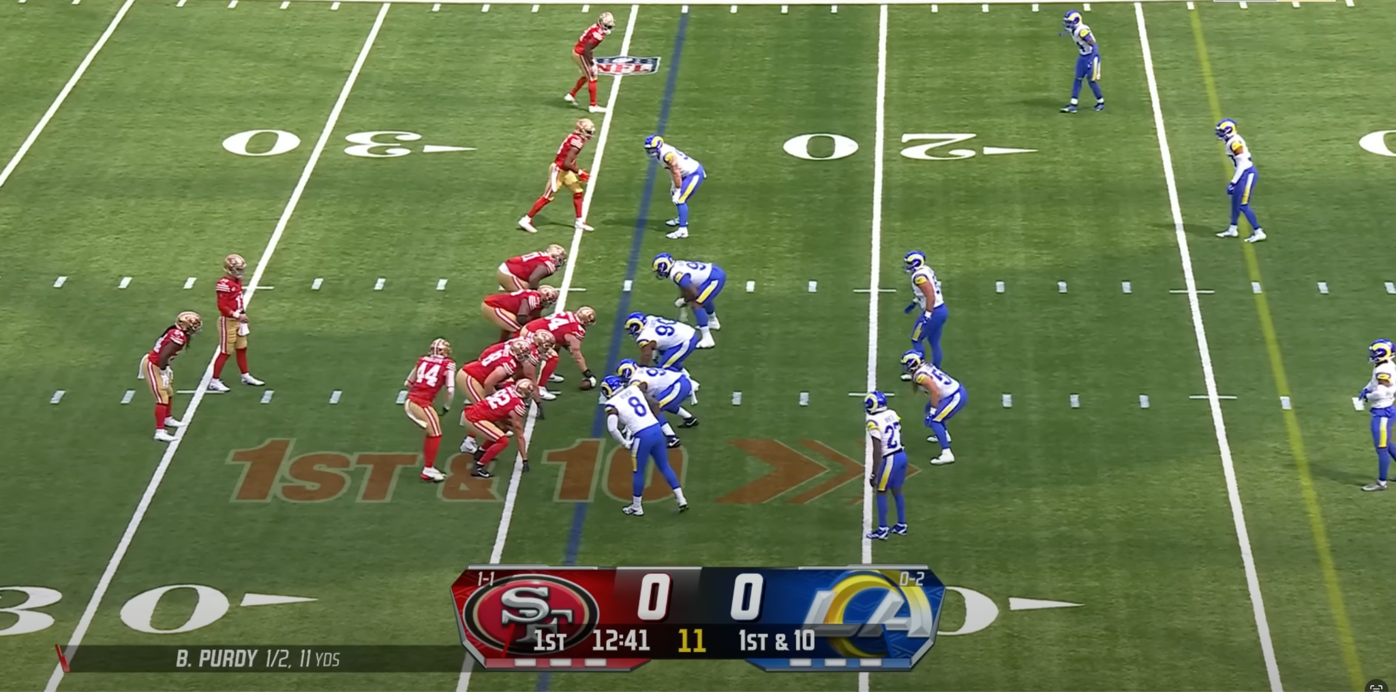
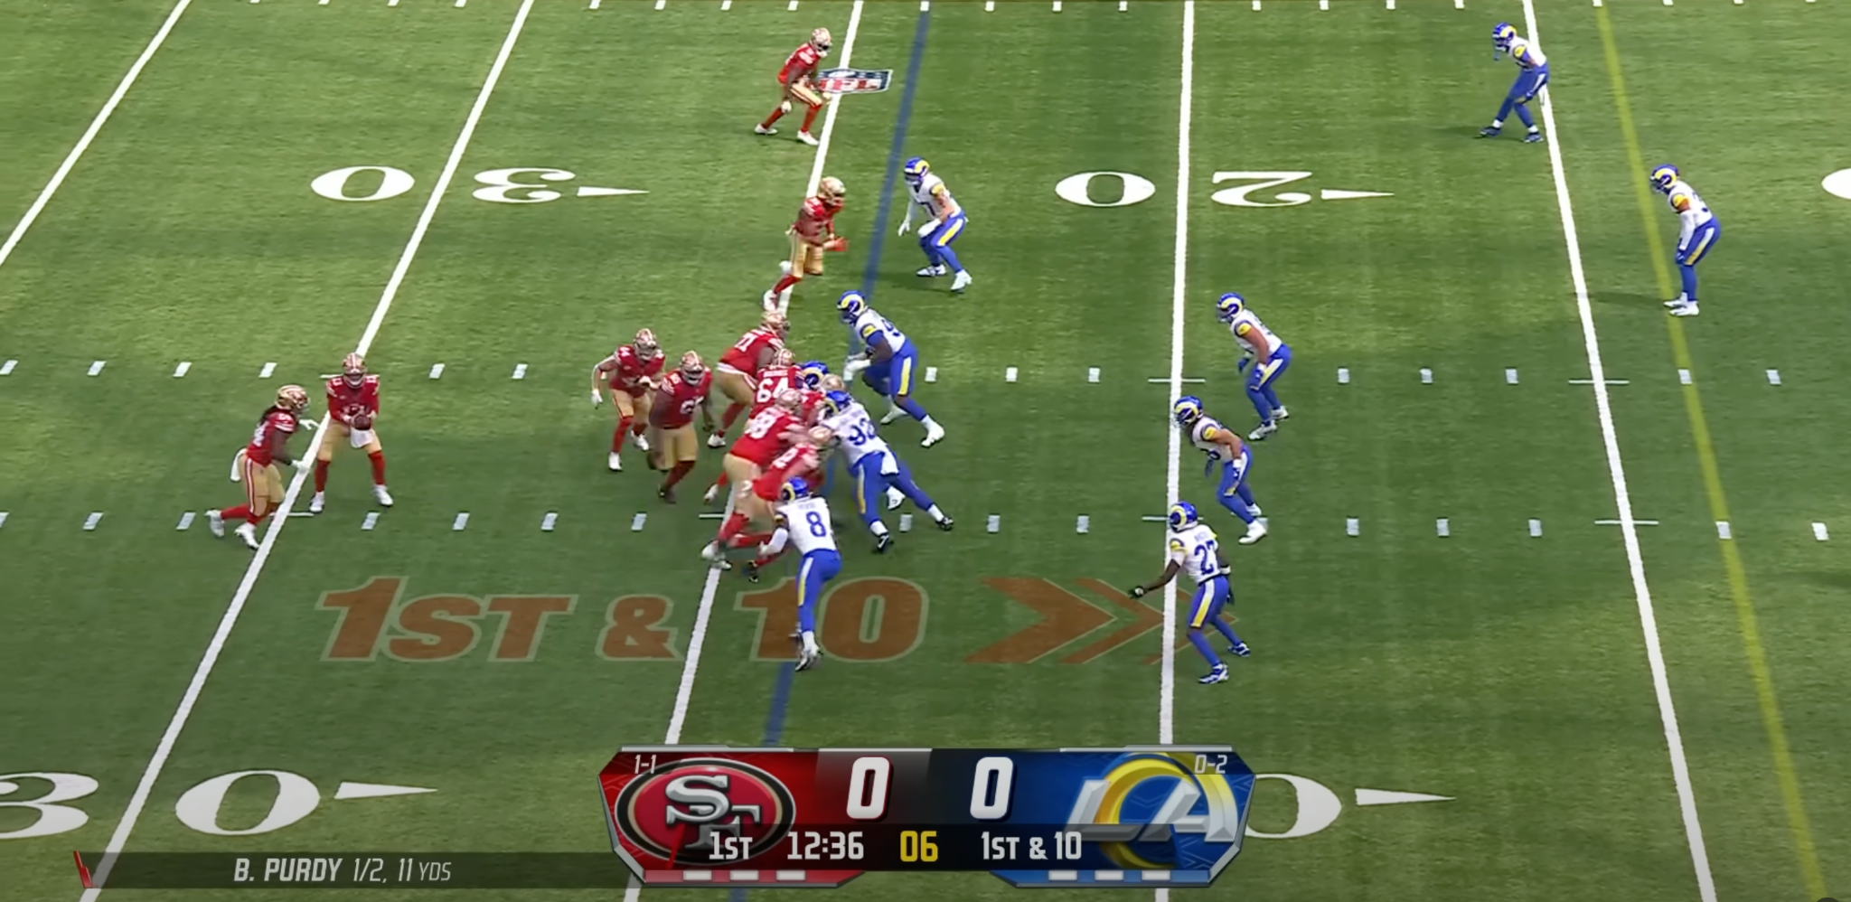
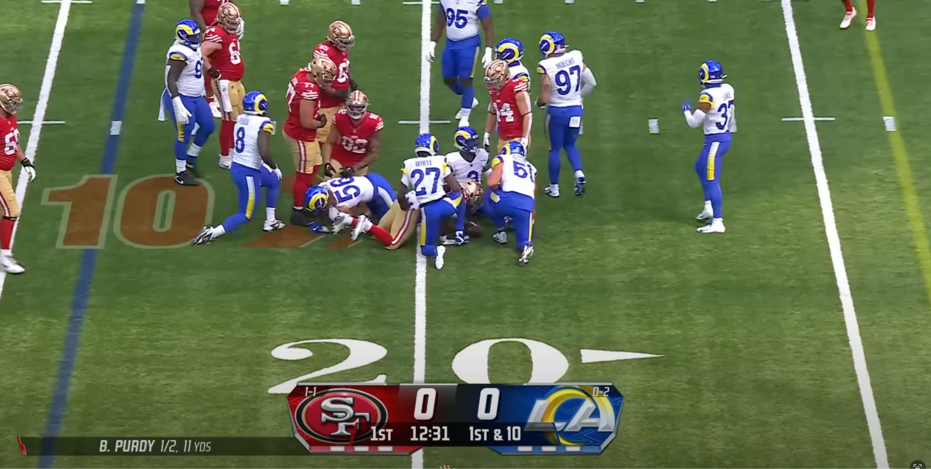
ACR Client
Captured frames
Notes:
Having looked at different Smart TV functionalities, I will now explain how ACR works on Smart TVs. User’s smart TV acts as an ACR Client. Let’s suppose user is watching NFL. As the user streams content on their smart TV, OS-integrated ACR tech continually captures the snapshots of the content being streamed. Depending on the ACR implementation used, these snapshots could correspond to audio samples or video screenshots or both. Next, the captured snapshots are combined using a proprietary algorithm to generate a content fingerprint that is periodically sent out to the ACR server controlled by the Smart TV manufacturers.
The ACR Server maintains its own content fingerprint database by generating and storing content fingerprints from live broadcast feed as well as media library of all content that can be streamed on the Smart TV using the same same proprietary algorithm. For each content fingerprint that the server receives from a given ACR client, it searches its database for a match to identify the content being streamed. For example, here, Server recognizes that the user is watching football and hence is interested in Sports. Over a period of time, as and when user streams different content at different times, Smart TVs profile users using ACR to generate their audience segments. These audience segments are further associated with TV’s advertising ID, device ID, IP address and other details to target ads to the user.

Slide 14

ACR Client
Captured frames
Content fingerprint
Notes:
Having looked at different Smart TV functionalities, I will now explain how ACR works on Smart TVs. User’s smart TV acts as an ACR Client. Let’s suppose user is watching NFL. As the user streams content on their smart TV, OS-integrated ACR tech continually captures the snapshots of the content being streamed. Depending on the ACR implementation used, these snapshots could correspond to audio samples or video screenshots or both. Next, the captured snapshots are combined using a proprietary algorithm to generate a content fingerprint that is periodically sent out to the ACR server controlled by the Smart TV manufacturers.
The ACR Server maintains its own content fingerprint database by generating and storing content fingerprints from live broadcast feed as well as media library of all content that can be streamed on the Smart TV using the same same proprietary algorithm. For each content fingerprint that the server receives from a given ACR client, it searches its database for a match to identify the content being streamed. For example, here, Server recognizes that the user is watching football and hence is interested in Sports. Over a period of time, as and when user streams different content at different times, Smart TVs profile users using ACR to generate their audience segments. These audience segments are further associated with TV’s advertising ID, device ID, IP address and other details to target ads to the user.

Slide 15
ACR Client
Captured frames
Content fingerprint
ACR Server
Notes:
Having looked at different Smart TV functionalities, I will now explain how ACR works on Smart TVs. User’s smart TV acts as an ACR Client. Let’s suppose user is watching NFL. As the user streams content on their smart TV, OS-integrated ACR tech continually captures the snapshots of the content being streamed. Depending on the ACR implementation used, these snapshots could correspond to audio samples or video screenshots or both. Next, the captured snapshots are combined using a proprietary algorithm to generate a content fingerprint that is periodically sent out to the ACR server controlled by the Smart TV manufacturers.
The ACR Server maintains its own content fingerprint database by generating and storing content fingerprints from live broadcast feed as well as media library of all content that can be streamed on the Smart TV using the same same proprietary algorithm. For each content fingerprint that the server receives from a given ACR client, it searches its database for a match to identify the content being streamed. For example, here, Server recognizes that the user is watching football and hence is interested in Sports. Over a period of time, as and when user streams different content at different times, Smart TVs profile users using ACR to generate their audience segments. These audience segments are further associated with TV’s advertising ID, device ID, IP address and other details to target ads to the user.

Slide 16

ACR Client
Captured frames
Content fingerprint
Content fingerprint database
ACR Server
Notes:
Having looked at different Smart TV functionalities, I will now explain how ACR works on Smart TVs. User’s smart TV acts as an ACR Client. Let’s suppose user is watching NFL. As the user streams content on their smart TV, OS-integrated ACR tech continually captures the snapshots of the content being streamed. Depending on the ACR implementation used, these snapshots could correspond to audio samples or video screenshots or both. Next, the captured snapshots are combined using a proprietary algorithm to generate a content fingerprint that is periodically sent out to the ACR server controlled by the Smart TV manufacturers.
The ACR Server maintains its own content fingerprint database by generating and storing content fingerprints from live broadcast feed as well as media library of all content that can be streamed on the Smart TV using the same same proprietary algorithm. For each content fingerprint that the server receives from a given ACR client, it searches its database for a match to identify the content being streamed. For example, here, Server recognizes that the user is watching football and hence is interested in Sports. Over a period of time, as and when user streams different content at different times, Smart TVs profile users using ACR to generate their audience segments. These audience segments are further associated with TV’s advertising ID, device ID, IP address and other details to target ads to the user.

Slide 17
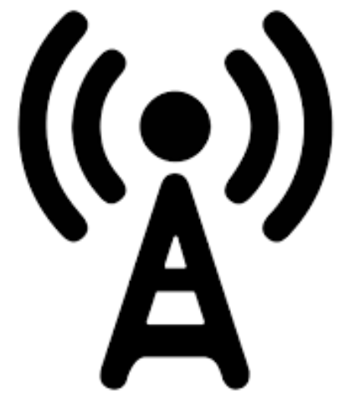

ACR Client
Live feed
Media library
Captured frames
Content fingerprint
Content fingerprint database
ACR Server
Notes:
Having looked at different Smart TV functionalities, I will now explain how ACR works on Smart TVs. User’s smart TV acts as an ACR Client. Let’s suppose user is watching NFL. As the user streams content on their smart TV, OS-integrated ACR tech continually captures the snapshots of the content being streamed. Depending on the ACR implementation used, these snapshots could correspond to audio samples or video screenshots or both. Next, the captured snapshots are combined using a proprietary algorithm to generate a content fingerprint that is periodically sent out to the ACR server controlled by the Smart TV manufacturers.
The ACR Server maintains its own content fingerprint database by generating and storing content fingerprints from live broadcast feed as well as media library of all content that can be streamed on the Smart TV using the same same proprietary algorithm. For each content fingerprint that the server receives from a given ACR client, it searches its database for a match to identify the content being streamed. For example, here, Server recognizes that the user is watching football and hence is interested in Sports. Over a period of time, as and when user streams different content at different times, Smart TVs profile users using ACR to generate their audience segments. These audience segments are further associated with TV’s advertising ID, device ID, IP address and other details to target ads to the user.

Slide 18


ACR Client
Live feed
Media library
Captured frames
Content fingerprint
match?
Content fingerprint database
ACR Server
Notes:
Having looked at different Smart TV functionalities, I will now explain how ACR works on Smart TVs. User’s smart TV acts as an ACR Client. Let’s suppose user is watching NFL. As the user streams content on their smart TV, OS-integrated ACR tech continually captures the snapshots of the content being streamed. Depending on the ACR implementation used, these snapshots could correspond to audio samples or video screenshots or both. Next, the captured snapshots are combined using a proprietary algorithm to generate a content fingerprint that is periodically sent out to the ACR server controlled by the Smart TV manufacturers.
The ACR Server maintains its own content fingerprint database by generating and storing content fingerprints from live broadcast feed as well as media library of all content that can be streamed on the Smart TV using the same same proprietary algorithm. For each content fingerprint that the server receives from a given ACR client, it searches its database for a match to identify the content being streamed. For example, here, Server recognizes that the user is watching football and hence is interested in Sports. Over a period of time, as and when user streams different content at different times, Smart TVs profile users using ACR to generate their audience segments. These audience segments are further associated with TV’s advertising ID, device ID, IP address and other details to target ads to the user.

Slide 19
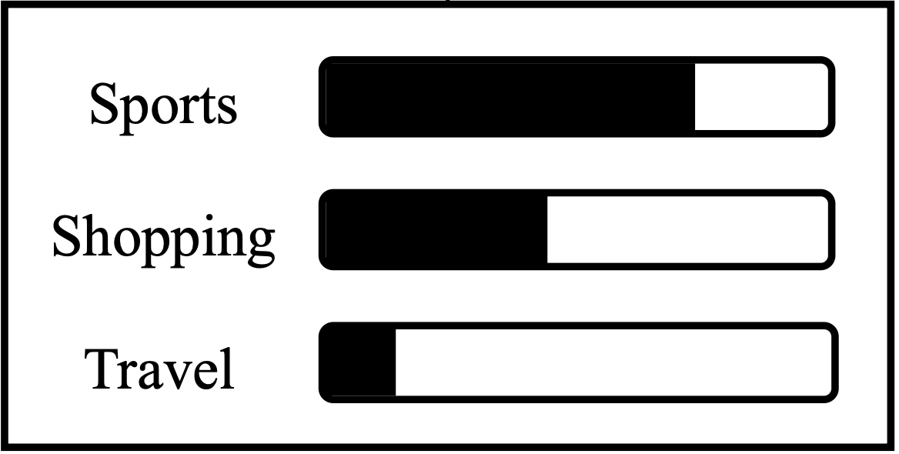
ACR Client
Live feed
Media library
Captured frames
Content fingerprint
match?
Content fingerprint database
ACR Server
Audience segments
Notes:
Having looked at different Smart TV functionalities, I will now explain how ACR works on Smart TVs. User’s smart TV acts as an ACR Client. Let’s suppose user is watching NFL. As the user streams content on their smart TV, OS-integrated ACR tech continually captures the snapshots of the content being streamed. Depending on the ACR implementation used, these snapshots could correspond to audio samples or video screenshots or both. Next, the captured snapshots are combined using a proprietary algorithm to generate a content fingerprint that is periodically sent out to the ACR server controlled by the Smart TV manufacturers.
The ACR Server maintains its own content fingerprint database by generating and storing content fingerprints from live broadcast feed as well as media library of all content that can be streamed on the Smart TV using the same same proprietary algorithm. For each content fingerprint that the server receives from a given ACR client, it searches its database for a match to identify the content being streamed. For example, here, Server recognizes that the user is watching football and hence is interested in Sports. Over a period of time, as and when user streams different content at different times, Smart TVs profile users using ACR to generate their audience segments. These audience segments are further associated with TV’s advertising ID, device ID, IP address and other details to target ads to the user.

Slide 20

ACR Client
Live feed
Media library
Captured frames
Content fingerprint
match?
Content fingerprint database
ACR Server
Audience segments
Notes:
Having looked at different Smart TV functionalities, I will now explain how ACR works on Smart TVs. User’s smart TV acts as an ACR Client. Let’s suppose user is watching NFL. As the user streams content on their smart TV, OS-integrated ACR tech continually captures the snapshots of the content being streamed. Depending on the ACR implementation used, these snapshots could correspond to audio samples or video screenshots or both. Next, the captured snapshots are combined using a proprietary algorithm to generate a content fingerprint that is periodically sent out to the ACR server controlled by the Smart TV manufacturers.
The ACR Server maintains its own content fingerprint database by generating and storing content fingerprints from live broadcast feed as well as media library of all content that can be streamed on the Smart TV using the same same proprietary algorithm. For each content fingerprint that the server receives from a given ACR client, it searches its database for a match to identify the content being streamed. For example, here, Server recognizes that the user is watching football and hence is interested in Sports. Over a period of time, as and when user streams different content at different times, Smart TVs profile users using ACR to generate their audience segments. These audience segments are further associated with TV’s advertising ID, device ID, IP address and other details to target ads to the user.

Slide 21
How frequently does ACR capture snapshots
of your viewing activities?
It varies from manufacturer to manufacturer …
Notes:
Having looked at ACR tracking mechanism, how frequently do you think ACR captures snapshots of user’s viewing activities? Like mentioned before, it varies from manufacturer to manufacturer.

Slide 22

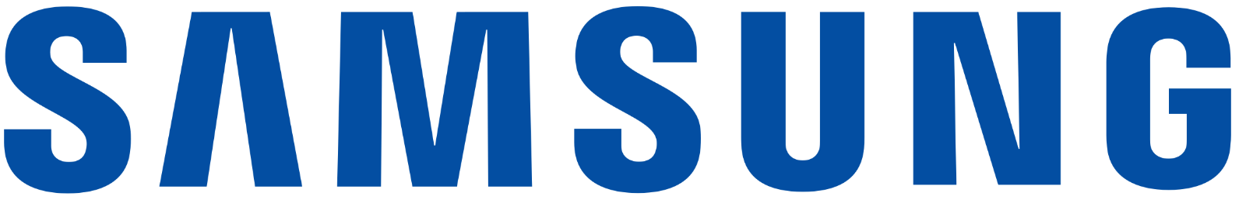


Captures video snapshots
Captures audio snapshots
500ms
10ms
Notes:
Samsung uses Tizen OS and LG uses WebOS. As per their documentation, we observed Samsung to capture video screenshots every 500ms and LG to capture audio snapshots every 10ms.

Slide 23
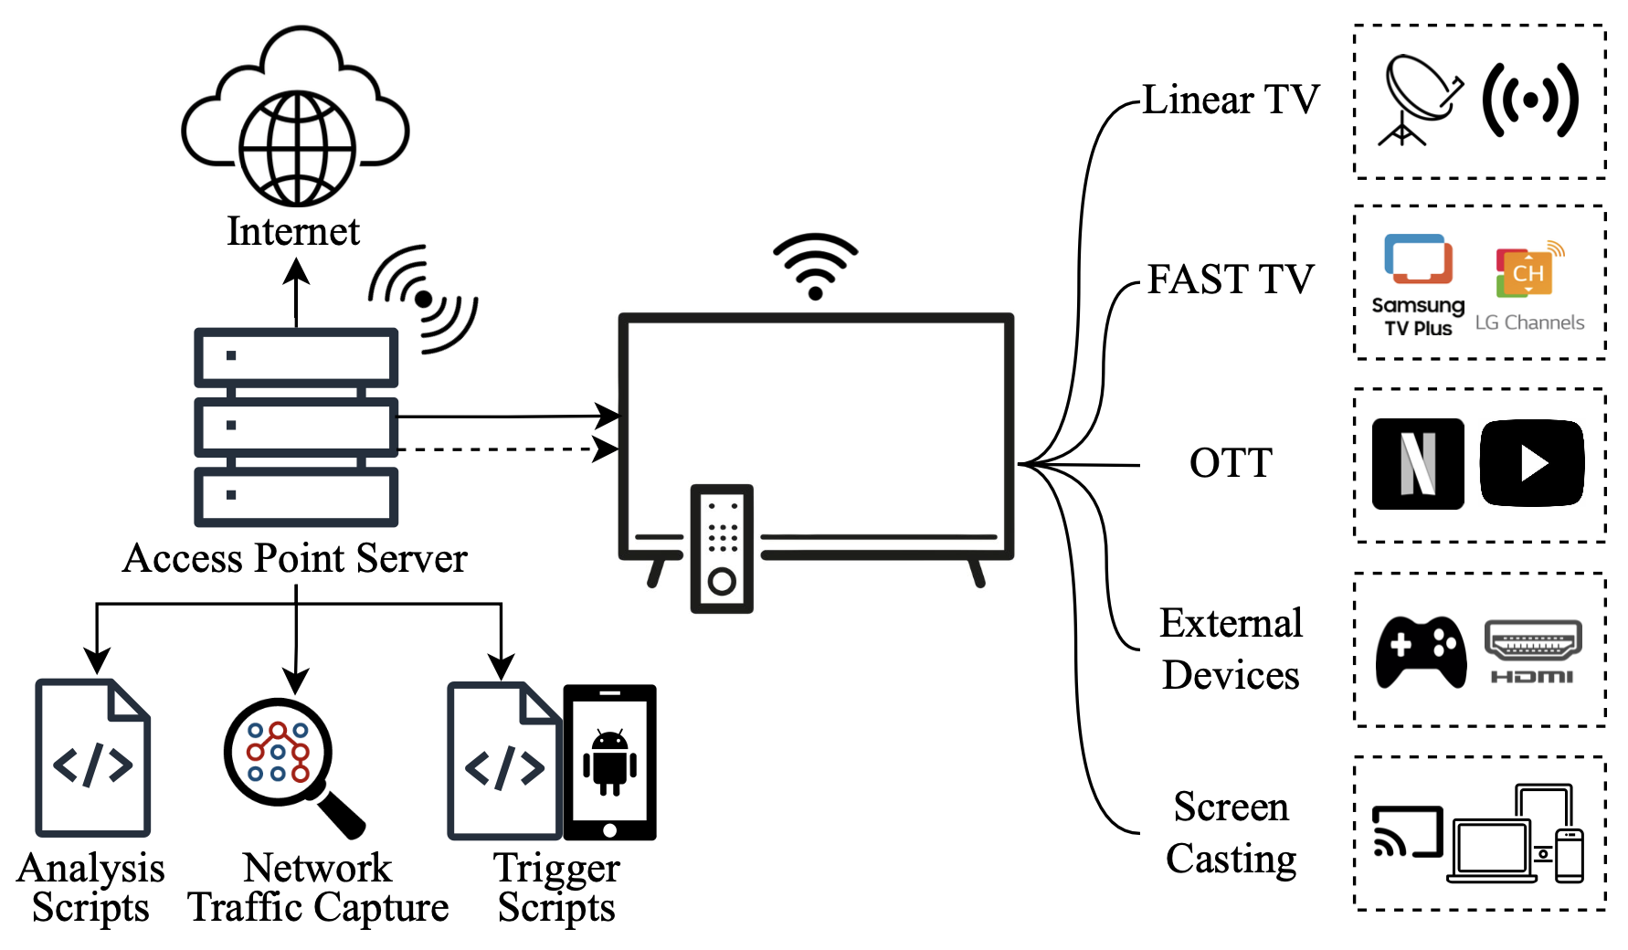
Experimental Infrastructure
Notes:
To study ACR Tracking, we connect our Smart TV wifi to the hotspot hosted on the access point server. Access point server is connected to the internet and acts as a tunnel to send the Smart TV traffic to external endpoints as we test different smart TV functionalities. We control smart TV using ADB via android phone connected to the access point server and capture Smart TV network traffic on access point using wireshark.

Slide 24
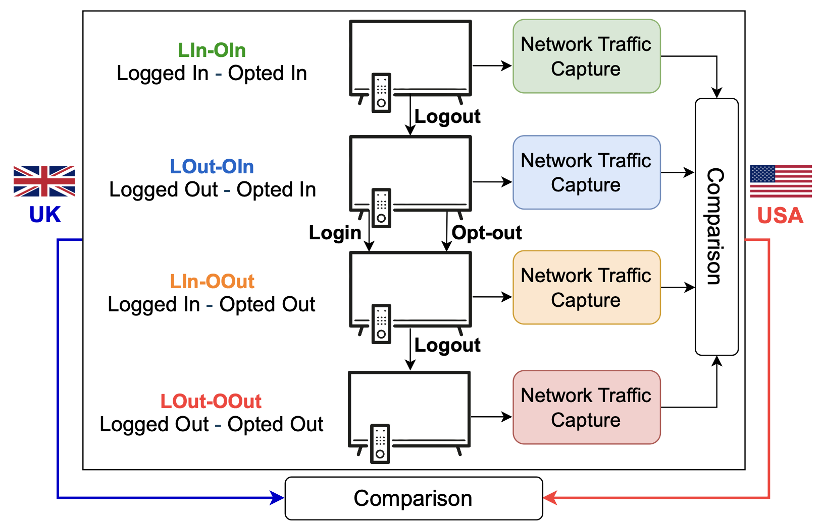
Methodology
Notes:
To understand RQ2 on effectiveness of privacy controls, we stream content using each smart TV functionality in each of the 4 scenarios of login and opting status on Smart TV. The experiments are repeated for both the UK and the US TVs.

Slide 25
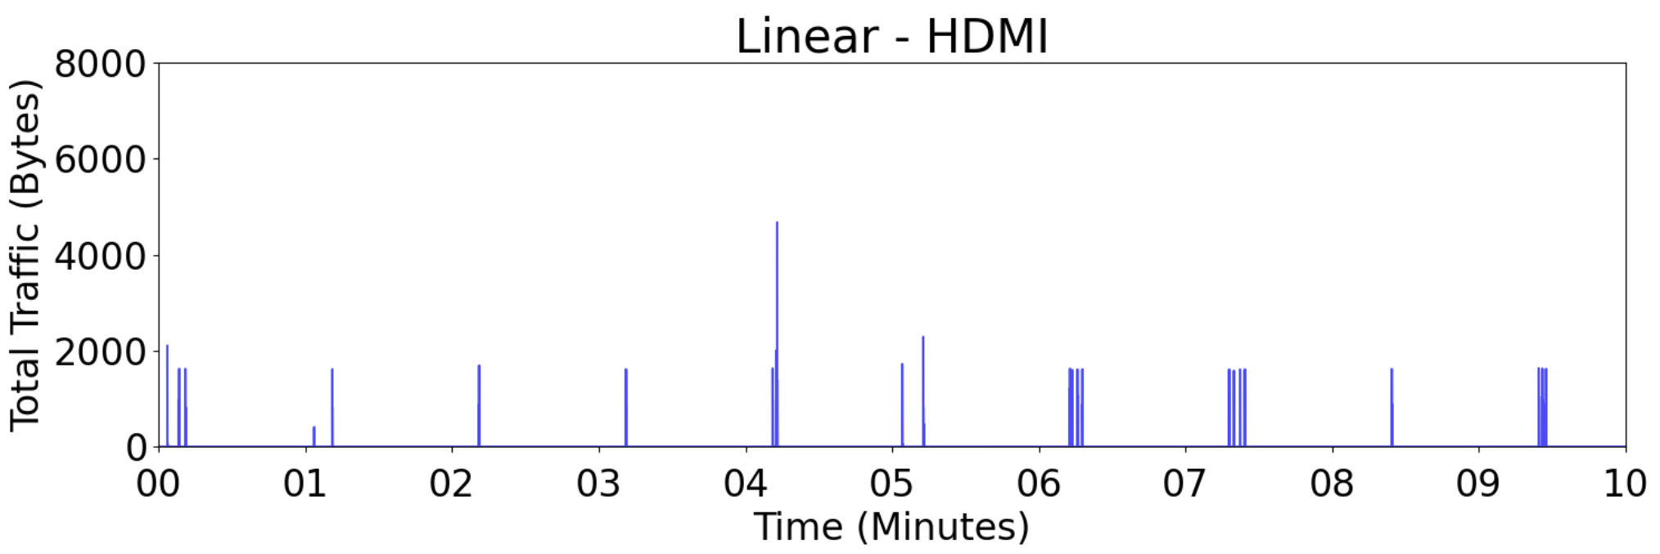
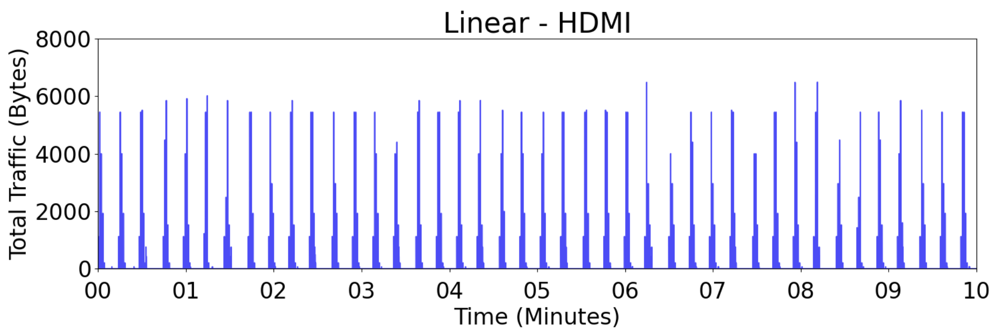
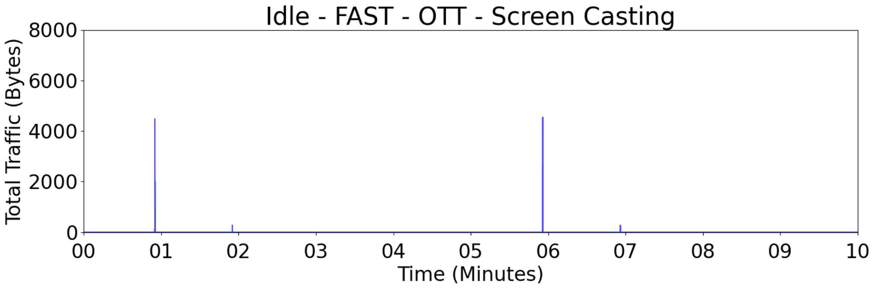
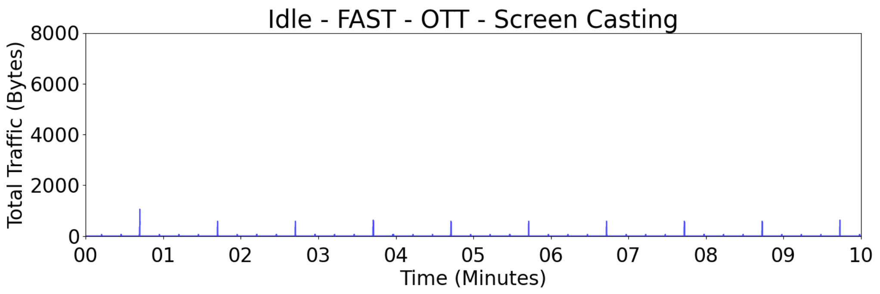
Results: Comparison across Smart TV functionalities (RQ1)
Notes:
Now, under RQ1, we look at ACR tracking across different Smart TV functionalities. This slide discusses results for the most common configuration of a logged-in and opted-in status.
Next, we plot the packets transmitted to these endpoints in packets per millisecond. In this plot for UK, we observe that ACR works only when a user streams Linear TV or connects an external device via HDMI for both Samsung and LG. Interestingly, LG transmits higher amount of data at a higher frequency to its ACR server as compared to Samsung. This can be explained by the differences in their ACR capture rates discussed earlier. However, the periodicity in these plots doesn’t correspond to 500ms and 10ms for Samsung and LG respectively. This suggests that both the TV manufacturers are essentially batching the captured snapshots into a fingerprint, which is sent every minute for Samsung and every 15 seconds for LG.
In the other scenarios depicted in the lower plots, ACR traffic is reduced upto 12X times. We believe that the reduced traffic mostly corresponds to “keep-alives” to ensure that the user is still streaming the same non-ACRed content.

Slide 26
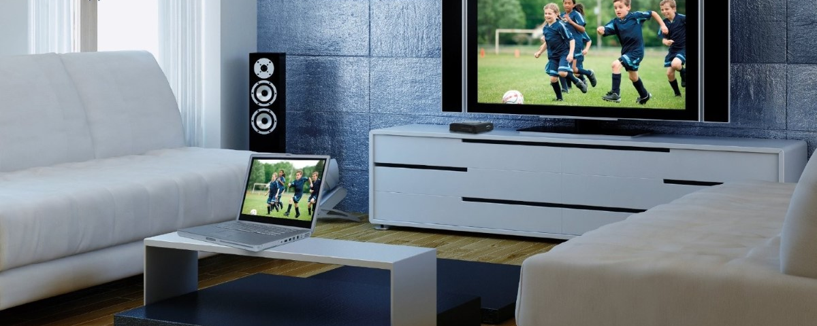

Smart TVs record your screen even when used as a
“DUMB” display using HDMI
Notes:
Most shocking finding to us was that Smart TVs continue taking snapshots of user’s viewing activities even when the unsuspecting user is simply using it as a DUMB external display via HDMI.

Slide 27

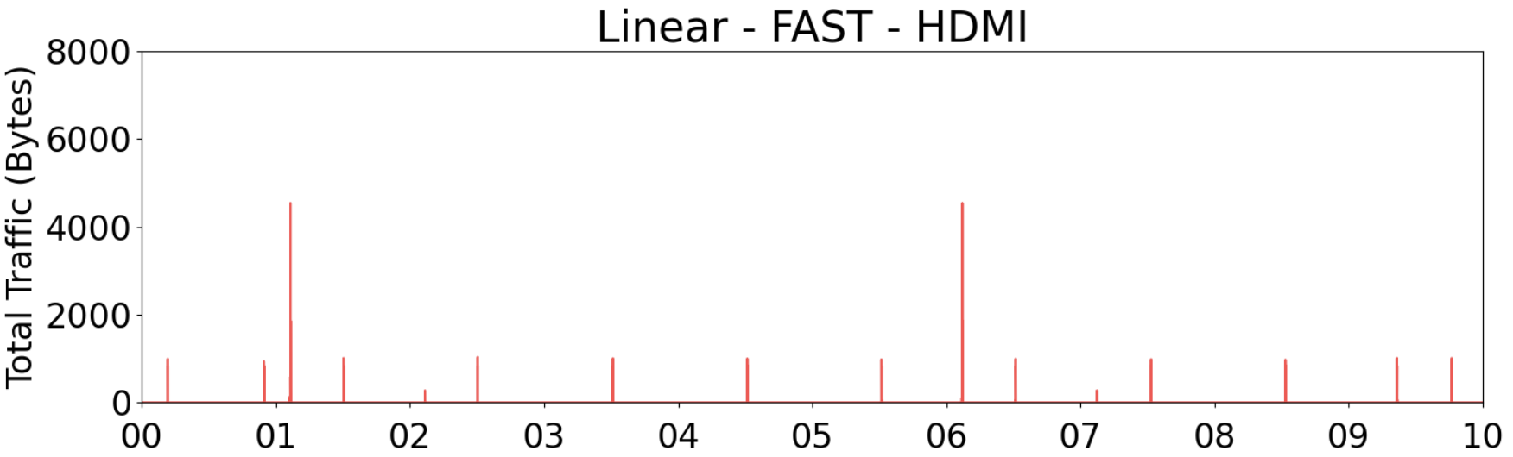
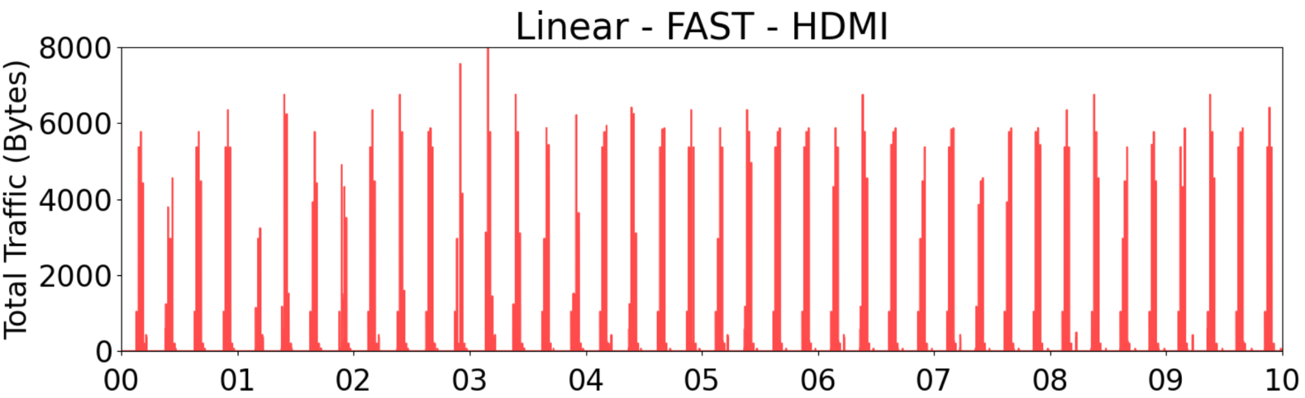

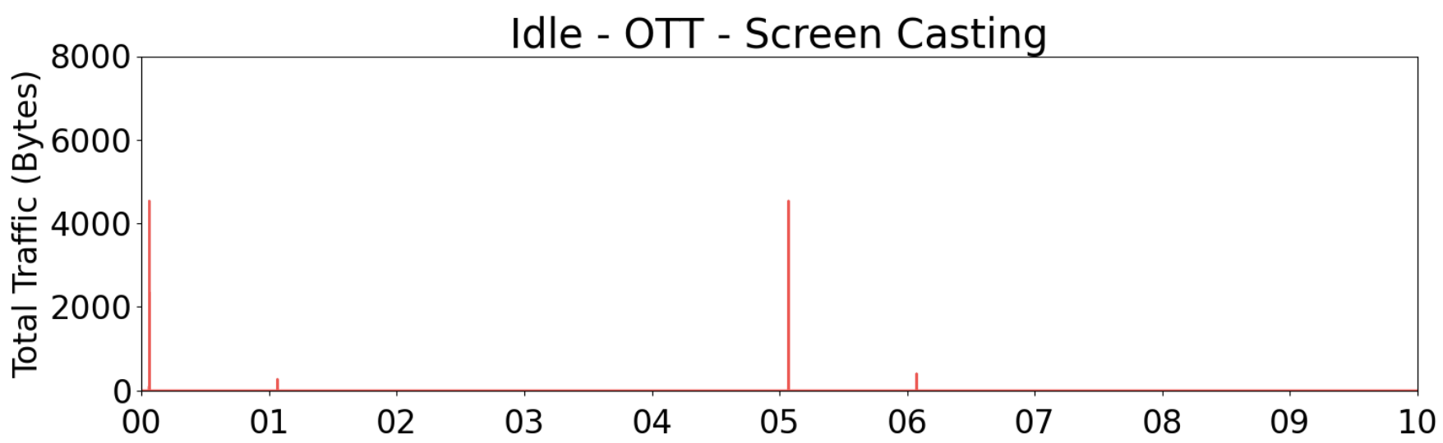
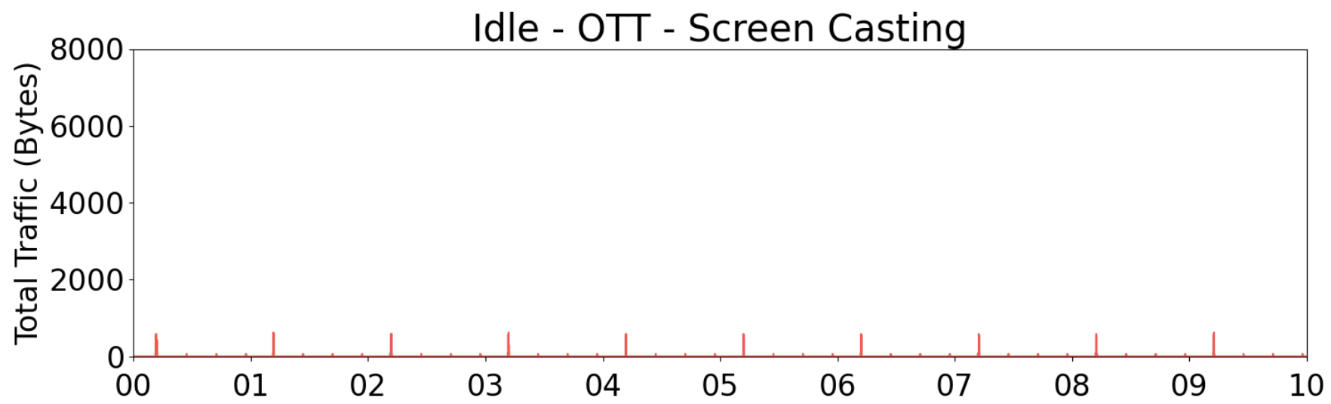
Results: Comparison across the UK and US
Notes:
As part of the last RQ, we compare the traffic observed in the UK and the US. From the perspective of network traffic patterns, we observe a similar pattern in ACR transmissions for all scenarios and phases – except that in US, we observe the ACR to also be active when a user streams FAST channels on both the TVs. This is possibly because FAST platforms have different agreements with the content providers in the US than the ones in UK, allowing ACR to operate in the US.

Slide 28
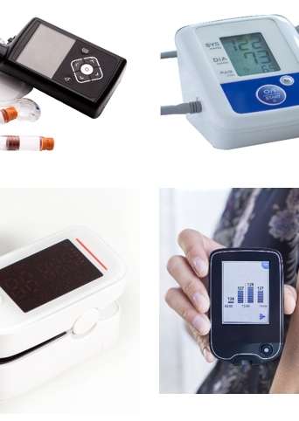
Reasons You Shouldn’t Use Smart Medical Devices
01

Slide 29
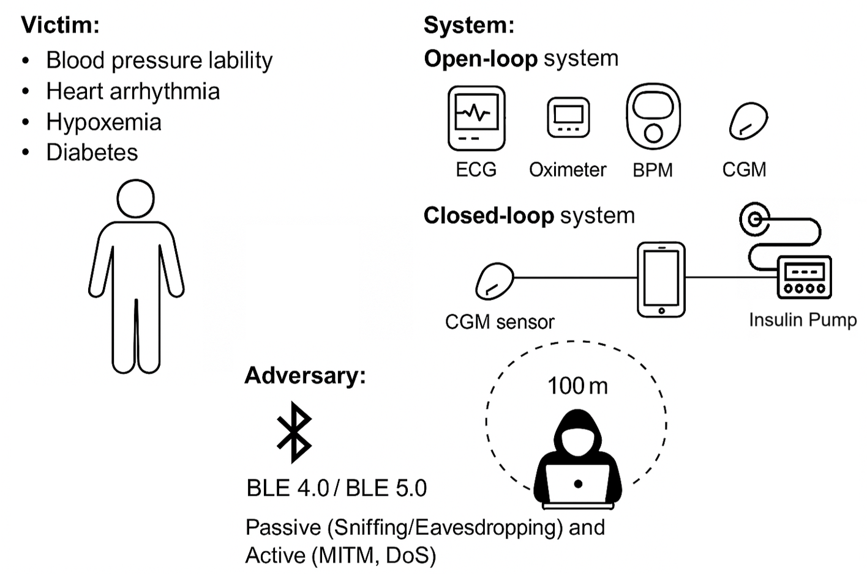
Threat Model

Slide 30
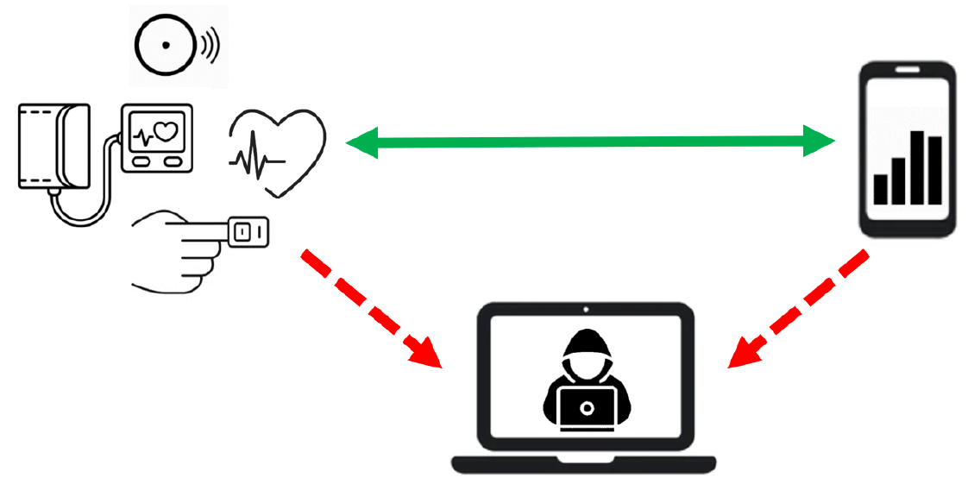
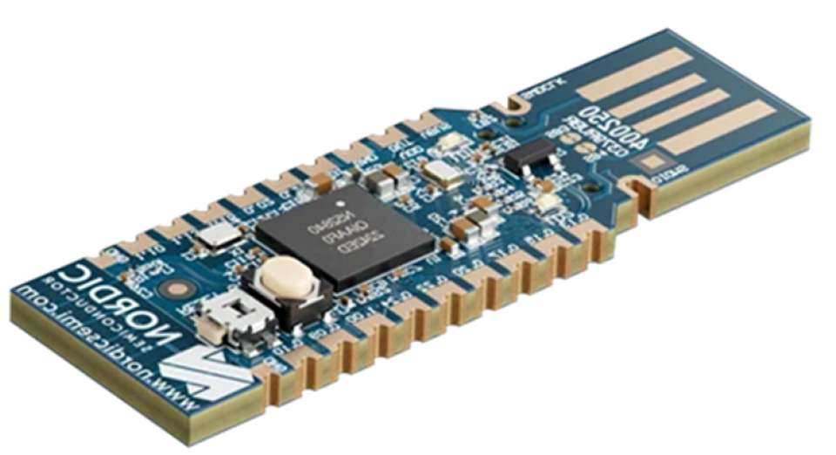
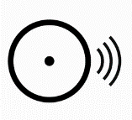
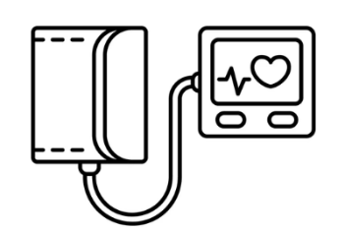

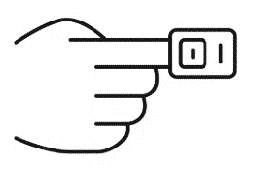
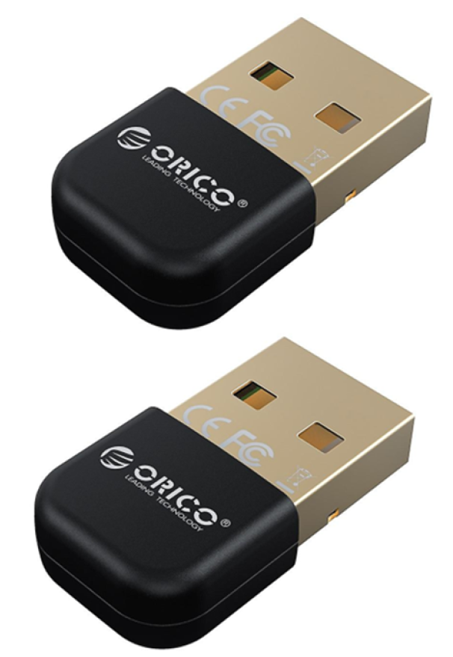
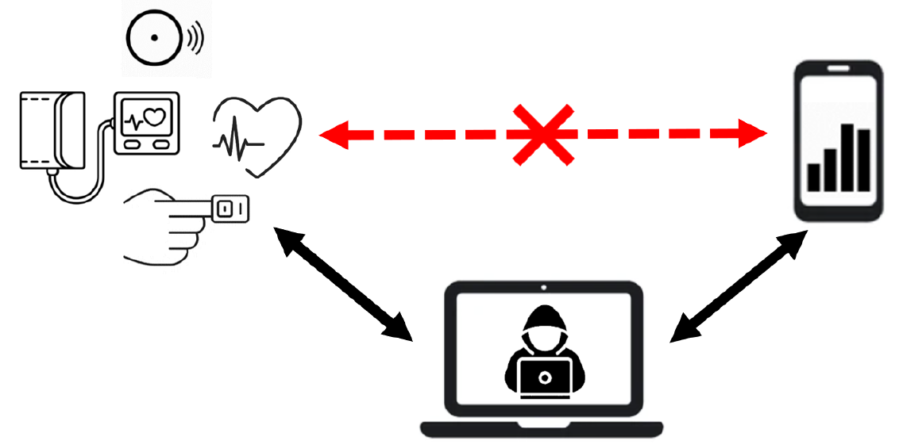
Testbed & Experimental Setup
Sniffing Attack
nRF52840 Nordic
Sniffer Dongle
Dexcom ONE and FreeStlye Libre2
Continious Glocuse Monitors (CGM)
iPhone 13 Pro/Google Pixel 3
SnapECG and DuoEK Wellue Electrocardiograms (ECG)
Wireshark Tool
Wellue Blood Pressure Monitors (BPM)
MITM Attack
iPhone 13 Pro/Google Pixel 3
Oxylink and SleepO2 1400 Oximeters
Bluetooth 4.0 Adapter USB Dongles
Kali Linux
Mirage Tool

Slide 31
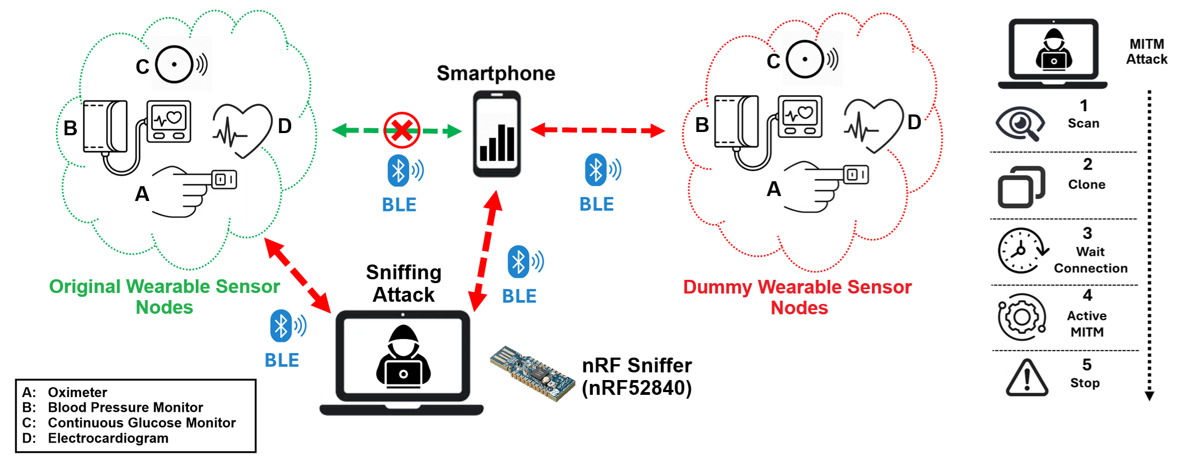
MITM & Sniffing Auditing Methodology

Slide 32
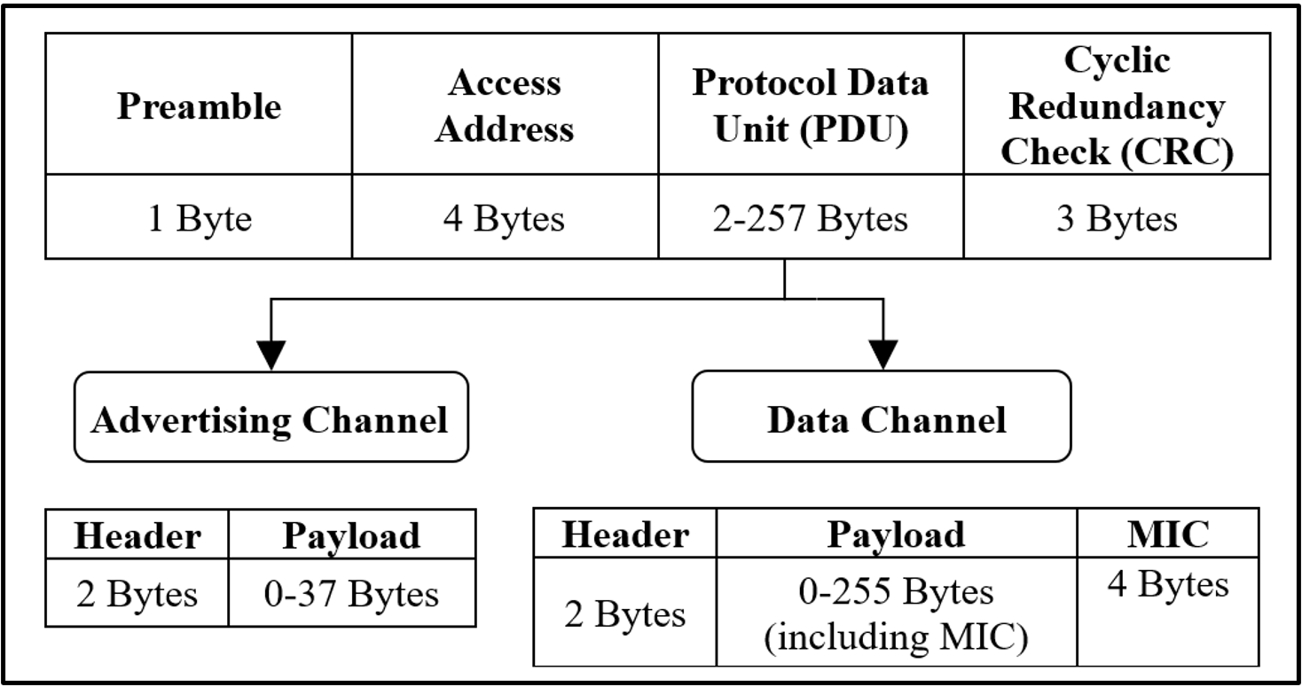
Bluetooth Low Energy – Packet Format

Slide 33
Active MITM Data Manipulation Technique
Oxylink Oximeter Encrypted Payload Content:
Handle “0x19”: 5500ff00000d00615e00000000004200070e0100
615e00000000
61 (hex) = 97 (dec)
5e (hex) = 94 (dec)
97% Oxygen Level
94/min Heart Rate
???
Original: Handle “0x19”: 5500ff00000d00615e00000000004200070e0100
Key: “39”
Replay: Handle “0x19”: 5500ff00000d0060410000000000550000050100
Key: “db”
60 (hex) = 96 (dec)
41 (hex) = 65 (dec)
96% Oxygen Level
65/min Heart Rate

Slide 34
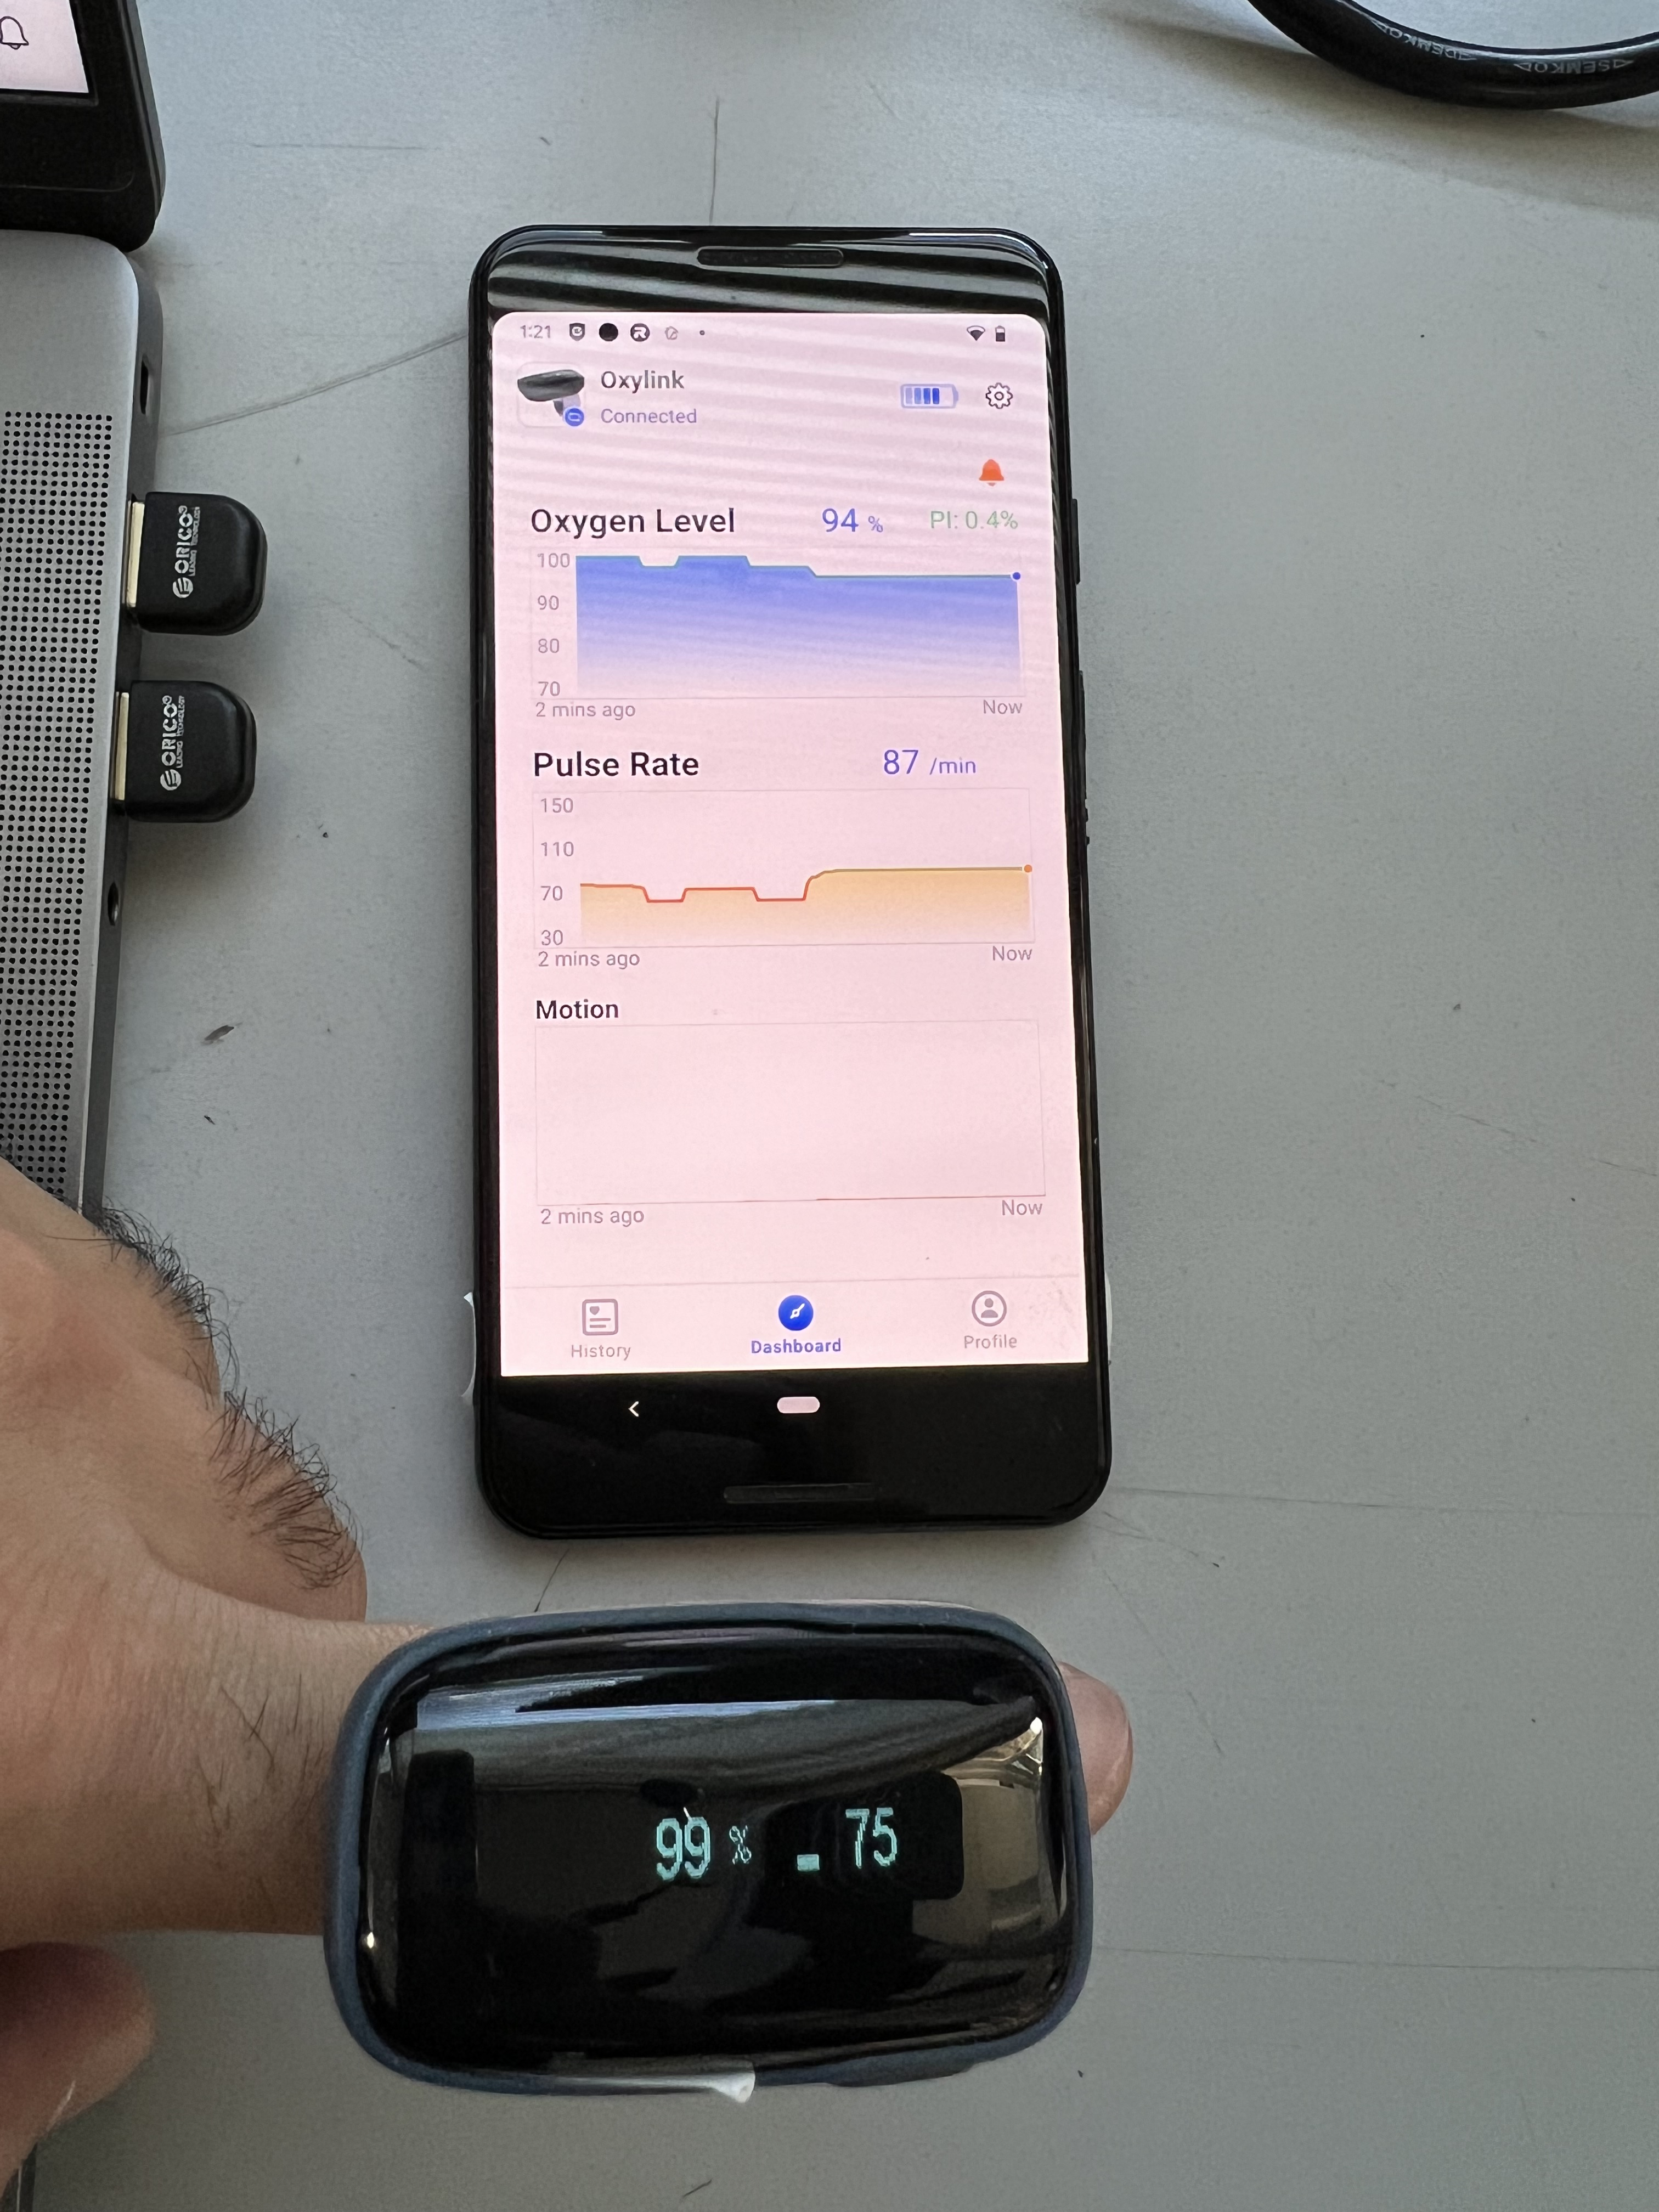
Oximeter Experimental Results (MITM Attacks)
Oxygen Level Manipulation
ViHealth App Real-time Data Manipulation
Pulse Rate Manipulation

Slide 35
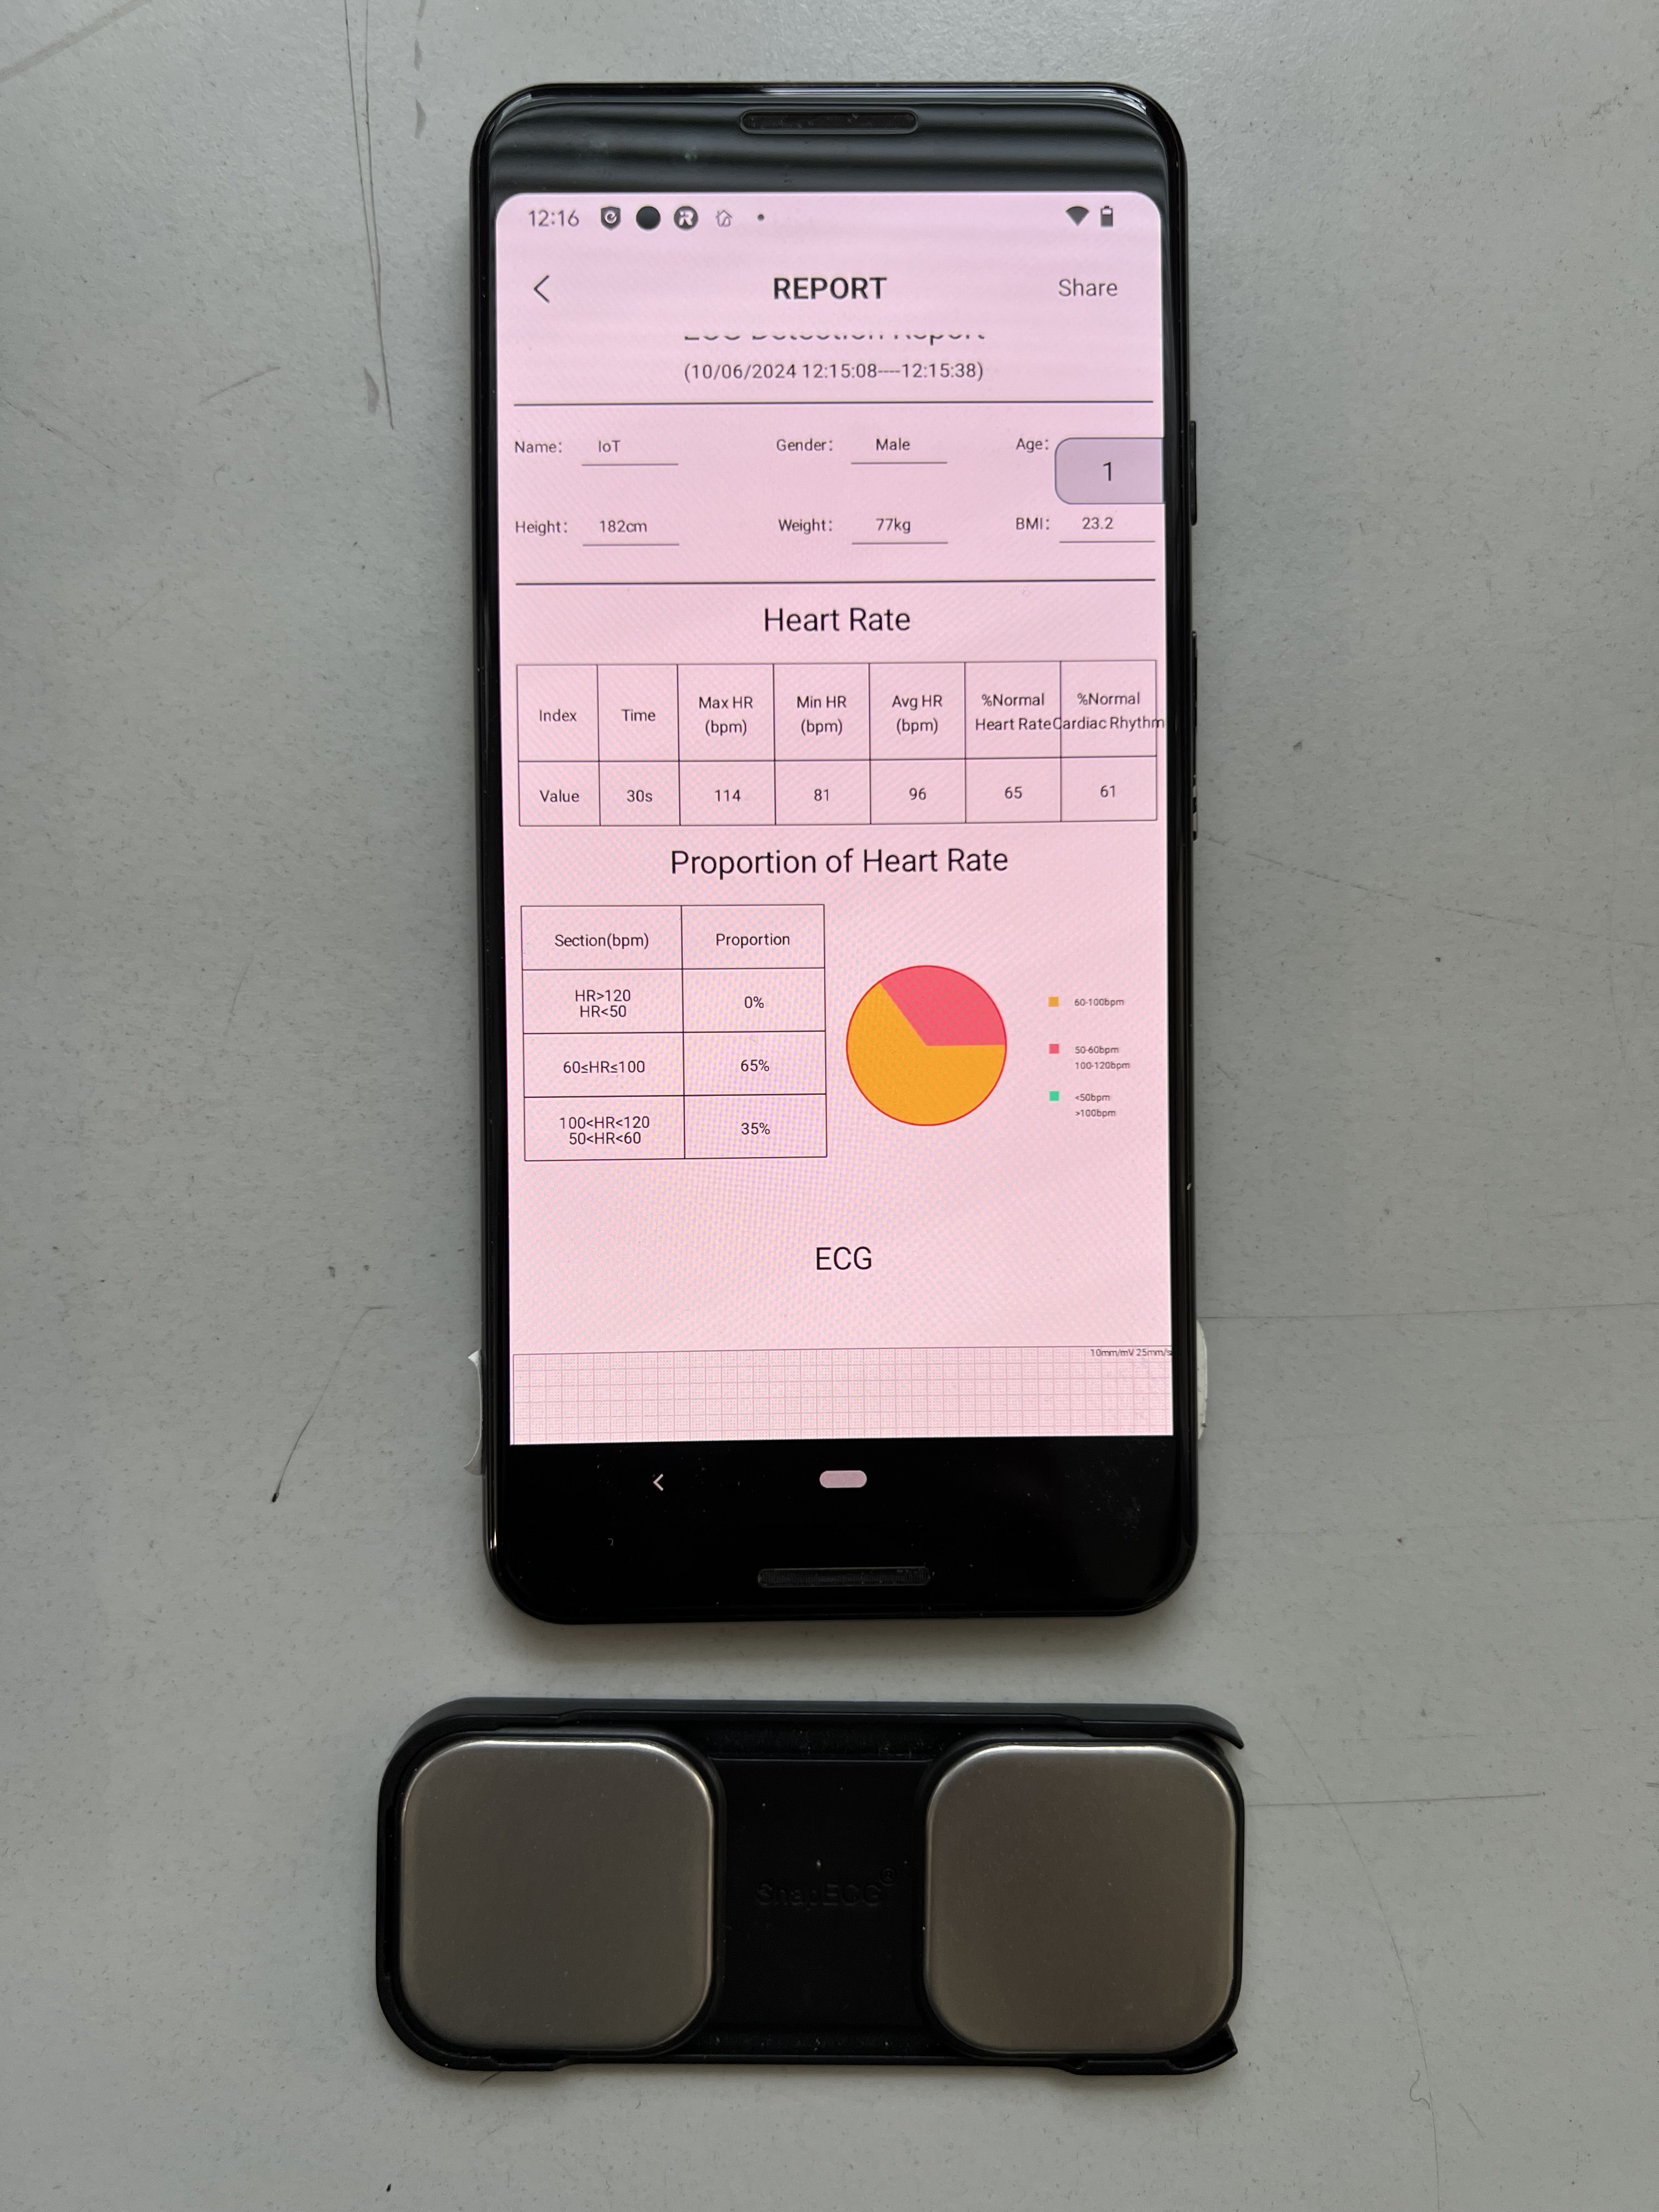
ECG Experimental Results (MITM Attacks)
Unhealthy Report

Slide 36
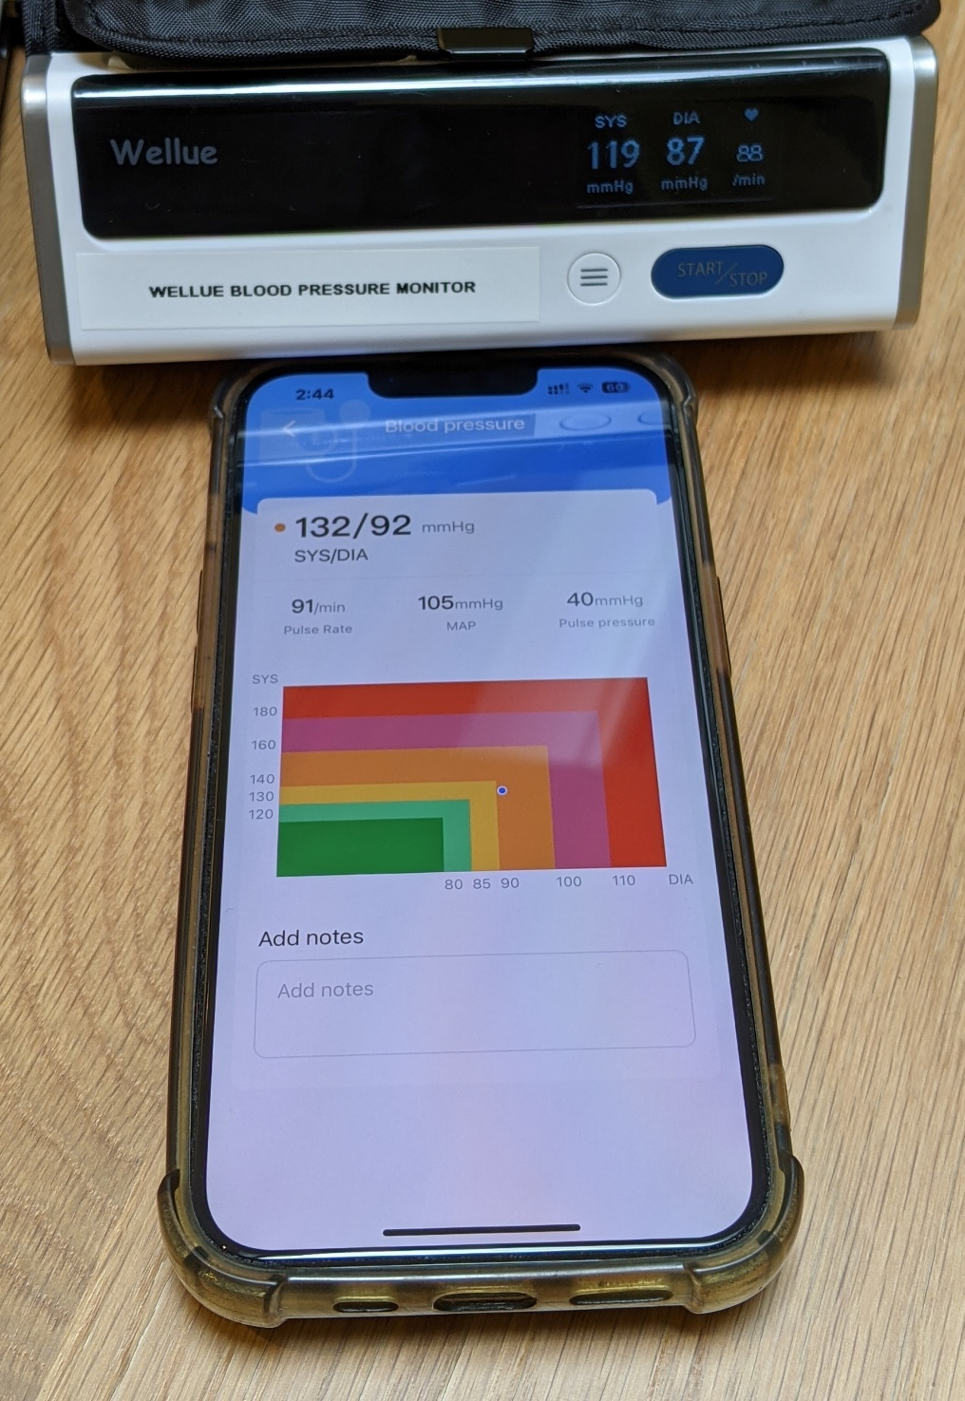
BPM Experimental Results (MITM Attacks)
Typical Normal Reading
Hypertension Stage 1

Slide 37

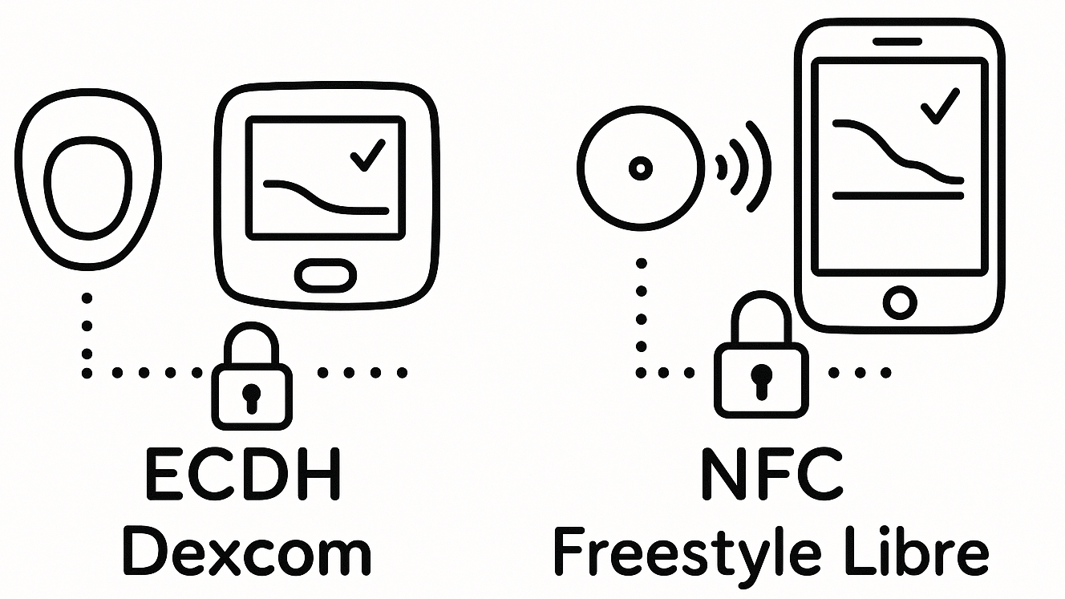
CGMs Improved Security Mechanisms
Secure Connections (for initial pairing and keys exchange):
Elliptic Curve Diffie-Hellman (ECDH).
Near Field Communication (NFC).
→ Private keys → Public keys → ECDH → Shared secret →
KDFs → rand → EDIV → IVs →
Session key
Secure Connections

Slide 38
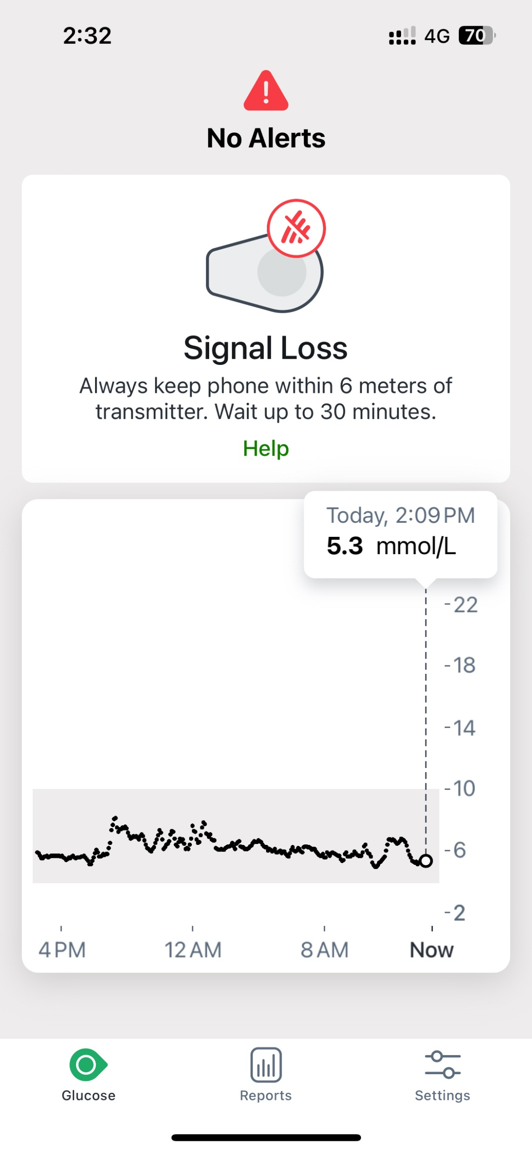
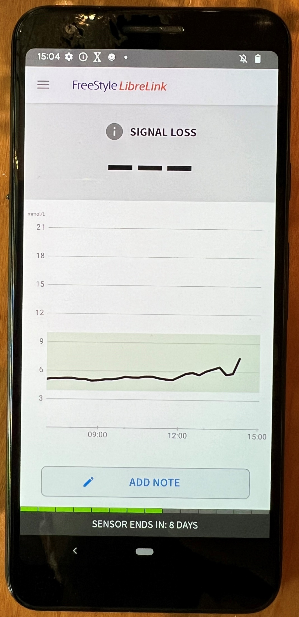
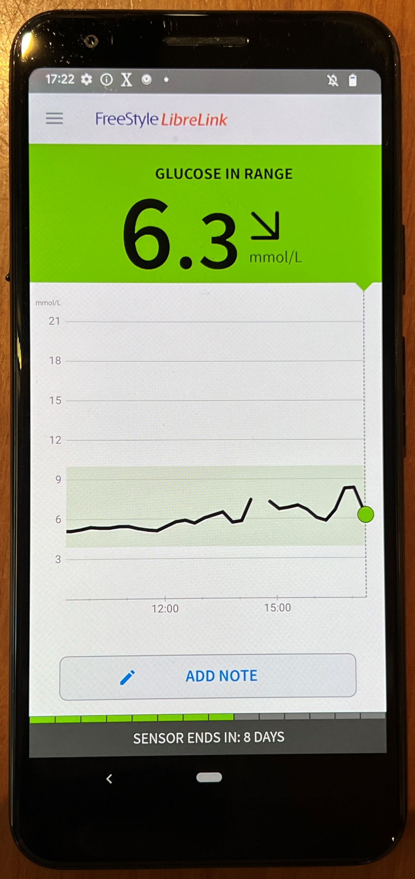
CGM Experimental Results (DoS Attacks)
LoV
LoV
LoV

Slide 39
Key Findings
Devices | Types of Attacks
 | Sniffing (Eavesdropping) | Passive MITM (Eavesdropping) | Active MITM (Data Manipulation) | DoS (Loss of View)
SnapECG (ECG) | ✓ | ✓ | ✓ | ✓
DuoEK Wellue (ECG) | ✓ | ✓ | × | ✓
OXYLINK (Oximeter) | ✓ | ✓ | ✓ | ✓
SleepO2 1400 (Oximeter) | ✓ | ✓ | ✓ | ✓
Wellue BP2A 2031 (BPM) | ✓ | ✓ | ✓ | ✓
Dexcom ONE (CGM) | ✓ | ✓ | × | ✓
FreeStyle Libre 2 (CGM) | ✓ | ✓ | × | ✓

Slide 40
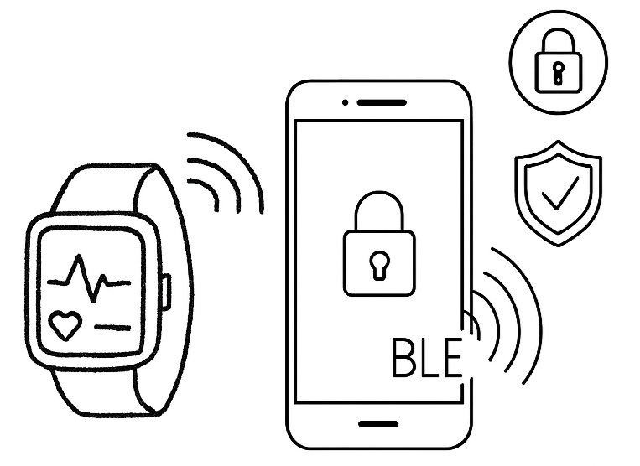
Conclusion
Significant vulnerabilities in BLE-enabled Wearable Sensor Nodes.
Recommendations for improving security:
  Stronger encryption
  Multi-layered approach
  Secure authentication
  Real-time monitoring of device performance and security status.
Call to action for manufacturers & stakeholders to address these issues.

Slide 41
Agenda
Problem: IoT Devices Expose Information Over the Internet
Privacy and Security Certification/Regulation
IoT Automating Testing and Compliance
01
02
03
Reasons you shouldn’t watch TV
Reasons you shouldn’t use smart medical devices.
EU Cyber Resilience Act (CRA)
GDPR
IoTrim ++
Black box assessment
Standards
Gaps
Conclusion
04
05
06
Standardization request
ETSI/CEN-CENELC WGs
IoT Manufactures
SMEs
What’s next?

Slide 42

Big Mess?
02

Slide 43

EU Cyber Resilience Act (CRA)
In the general case, they will do a self-assesment
If their product is on the list of “important” products, they will either need to follow standards or do a third-party assessment
If their product is on the critical list, they will need to undergo a third-party assessment and possibly be certified in the future.
FOSS (Free and Open Source Software) products do self assessments except for critical products

Slide 44

GDPR
Information Commissioner's Office (ICO) IoT guidelines [to be released in June for consultation]
IoT device manufacturers must ensure data protection by design and by default
They are obligated to provide clear, accessible information to users about data collection

Slide 45
Agenda
Problem: IoT Devices Expose Information Over the Internet
Privacy and Security Certification/Regulation
IoT Automating Testing and Compliance
01
02
03
Reasons you shouldn’t watch TV
Reasons you shouldn’t use smart medical devices.
EU Cyber Resilience Act (CRA)
GDPR
IoTrim ++
Black box assessment
Standards
Gaps
Conclusion
04
05
06
Standardization request
ETSI/CEN-CENELC WGs
IoT Manufactures
SMEs
What’s next?

Slide 46
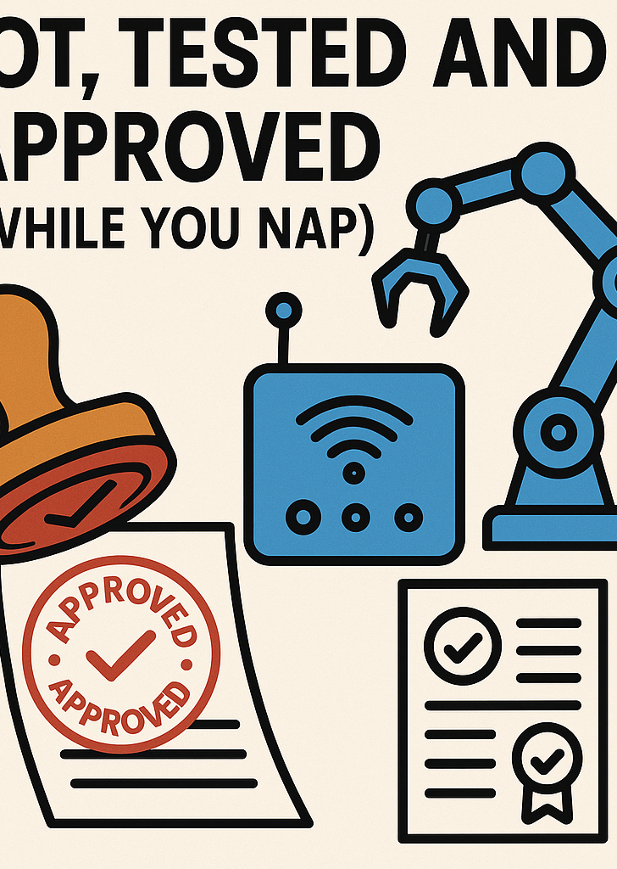
Compliance Without Tears:
Let the IoT Do It
03

Slide 47
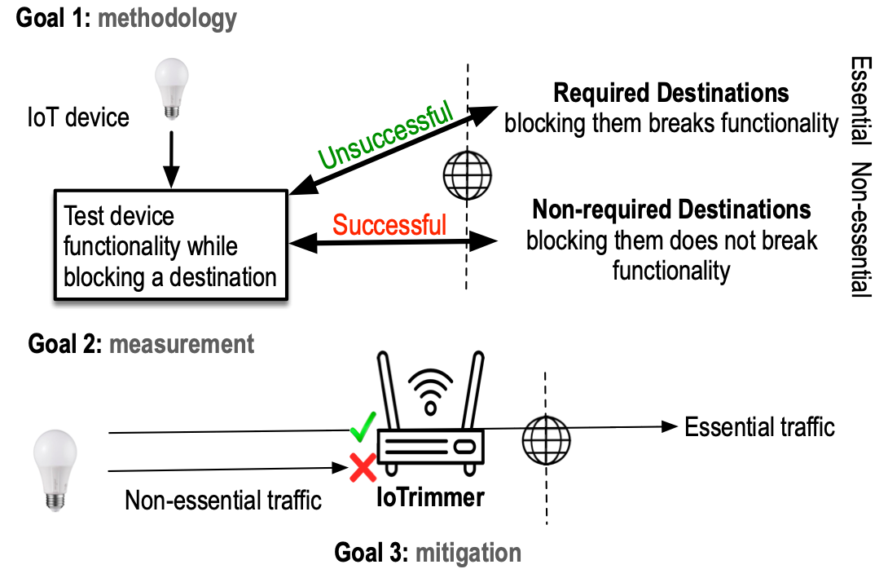
IoTrim++
/ Generalizable
/ Self adaptive
/ Accurate IoT blocker
Notes:
One of the critical steps that will enable this, is solutions at the edge and not only at home but also on our Internet service provider.
We need solution at the EDGE!, directly at people’s home and specifically for IoT devices.
We need an automated framework for detecting and isolating non-critical communications from IoT devices.
We are working on it and We called this IoTrimmer. In a way, Iotrimmer will works like a firewall or an ad-blocker for IoT devices that can be implemented on a home gateway
We start investigating this and we were able to block already 61% of destinations for 31 IoT devices without breaking the main functionality of the devices.
Iotrimmer will have a user interface where user can decide and control their privacy. Control will be back to the user.

Slide 48
Automatically detecting non-essential destinations

Slide 49
Automatically detecting non-essential destinations

Slide 50
Automatically detecting non-essential destinations

Slide 51
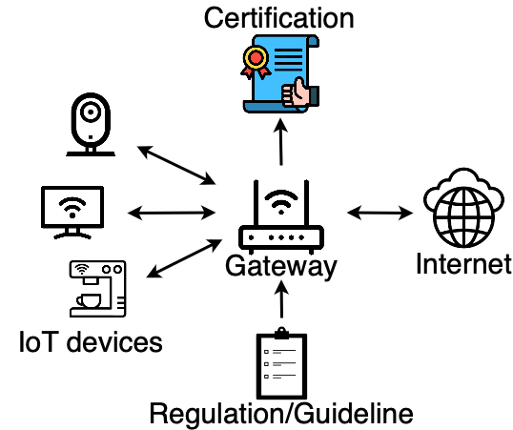
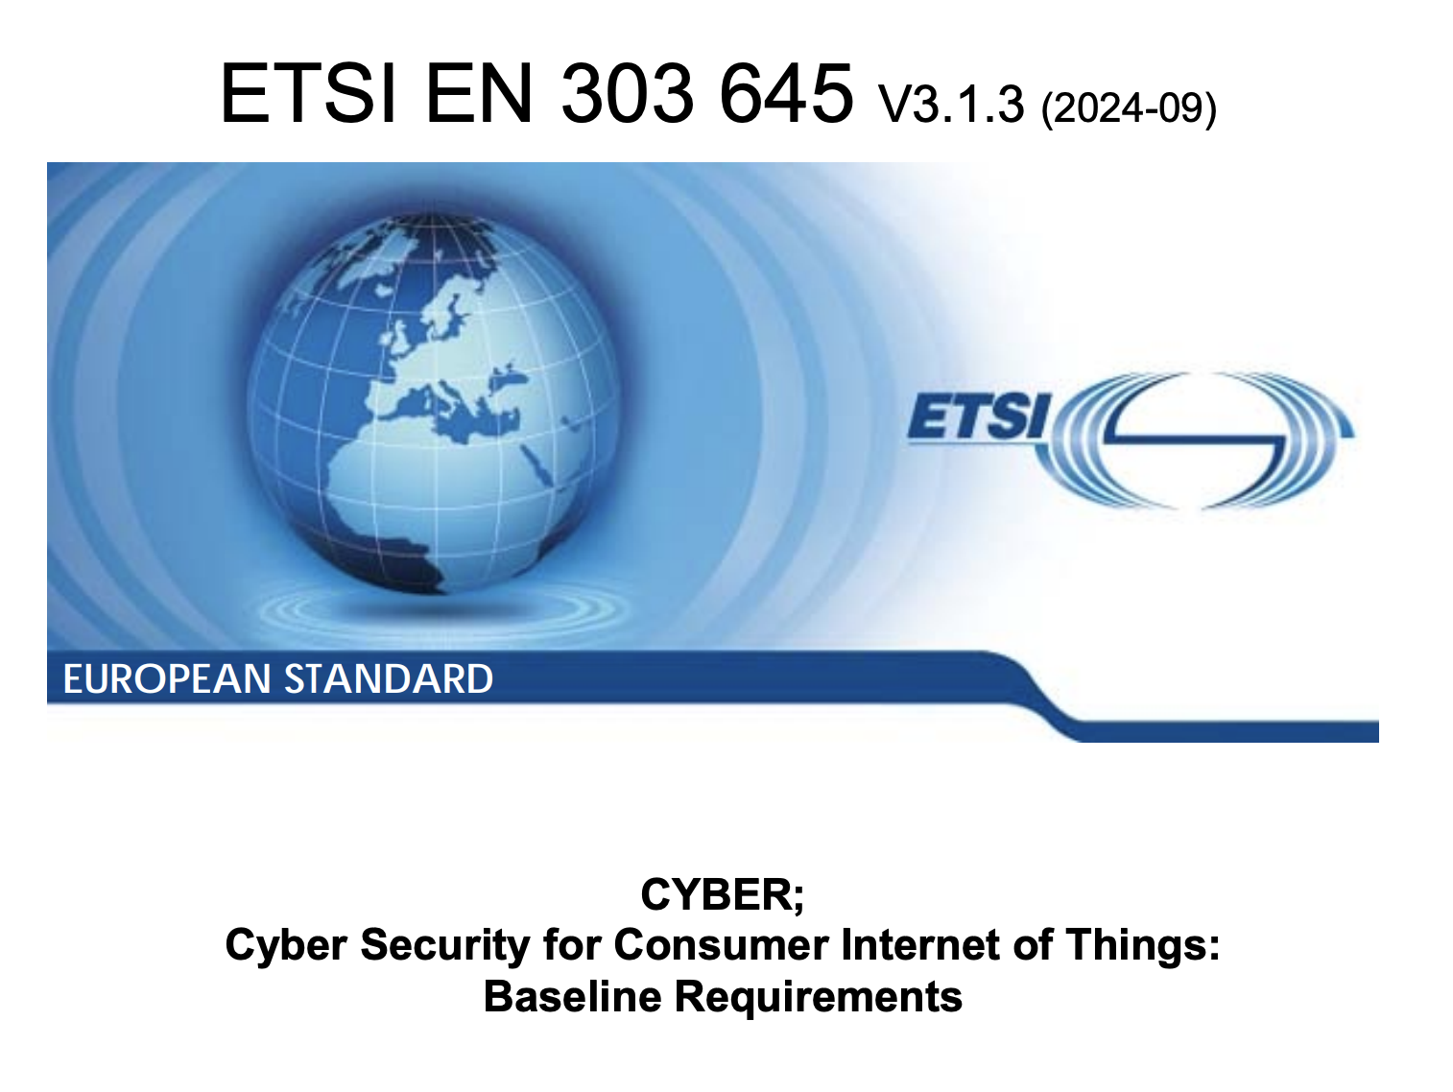
Black Box Assessment
Select security guidelines and
privacy regulations
v
Define experiments to test the extracted metrics on IoT devices
Produce a certification label for the tested device
Turn them into metrics

Slide 52

Testing Requirements
For how long do we need to test the device?
Used Ports

Slide 53
Agenda
Problem: IoT Devices Expose Information Over the Internet
Privacy and Security Certification/Regulation
IoT Automating Testing and Compliance
01
02
03
Reasons you shouldn’t watch TV
Reasons you shouldn’t use smart medical devices.
EU Cyber Resilience Act (CRA)
GDPR
IoTrim ++
Black box assessment
Standards
Gaps
Conclusion
04
05
06
Standardization request
ETSI/CEN-CENELC WGs
IoT Manufactures
SMEs
What’s next?

Slide 54
When in Doubt, Create Another Standard!
04

Slide 55
CRA Standardization Effort
🧩 Current Focus Areas
🚀 Impact
Mapping existing standards to CRA requirements
Defining secure lifecycle processes for digital products
Ensuring interoperability and compliance frameworks
Supporting conformity assessment procedures
Streamlined compliance for EU manufacturers
Stronger cybersecurity baseline across digital products
Cross-sector adoption of harmonized security standards
CEN-CENELEC
ETSI
Aligning and integrating standards into the EU regulatory framework
Developing Harmonized Standards (HAS) for CRA compliance
Coordinating with EC and stakeholders through JTC 13 (Cybersecurity & Data Protection)
Leading development of technical standards and specifications for ICT
Key standards: ETSI EN 303 645 (IoT security baseline)

Slide 56
Agenda
Problem: IoT Devices Expose Information Over the Internet
Privacy and Security Certification/Regulation
IoT Automating Testing and Compliance
01
02
03
Reasons you shouldn’t watch TV
Reasons you shouldn’t use smart medical devices.
EU Cyber Resilience Act (CRA)
GDPR
IoTrim ++
Black box assessment
Standards
Gaps
Conclusion
04
05
06
Standardization request
ETSI/CEN-CENELC WGs
IoT Manufactures
SMEs
What’s next?

Slide 57

When Your Toaster Is Smarter Than Your Compliance Process
05

Slide 58
Gap
IoT Manufactures and SMEs need help!

Slide 59
Gap
How can we create a standard based on network behaviour of IoT devices?

Slide 60


Helping Manufacturers and SMEs to be Automatically Compliant
Mulini
RIPE NCC Community Projects Fund
One click. More security and privacy.
The project automates IoT security checks using machine learning and real-world monitoring to ensure compliance with cybersecurity standards.
Final Goal
Stakeholders involvement
Open tool for developers and regulatory compliance auditors for independent compliance checking and security threat detection.
SMEs
IoT Manufacturers
Policy Makers

Slide 61
Testing Requirements
For how long do we need to test the device?
Used Ports

Slide 62

Help!
If interested, please get in touch!

Slide 63
Agenda
Problem: IoT Devices Expose Information Over the Internet
Privacy and Security Certification/Regulation
IoT Automating Testing and Compliance
01
02
03
Reasons you shouldn’t watch TV
Reasons you shouldn’t use smart medical devices.
EU Cyber Resilience Act (CRA)
GDPR
IoTrim ++
Black box assessment
Standards
Gaps
Conclusion
04
05
06
Standardization request
ETSI/CEN-CENELC WGs
IoT Manufactures
SMEs
What’s next?

Slide 64

Making Compliance So Easy, Even Your Lightbulb Could Do It
06

Slide 65



What’s Next?
Privacy Preserving IoT Security Management
Real IoT gateway
Mitigation
Real deployment and evaluation
Third party certification
Privacy and Security Label/Certification
Privacy and security by default
Shared Database privacy and security vulnerabilities of IoT
Notes:
How? in the next few years I will focus on understanding of real-world threats and driving secure system design. I will develop privacy-preserving systems using access networking tools, machine learning and binary code instrumentation to detect data leakage in real time for more sensitive devices like medical devices and wearable.
In the near term I’ll work with the NHS for enhancing privacy preserving techniques for medical IoT Devices.
In the long term I am planing to spin out my startup and provide concrete solutions to ISP, but also work closely with governments for adopting privacy labels.

Slide 66


Thank You

