Slide 1
INFERMAL: Inferential Analysis of Maliciously Registered Domains
Samaneh Tajalizadehkhoob
Director of Security Research
Office of CTO (OCTO)
ICANN

Slide 2
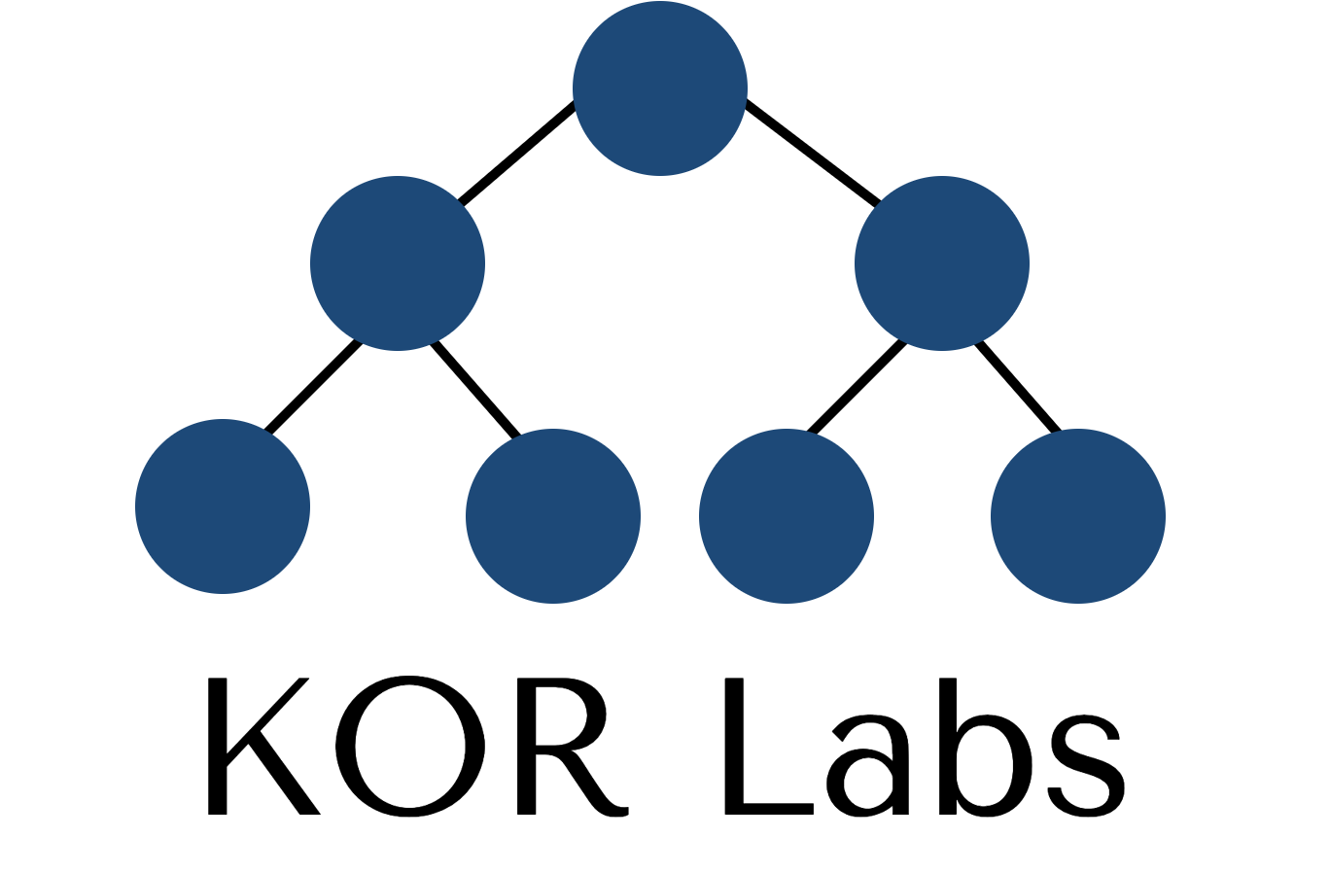
Exposing the Roots of DNS Abuse: A Data-Driven Analysis of Key Factors Behind Phishing Domain Registrations
Yevheniya Nosyk, Maciej Korczyński, Carlos Gañán, Sourena Maroofi, Jan Bayer, Zul Odgerel, Samaneh Tajalizadehkhoob, Andrzej Duda KOR Labs / Grenoble Alpes University
ICANN org
ACM CCS’25 - upcoming

Slide 3
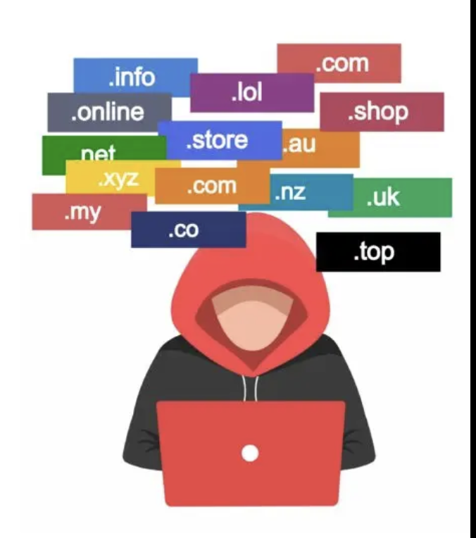
Motivation
Cybercriminals exploit domains for: phishing, malware, spam, botnets
Constantly register new domains to fuel attacks
Prior studies show high abuse in specific registrars and TLDs
No comprehensive research on factors influencing malicious registrations

Slide 4
Goal
Investigate domain abuse from the attacker’s perspective
Identify factors driving malicious domain registrations

Slide 5
Approach – overview
Scope: Maliciously registered phishing domains
Features: 73 features encompassing three latent factors:
Registration attributes
Proactive verification
Reactive security practices
GLM regression analysis:
Relationship between features and the concentration of phishing domains at the registrar-TLD level
Features are favored by attackers alone or also by legitimate users

Slide 6
Datasets
Phishing: APWG, PhishTank, OpenPhish
Benign domain names: ICANN CZDS, Google CT logs, etc.
Features:
TLD-List (e.g., domain registration costs, discounts, free features) *
Manually collected data (e.g., free API, API create user account, API register domain, restrictions)
Active measurements (uptimes)
Active WHOIS and DNS measurements
* https://tld-list.com/

Slide 7
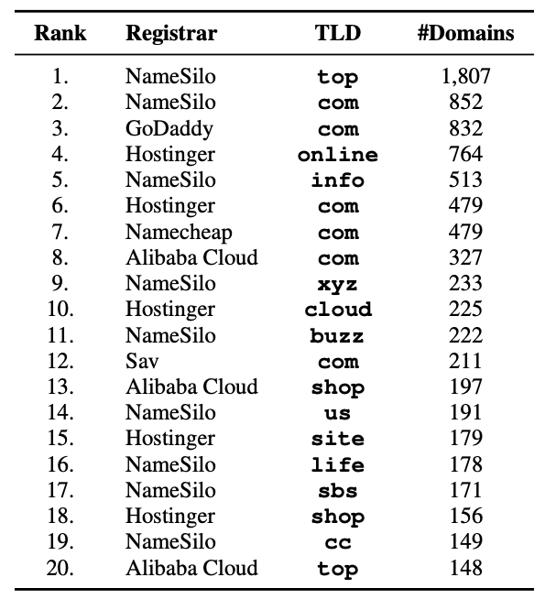
Maliciously registered phishing and benign domains
534 K bloclisted URLs (Aug 2023 – Jan 2024)
108 K domain names
Excluding domains of benign services
Active measurements (DNS, WHOIS) over one month to verify if the takedown occurred
28 K registered maliciously
Mapping between domains and daily-collected registration features
14 K maliciously registered (165 TLDs, 31 registrars)
Benign dataset of 15.4 K domains under 259 TLDs originating from 38 registrars
20 most frequently observed registrar/TLD pairs in our dataset of maliciously registered domain names

Slide 8
Selected features
Registration attributes
Free API: the registrar APIs enable users to search, purchase, and manage domains
Free bulk search: the capability to search domains in bulk
Available payment methods: 24 boolean features for
each payment method, including PayPal, Bitcoin, etc.
Retail pricing: domain name registration prices
Discounts: deducting a fixed amount or % from the regular price
Pricing terms: might apply only to a limited number of domains or new customers
Free web hosting, free DNS, free email account: included for free in each domain registration

Slide 9
Selected features
Proactive verification
Operational validation of the registrant contact details: Test whether contact details (email/phone) are verified during account creation or before domain purchase.
Domain registration warnings and restrictions: three labels defined:
9e86e6d5d4c676441da (the first 20 characters of the MD5hash of “DNS abuse”),
office365-my-account
facebook-login-page
For each registrar-TLD pair, we proceed to the payment prompt.
Registration restrictions: 14 boolean features, e.g., local presence required, ID required, professionals only

Slide 10
Selected features
Reactive security practices: malicious domain name uptimes (with and without notifications)
WHOIS/DNS measurements
5 minutes, 15 m, 30 m, 1 hour, 2 h, 3 h, 4 h, 5 h, 6 h, 12 h, 24 h, 36 h, and 48 h after blocklisting, and then every 12 hours
for a subset of maliciously registered domain names, notifications are sent to registrars

Slide 11
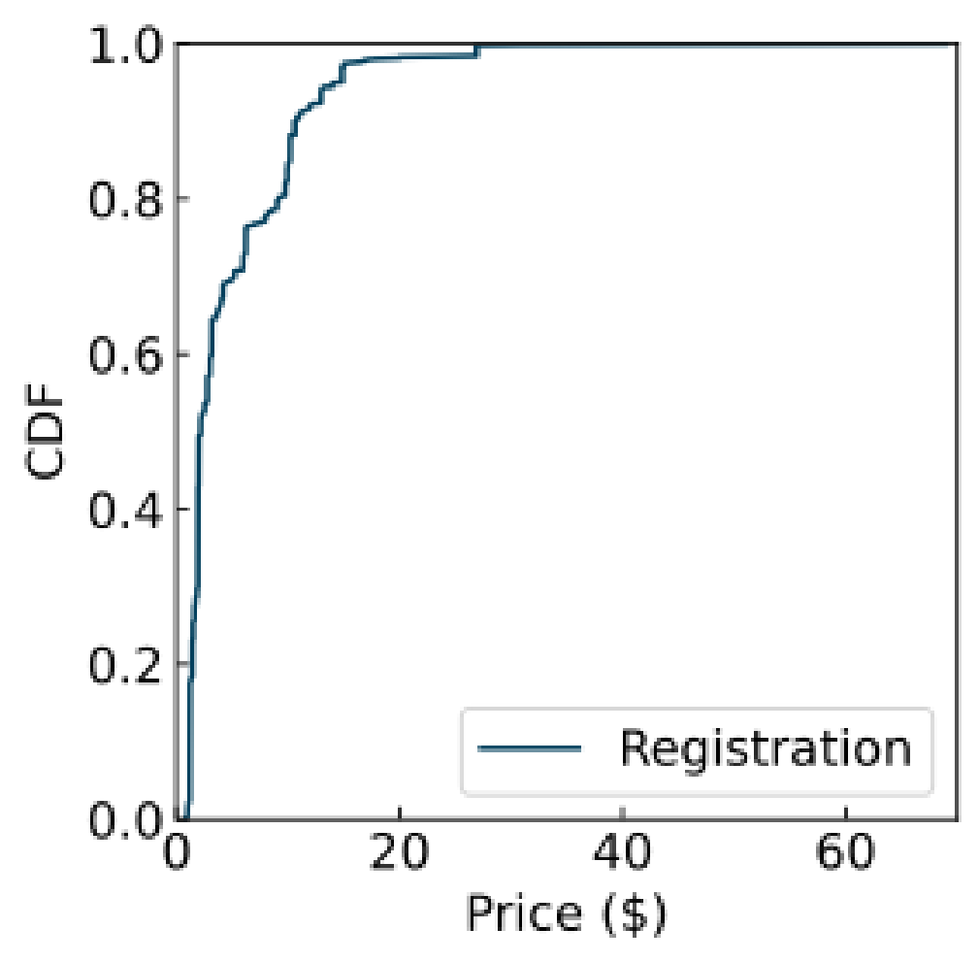
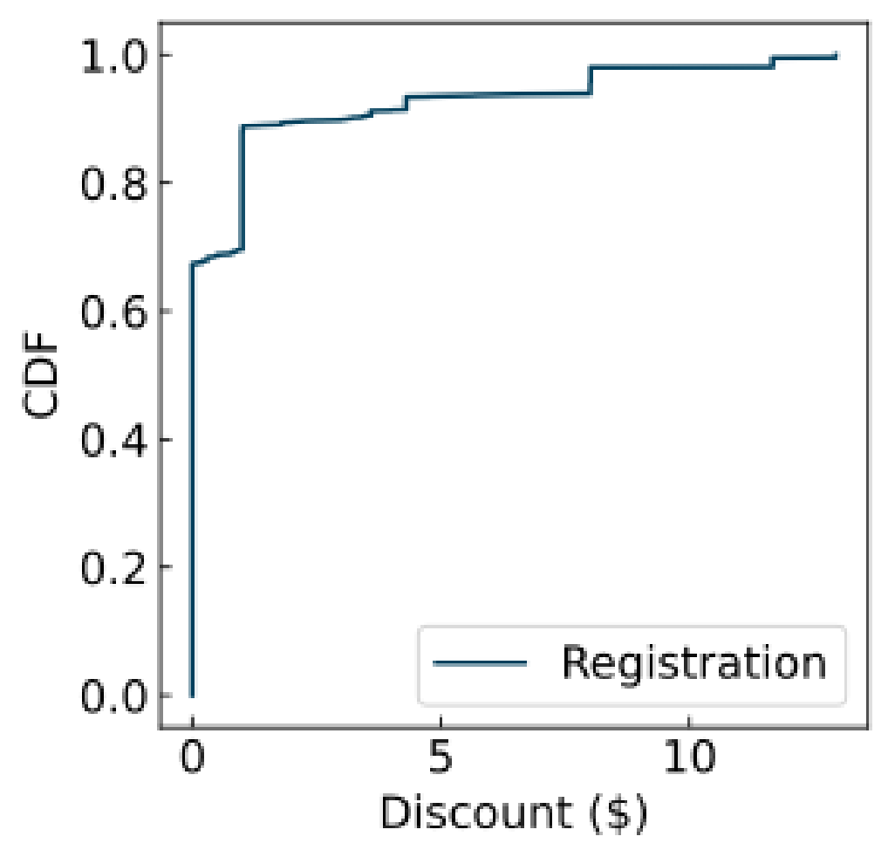
Descriptive Analysis of Features
Prices and discounts: Registration
Prices range from $0.78 to $69, with nearly 50% costing $2 or less

Slide 12
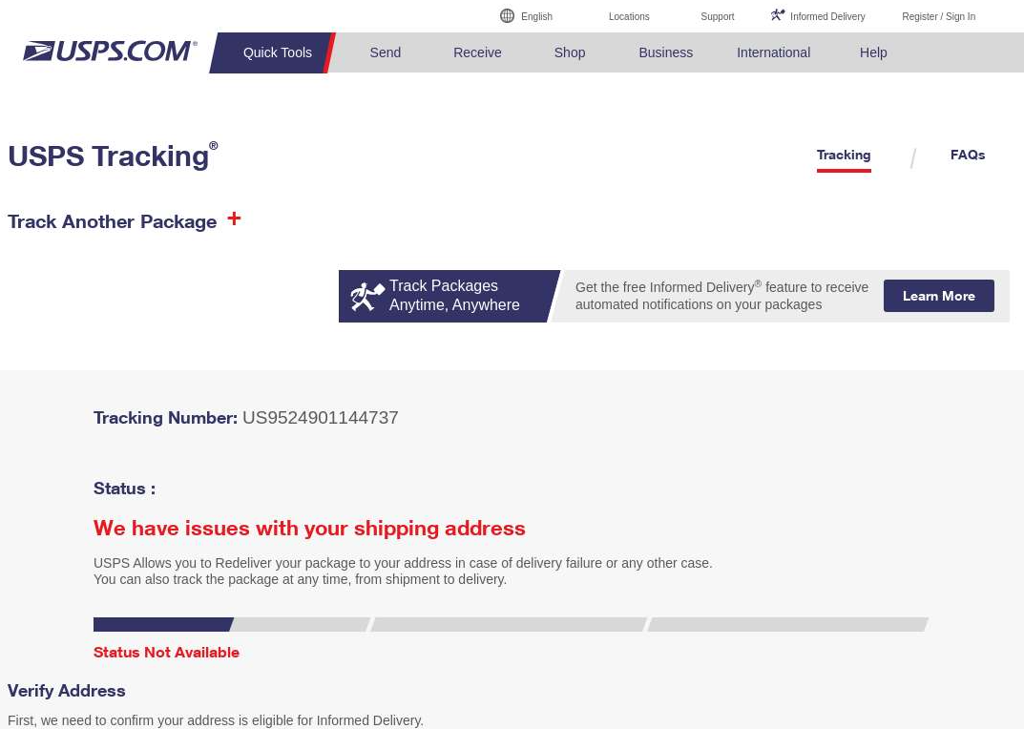
Descriptive Analysis of Features
Prices and discounts: Registration
Examples of expensive domains include usps.bar ($69), support-fb.sh ($59.99), and dhlcenter.net ($56)

Slide 13
Descriptive Analysis of Features
Registration prices and discounts:
Registration prices may be subject to various terms (e.g., 4,423, reduced registration prices were valid for one domain), discounts to new customers only

Slide 14
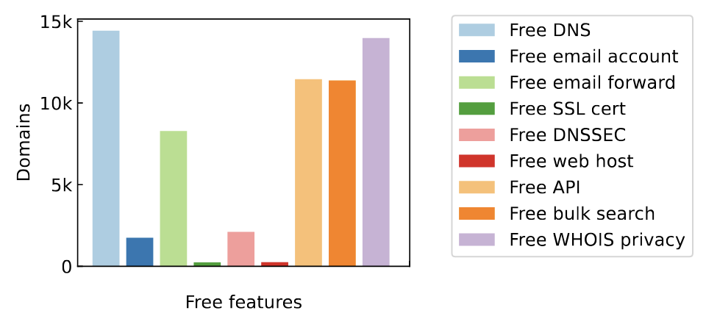
Descriptive Analysis of Features
Free features
A free API is offered by 16 of the 31 registrars we examined
Four registrars permit the automated account creation (e.g., as a subaccount under an existing API user)
18 registrars offer a “bulk search” to check availability and prices for 20 to 10 K+

Slide 15
Descriptive Analysis of Features
Payment methods
13 are supported by the 31 analyzed registrars. Bitcoin supported in more than two-thirds of cases.
Domain Name Registrant Data
Phone verification is rare: 23 registrars check syntax, and only 6 validate operationally
Prevention of Trademark Infringement
Two registrars blocked trademarked domains from being added to the cart

Slide 16
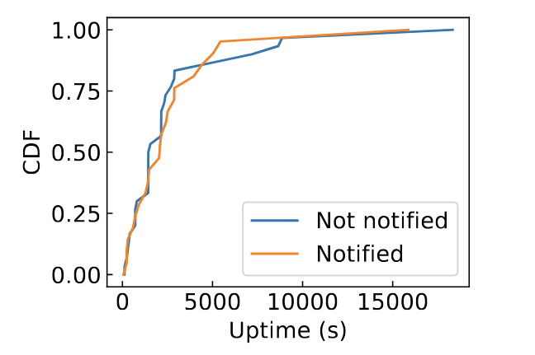
Descriptive Analysis of Features
Malicious Domain Uptimes
Similar results at the domain and registrar levels
CDF of uptimes for notified and not notified registrars

Slide 17
Driving Factors of Domain Abuse
Model 1: Relationship between features and the concentration of phishing domains at the registrar-TLD level
Driver | Type | Correlation with abuse counts | Increase
Retail registration price | Numerical | Weak positive | 1$↓ (6.6%↑)
Retail registration discounts | Numerical | Positive | 1$↓ (49%↑)
Cryptocurrency payment(s) available | Boolean | Positive | 30%
APIs to register domains or to create accounts available | Boolean | Strong positive | 401%
Economic Incentives
Discounts: Attaches are more price sensitive, Mean price of benign domains ($8.62) is higher compared to $4.71 of malicious ones

Slide 18
What about Benign Domains?

Slide 19
Role of Free Services
Model 1: Relationship between features and the concentration of phishing domains at the registrar-TLD level
Driver | Type | Correlation with abuse counts | Increase
Retail registration price | Numerical | Weak positive | 1$↓ (6.6%↑)
Retail registration discounts | Numerical | Positive | 1$↓ (49%↑)
Cryptocurrency payment(s) available | Boolean | Positive | 30%
APIs to register domains or to create accounts available | Boolean | Strong positive | 401%
Account creation and Management

Slide 20
Role of Free Services
these bundled features are attractive to both malicious and legitimate users.
Driver | Correlation with abuse counts | Correlation with abuse counts | Increase
Free DNS service | Boolean | Positive | 205%
Free hosting service | Boolean | Positive | 88%
Presence of restrictions (e.g., commitment required, local presence, professionals only) | Boolean | Negative | 63%
Validation of email/phone present | Boolean | Negative | 70%
Shorter uptimes | Numerical | Statistically significant but negligible correlation | ~0%

Slide 21
Proactive Upfront Checks
Driver | Correlation with abuse counts | Correlation with abuse counts | Increase
Free DNS service | Boolean | Positive | 205%
Free hosting service | Boolean | Positive | 88%
Presence of restrictions (e.g., commitment required, local presence, professionals only) | Boolean | Negative | 63%
Validation of email/phone present | Boolean | Negative | 70%
Shorter uptimes | Numerical | Statistically significant but negligible correlation | ~0%
Stringent registration restrictions (e.g., local presence, ID required, content restrictions, etc.) 62 less abuse, while legitimate registrants, faced with a more rigorous process, are less likely to choose less restrictive registrars.

Slide 22
Discussion and Considerations
Key factors driving malicious domain registrations from the attacker’s perspective.
Results should be interpreted with caution and may or may not be generalized into actions by registrars or TLDs.
Some factors are combined and involve a variety of features.
401%? Come from a statistical model that looks at many factors at once. That 401% figure doesn't exist in isolation; it reflects the impact of offering an API while holding all the other factors in the model constant. If you added or removed other factors from the model, the number would change.

Slide 23
Discussion and Considerations
Variables that are used in this study are combined: registration restrictions or the consolidation of payment methods into three categories—cryptocurrency, bank transfer, and digital wallets.
Consider the economic implications, the impact on legitimate users, and the likely response of attackers to adjustments, the result of partial/full implementation.

Slide 24
Contact information
Yevheniya Nosyk, Maciej Korczyński, Sourena Maroofi, Jan Bayer, Zul Odgerel, Andrzej Duda (KOR Labs / Grenoble Alpes Univ.)
Project website: https://infermal.korlabs.io/
Maciej Korczyński
KOR Labs
maciej.korczynski@korlabs.io
Samaneh Tajalizadehkhoob
ICANN OCTO
samaneh.tajali@icann.org

Slide 25
Thank you!
Questions

