Slide 1
SPF, DKIM and DMARC within .fr
May 2025
A quick look at over 4 million domains

Slide 2
SPF, DKIM and DMARC in a nutshell
DMARC (RFC 7489)
E-mail “From” header’s consistency with the fields checked by SPF and DKIM; reports (statistics, errors…)
SPF (RFC 7208)
Is the e-mail coming from an authorized server?
DKIM (RFC 6376)
Digital signing of e-mail headers and body
Internet Message Format (RFC 5322)
SMTP – Simple Message Transfer Protocol (RFC 5321)

Slide 3
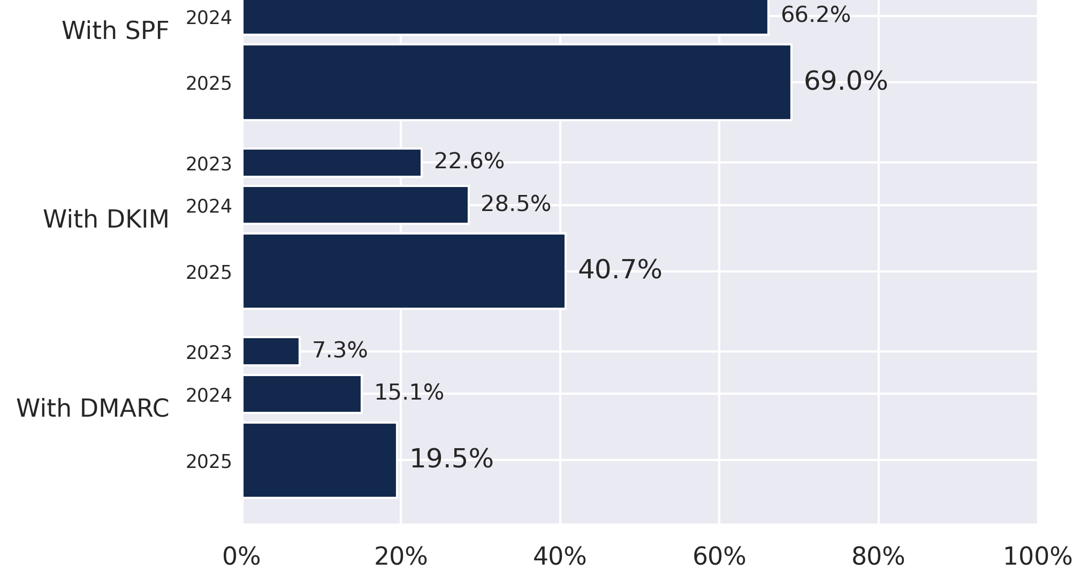
How are SPF, DKIM and DMARC doing within .fr?
Approximate data collection dates:
2023-01-30;
2024-02-15;
2025-01-15.

Slide 4
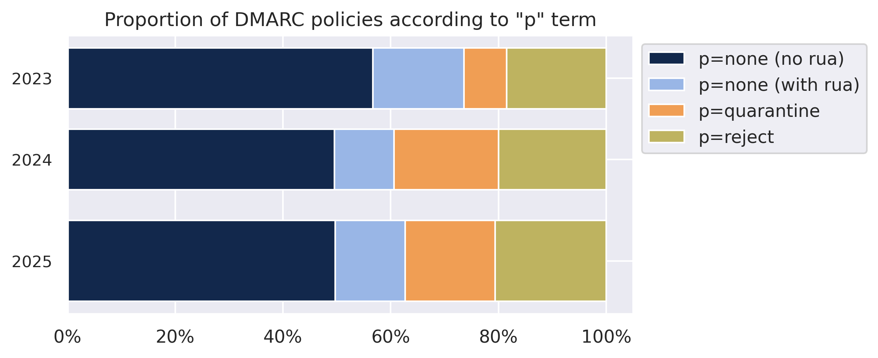
A closer look at DMARC “p=” terms

Slide 5
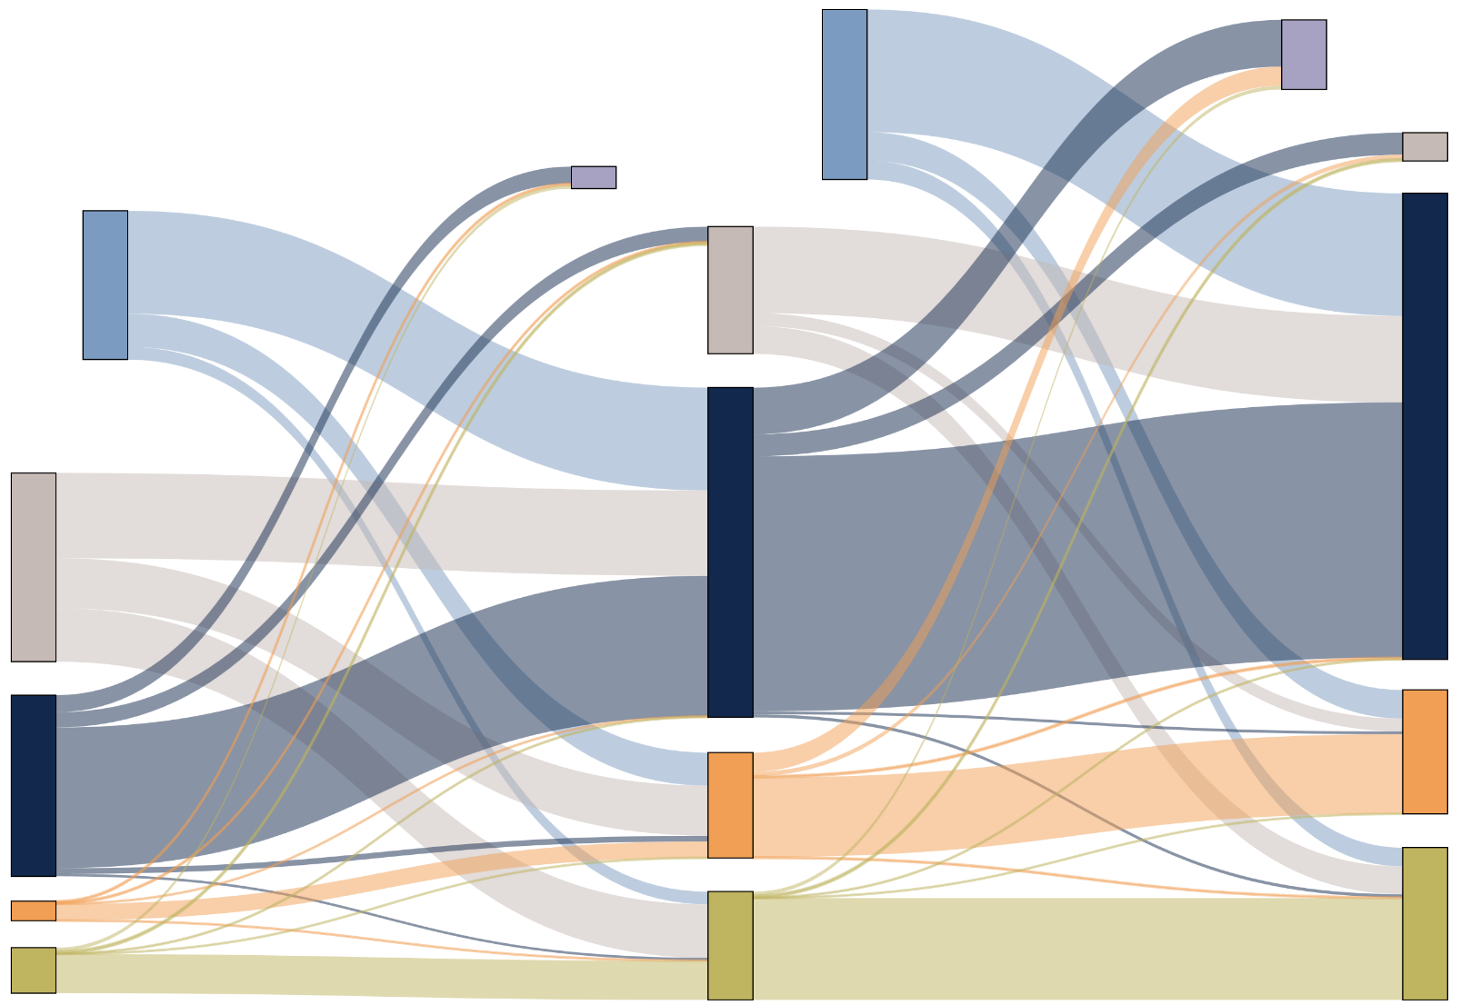
DMARC “p=” terms hardly change
Deleted domains
Deleted
New
No DMARC
New domains
p=none
No DMARC
p=none
p=quarantine
p=quarantine
p=reject
p=reject
2023
2024
2025

Slide 6
Overly permissive SPF policies
"v=spf1 ip4:203.0.113.0/16 +all"
"v=spf1 mx a include:mailgun.org include:_mailcust.gandi.net ip4:192.0.2.96 ip4:198.51.100.0/2 ?all"
"v=spf1 ip4:198.54.100.90/0 ip6:::/0 ?all"

Slide 7
Publishing more than one SPF policy
In one case, a domain publishes ten SPF policies :
"v=spf1 include:squarespace-mail.com -all"
"v=spf1 include:spf.protection.outlook.com -all"
"v=spf1 mx -all"
"v=spf1 a:mail-qk1-f172.google.com -all"
"v=spf1 include:spf.[domain].fr -all"
"v=spf1 include:[domain].fr -all"
"v=spf1 squarespace-mail.com -all"
"v=spf1 a:[domain].fr -all"
"v=spf1 a -all"
"v=spf1 include:_spf.google.com ~all"

Slide 8
Where did the SPF record go?
$ dig +short TXT firstspirit.fr
"google-site-verification=zN8Enp3tkxLCTSRrHt9xYJtePDp60Zagnp9cWmoE8hM"
"google-site-verification=RrVtg0LiPo2pTgFV5UpGTmckhmDDK_WHiGoFhDTZgVY"
"google-site-verification=a-9-N6Oggk5gB4Q69mUCSu3jVp3tlzUvpIFS9IDVw-E"
"google-site-verification=FPwK2qgXBw3g7r5Jp3jYgytJmswI2_gvsmf1bqG1UFI"
"google-site-verification=U2l-VPs3tlEs7D592d7bn6yIitaKnCw_i9nrb34_WOE"
"google-site-verification=4hSkJS18boqwDa5lK01Cqp_nqgQe4vttp1QljLBCwHg"
"google-site-verification=slOUuac5KCvLcfZVXMBhHgFW8tCroiCqdOhVtXQPn8I"
"google-site-verification=3_pU5s95E1T9QAugP71rydxY9nY8jSORnFd1QrZyZbg"
"google-site-verification=VVh_UoUY4tAmOMq1-oKubayxA1ljnAX_IbiHRSbz8kM"
"google-site-verification=PcM7CNx2z9xdqYX9MBULrT33FyCmfnEmNFe6XM2Xsl0"
"google-site-verification=HFamqnLISpsv8xyeFpkCRuslyQX9I4SCM16M7WzDTRE"
"google-site-verification=EP9tEUcJqmJ4VheV_0Af340dJOgAZPA-MSk8Yck2bTQ"
"google-site-verification=mjyshVuuH7oE4m4tOOZkYzyV8Nts4tDHOFn-HIVza88"
"google-site-verification=kYm5cggnWfPboFQj0f96Cw5X0FAUWVI2RM9Za4WOLig"
"google-site-verification=nqacNsk1XrfrVp29oebrYaY7awJ7rsvRytdCUUBQleI"
"google-site-verification=WfbE93ZpSX5-qIpztGc98qBAkPz1nPCTxOJykFyQgKQ"
"google-site-verification=L_TUkOGZ_E13vWRxjd49juBEiKeaIuX0hhFAMW1lA0U"
"google-site-verification=lKcM-NvM9jpYdwEvnCyCE86qjZHEehjWWw7xM2BRrqE"
"google-site-verification=QZq5f-Tux3bTZDWkJtyxhMue5w_Xd3nPsnWKGFRb3qY"
"google-site-verification=iDOteCcCOn04Tah8cisebiHAMp9688_HirBK49LD8eg"
"google-site-verification=BUPemZUe2CMm-xXdSEGIL4qWsC43mgJuHxX-jlhe4bY"
"google-site-verification=7rS_OmlQrdhAqwmZZRT5XVOPQPyICQq8cZ-X7BzzyJU"
"google-site-verification=tcxhOOcSZs9I4Qa1CoNB5R8Pz2QbJyII_3aqKCnlKUY"
"v=spf1 a mx ip4:212.29.33.128/29 ip4:212.29.44.128/27 ip4:85.22.92.224/27 ip6:2a03:f580:1001::1 ip6:2a03:f580:1001:200::2 include:_spf.google.com -all"
"google-site-verification=o-l1dGbDC51TniOpYHnssTMy4Fer6vw-nDq0U16FkYY"
"google-site-verification=4brxF_SUgXbzRnMidw0qasZgpmLXxXwxw7fduBMNXgg"
"google-site-verification=iECBghW7SpsWg6lkF8nxJanfLCw2cCcapeXrPIyZYPA"
"google-site-verification=MgLVTP2TpS3MH_WXEoq-gYceqqTMFWDA8VBkVEjGCjM"
"google-site-verification=LFOYo82mque4ph7N6rm2PnasSS4EhcCcxRTWX2Wq4hI"
"google-site-verification=xvX4zuWhdRlHpmEoCh11DSEJXlGwB-8rmRWiuDG5xd8"
"google-site-verification=TtMqaQqj0TQ3oPJOCDAyLHKNtZTT26nBXHZoEl2eFwc"
"google-site-verification=6o0pj1AC1-WlUmO7TRAUR14ZfDhmYnSlLhxzGVGBEYI"
"google-site-verification=cMunChV8p9EqoJdU89vBeiZwTly0JpB9UC7Ln-tpC1g"
"google-site-verification=lX-a8NmXoTVnn-zCgu8T-wAvzifDn-KKtT5jQOBUy6o"
"google-site-verification=qPLynbSQZnLjMBzK7QGrw5T7HWxNAbktAh0-QrYdMTE"
"google-site-verification=2O9L8MU6nGzca80IP_Se9OeCdERWAkXbHg34t2Yu3AM"
"google-site-verification=DPYG5IKdUXBWXjlPcd10Lr-LzAZ2YPANPcyylSJObQQ"
"google-site-verification=yESRulGJiqyKqecIVDlL7IILdbVBqs9ou_9q4WttXJw"
"google-site-verification=_XjaUKI8b_w7N4AS8DGaif4QgjXrL-0WYQKCFA1WrKw"
"google-site-verification=8g0_rk2ILwuLSlvHVK1TNaEQ1I_RKdzmxM9uatsuy6k"
"google-site-verification=e-bkRj49DUP7NdRAOi03HTzFFp56tUwBmcSAFPfV2EI"
"google-site-verification=klXDs4cVltRFgG3tLEUfMKz349fJ1fsf4rH-M1wFdzI"
"google-site-verification=X097O6yo1iLRXWSRWsGtFUe6T89twchxrGrPrXqwwd0"
"google-site-verification=2pOgw1c3E3kKdmyS-YXoGnPkPWpczS7keJShBrBwDhI"
"google-site-verification=R_9RgCbzoQ8xh5VIM2wKDaVSTOitMNovdMu_-NAgyLM"
"google-site-verification=39OFiaDBFaEIin7dXLZBvWmDSIqwV1VxYdb2yPDbZrw"
"google-site-verification=3TkkQQ-DVmIj4UWEOW7R1fmJl7FzjXnnV-O3nmbArYE"
"google-site-verification=QCWbzXlhm7cGOka-hjPPFOhUDXdQL5q_5N7LyQ2TjbM"
"google-site-verification=DnJiL-V721Mqp84h9c-gEdT8Wk8wxbfciFBf0UjUJ2U"
"google-site-verification=RkUdotXDtFQsmOVA56pNZ7Mu4nh1NcuvvCYwVGPjjQI"
"google-site-verification=c8d0wDMF1a4wWiCnWuwzZTLKAlGsbw-glokymT5N15U"
"google-site-verification=9MHKO8G23fVbSobnOyGDKyYITv6vr74xQsweMWWeTQE"
"google-site-verification=IDnF7iCIK8wlAmAkfV2L0jBEWqmKrGss3QY00f1jqYU"
"google-site-verification=zoMf9maCIutyC8wh04499aXYt6yHplTkHMaRX21qVo4"
"google-site-verification=hred_n_k7KCcyzvTVA3Y9iHQGP7oD_EHVMn8h1Zsu3g"
"google-site-verification=4-qjSWCxdutnwI3TmEVhH_pE-Yf6YlIOAUUh-wJBjB4"
"google-site-verification=Cd1EjNRpqY94E5b6hGXWdr3bn_zttmYyDY-ksouhFD0"
"google-site-verification=tv3xmOnw0BUJq3c6qGXGmrx-Efb4owphsedGi3GvfmI"
"google-site-verification=DnDV7j7wFYSmI0vb789CAyoHkvO-tU8eqau3AB_jST4"
"google-site-verification=yXXg3wbshSN08gizTEyiboio3CijovEtLaCOyPsw1Pk"
"google-site-verification=Opc9BNKsreXypo0pJzARkixUgemkvzdUT37kLdn8mxg"
"google-site-verification=XQtH1HsTgQMqfdDERfVFTQAbguOyQosDEG9r86fXL_U"
"google-site-verification=SoOq6XSVYiNveuGpbJJfxafbGKbaiup2ddf9rxU0ap4"
"google-site-verification=bBFeZtdEIlc4NR_tQQb5Eo6ysjjheusooqTiM1FWnkU"
"google-site-verification=vC5XeM1SxfhmaRpo1a4EzK4xgoWiuVBPqwbu2qbZ7PQ"
"google-site-verification=MooNonAubnsHcL-L8DUV0SJOn6974ggS9r1tgXUoaNk"
"google-site-verification=Dk3U-euHJ38fyhw-YgbG_-inoouyVf3rGqsNalLMNp4"
"google-site-verification=10HmX8VN61d1OgkHRf34ovibAJR11xH5-kB-WePlU1k"
"google-site-verification=HUCTEY8ujpgjcx84rin5ta6BtKfB2zBVhMldxaaOJgc"
"google-site-verification=EINTA9YcI5tfhF4hwNsRcJBsRnkpmLPBRio3mIj-fx8"
"google-site-verification=r7-r5LKqIyj3z2msZ6iUdFLidV1PYBq6uzt-uxnb-5o"
"google-site-verification=M11AnRGXNLUsWgrpHgU8eE9aj_TKkEGL8JUSNJt1rIE"
"google-site-verification=-apPdjMNIrNP_O1I9Imj8ZimL7DBR88AFpjFPG3tL94"
"google-site-verification=mtnVgoaipYEzb2SmBFbwZrmWPtH6vTu7taPJWrnF8g0"
"google-site-verification=3JFa5kZdvbTP5OrDP5WCNQ8yvbiTCCdb83lwZoGsrtc"
"google-site-verification=UYlb96QTHb5vcqu2SfUDcL4o7mMEhueEaCYNcg48vXE"
"google-site-verification=FT9wf38P1U_0IDC0i8RFGu7zwuzSoER3cBb2DuB_808"
"google-site-verification=2Bi0iLLrpytnMfcu7c51oa74a9rwWH--3LMWs42sFEM"
"google-site-verification=-JP-9eGt9fyv3x0j3ZKooNxb_3EYfihF87kiKNRLXaU"
"google-site-verification=RE_AfDm2eureUpXZJn3MeoPC6GO8pMTfzCZ277MsDc4"
"google-site-verification=Mi2PVAzPY-hxeb4H4WW8G31tIJV8YVGu1m0dRqlY4t8"
"google-site-verification=Jcp-rAblFuiXfCF664ptPH5cTccJ9sAp3wdNciQIamA"
"google-site-verification=BWq5O0XHGVVRz5oE9oe4fgS7k0GESumtQnO4VE_klx0"
"google-site-verification=ttThnjycjdSo6IPWc2FYSJMrEAa8JZ5drdKBN4EtyO0"
"google-site-verification=AL5Y-hkFOTeyRd4FlxL-58txSAjb2Ua8kgJIXo349Ds"
"google-site-verification=pxT9ZOGM0fhIG37wxQABw8varHo5a8JGMNn9xnIgM5c"
"google-site-verification=BseqIMUbtIXiOaelz3fOHzVk1v7C-PnKYVodf4oMQN8"
"google-site-verification=CmjxQwI7roKdQK2M-p2TPHLSZxTN_v1L9CX6hMjgFpk"

Slide 9
$ dig +short TXT firstspirit.fr
"google-site-verification=zN8Enp3tkxLCTSRrHt9xYJtePDp60Zagnp9cWmoE8hM"
"google-site-verification=RrVtg0LiPo2pTgFV5UpGTmckhmDDK_WHiGoFhDTZgVY"
"google-site-verification=a-9-N6Oggk5gB4Q69mUCSu3jVp3tlzUvpIFS9IDVw-E"
"google-site-verification=FPwK2qgXBw3g7r5Jp3jYgytJmswI2_gvsmf1bqG1UFI"
"google-site-verification=U2l-VPs3tlEs7D592d7bn6yIitaKnCw_i9nrb34_WOE"
"google-site-verification=4hSkJS18boqwDa5lK01Cqp_nqgQe4vttp1QljLBCwHg"
"google-site-verification=slOUuac5KCvLcfZVXMBhHgFW8tCroiCqdOhVtXQPn8I"
"google-site-verification=3_pU5s95E1T9QAugP71rydxY9nY8jSORnFd1QrZyZbg"
"google-site-verification=VVh_UoUY4tAmOMq1-oKubayxA1ljnAX_IbiHRSbz8kM"
"google-site-verification=PcM7CNx2z9xdqYX9MBULrT33FyCmfnEmNFe6XM2Xsl0"
"google-site-verification=HFamqnLISpsv8xyeFpkCRuslyQX9I4SCM16M7WzDTRE"
"google-site-verification=EP9tEUcJqmJ4VheV_0Af340dJOgAZPA-MSk8Yck2bTQ"
"google-site-verification=mjyshVuuH7oE4m4tOOZkYzyV8Nts4tDHOFn-HIVza88"
"google-site-verification=kYm5cggnWfPboFQj0f96Cw5X0FAUWVI2RM9Za4WOLig"
"google-site-verification=nqacNsk1XrfrVp29oebrYaY7awJ7rsvRytdCUUBQleI"
"google-site-verification=WfbE93ZpSX5-qIpztGc98qBAkPz1nPCTxOJykFyQgKQ"
"google-site-verification=L_TUkOGZ_E13vWRxjd49juBEiKeaIuX0hhFAMW1lA0U"
"google-site-verification=lKcM-NvM9jpYdwEvnCyCE86qjZHEehjWWw7xM2BRrqE"
"google-site-verification=QZq5f-Tux3bTZDWkJtyxhMue5w_Xd3nPsnWKGFRb3qY"
"google-site-verification=iDOteCcCOn04Tah8cisebiHAMp9688_HirBK49LD8eg"
"google-site-verification=BUPemZUe2CMm-xXdSEGIL4qWsC43mgJuHxX-jlhe4bY"
"google-site-verification=7rS_OmlQrdhAqwmZZRT5XVOPQPyICQq8cZ-X7BzzyJU"
"google-site-verification=tcxhOOcSZs9I4Qa1CoNB5R8Pz2QbJyII_3aqKCnlKUY"
"v=spf1 a mx ip4:212.29.33.128/29 ip4:212.29.44.128/27 ip4:85.22.92.224/27 ip6:2a03:f580:1001::1 ip6:2a03:f580:1001:200::2 include:_spf.google.com -all"
"google-site-verification=o-l1dGbDC51TniOpYHnssTMy4Fer6vw-nDq0U16FkYY"
"google-site-verification=4brxF_SUgXbzRnMidw0qasZgpmLXxXwxw7fduBMNXgg"
"google-site-verification=iECBghW7SpsWg6lkF8nxJanfLCw2cCcapeXrPIyZYPA"
"google-site-verification=MgLVTP2TpS3MH_WXEoq-gYceqqTMFWDA8VBkVEjGCjM"
"google-site-verification=LFOYo82mque4ph7N6rm2PnasSS4EhcCcxRTWX2Wq4hI"
"google-site-verification=xvX4zuWhdRlHpmEoCh11DSEJXlGwB-8rmRWiuDG5xd8"
"google-site-verification=TtMqaQqj0TQ3oPJOCDAyLHKNtZTT26nBXHZoEl2eFwc"
"google-site-verification=6o0pj1AC1-WlUmO7TRAUR14ZfDhmYnSlLhxzGVGBEYI"
"google-site-verification=cMunChV8p9EqoJdU89vBeiZwTly0JpB9UC7Ln-tpC1g"
"google-site-verification=lX-a8NmXoTVnn-zCgu8T-wAvzifDn-KKtT5jQOBUy6o"
"google-site-verification=qPLynbSQZnLjMBzK7QGrw5T7HWxNAbktAh0-QrYdMTE"
"google-site-verification=2O9L8MU6nGzca80IP_Se9OeCdERWAkXbHg34t2Yu3AM"
"google-site-verification=DPYG5IKdUXBWXjlPcd10Lr-LzAZ2YPANPcyylSJObQQ"
"google-site-verification=yESRulGJiqyKqecIVDlL7IILdbVBqs9ou_9q4WttXJw"
"google-site-verification=_XjaUKI8b_w7N4AS8DGaif4QgjXrL-0WYQKCFA1WrKw"
"google-site-verification=8g0_rk2ILwuLSlvHVK1TNaEQ1I_RKdzmxM9uatsuy6k"
"google-site-verification=e-bkRj49DUP7NdRAOi03HTzFFp56tUwBmcSAFPfV2EI"
"google-site-verification=klXDs4cVltRFgG3tLEUfMKz349fJ1fsf4rH-M1wFdzI"
"google-site-verification=X097O6yo1iLRXWSRWsGtFUe6T89twchxrGrPrXqwwd0"
"google-site-verification=2pOgw1c3E3kKdmyS-YXoGnPkPWpczS7keJShBrBwDhI"
"google-site-verification=R_9RgCbzoQ8xh5VIM2wKDaVSTOitMNovdMu_-NAgyLM"
"google-site-verification=39OFiaDBFaEIin7dXLZBvWmDSIqwV1VxYdb2yPDbZrw"
"google-site-verification=3TkkQQ-DVmIj4UWEOW7R1fmJl7FzjXnnV-O3nmbArYE"
"google-site-verification=QCWbzXlhm7cGOka-hjPPFOhUDXdQL5q_5N7LyQ2TjbM"
"google-site-verification=DnJiL-V721Mqp84h9c-gEdT8Wk8wxbfciFBf0UjUJ2U"
"google-site-verification=RkUdotXDtFQsmOVA56pNZ7Mu4nh1NcuvvCYwVGPjjQI"
"google-site-verification=c8d0wDMF1a4wWiCnWuwzZTLKAlGsbw-glokymT5N15U"
"google-site-verification=9MHKO8G23fVbSobnOyGDKyYITv6vr74xQsweMWWeTQE"
"google-site-verification=IDnF7iCIK8wlAmAkfV2L0jBEWqmKrGss3QY00f1jqYU"
"google-site-verification=zoMf9maCIutyC8wh04499aXYt6yHplTkHMaRX21qVo4"
"google-site-verification=hred_n_k7KCcyzvTVA3Y9iHQGP7oD_EHVMn8h1Zsu3g"
"google-site-verification=4-qjSWCxdutnwI3TmEVhH_pE-Yf6YlIOAUUh-wJBjB4"
"google-site-verification=Cd1EjNRpqY94E5b6hGXWdr3bn_zttmYyDY-ksouhFD0"
"google-site-verification=tv3xmOnw0BUJq3c6qGXGmrx-Efb4owphsedGi3GvfmI"
"google-site-verification=DnDV7j7wFYSmI0vb789CAyoHkvO-tU8eqau3AB_jST4"
"google-site-verification=yXXg3wbshSN08gizTEyiboio3CijovEtLaCOyPsw1Pk"
"google-site-verification=Opc9BNKsreXypo0pJzARkixUgemkvzdUT37kLdn8mxg"
"google-site-verification=XQtH1HsTgQMqfdDERfVFTQAbguOyQosDEG9r86fXL_U"
"google-site-verification=SoOq6XSVYiNveuGpbJJfxafbGKbaiup2ddf9rxU0ap4"
"google-site-verification=bBFeZtdEIlc4NR_tQQb5Eo6ysjjheusooqTiM1FWnkU"
"google-site-verification=vC5XeM1SxfhmaRpo1a4EzK4xgoWiuVBPqwbu2qbZ7PQ"
"google-site-verification=MooNonAubnsHcL-L8DUV0SJOn6974ggS9r1tgXUoaNk"
"google-site-verification=Dk3U-euHJ38fyhw-YgbG_-inoouyVf3rGqsNalLMNp4"
"google-site-verification=10HmX8VN61d1OgkHRf34ovibAJR11xH5-kB-WePlU1k"
"google-site-verification=HUCTEY8ujpgjcx84rin5ta6BtKfB2zBVhMldxaaOJgc"
"google-site-verification=EINTA9YcI5tfhF4hwNsRcJBsRnkpmLPBRio3mIj-fx8"
"google-site-verification=r7-r5LKqIyj3z2msZ6iUdFLidV1PYBq6uzt-uxnb-5o"
"google-site-verification=M11AnRGXNLUsWgrpHgU8eE9aj_TKkEGL8JUSNJt1rIE"
"google-site-verification=-apPdjMNIrNP_O1I9Imj8ZimL7DBR88AFpjFPG3tL94"
"google-site-verification=mtnVgoaipYEzb2SmBFbwZrmWPtH6vTu7taPJWrnF8g0"
"google-site-verification=3JFa5kZdvbTP5OrDP5WCNQ8yvbiTCCdb83lwZoGsrtc"
"google-site-verification=UYlb96QTHb5vcqu2SfUDcL4o7mMEhueEaCYNcg48vXE"
"google-site-verification=FT9wf38P1U_0IDC0i8RFGu7zwuzSoER3cBb2DuB_808"
"google-site-verification=2Bi0iLLrpytnMfcu7c51oa74a9rwWH--3LMWs42sFEM"
"google-site-verification=-JP-9eGt9fyv3x0j3ZKooNxb_3EYfihF87kiKNRLXaU"
"google-site-verification=RE_AfDm2eureUpXZJn3MeoPC6GO8pMTfzCZ277MsDc4"
"google-site-verification=Mi2PVAzPY-hxeb4H4WW8G31tIJV8YVGu1m0dRqlY4t8"
"google-site-verification=Jcp-rAblFuiXfCF664ptPH5cTccJ9sAp3wdNciQIamA"
"google-site-verification=BWq5O0XHGVVRz5oE9oe4fgS7k0GESumtQnO4VE_klx0"
"google-site-verification=ttThnjycjdSo6IPWc2FYSJMrEAa8JZ5drdKBN4EtyO0"
"google-site-verification=AL5Y-hkFOTeyRd4FlxL-58txSAjb2Ua8kgJIXo349Ds"
"google-site-verification=pxT9ZOGM0fhIG37wxQABw8varHo5a8JGMNn9xnIgM5c"
"google-site-verification=BseqIMUbtIXiOaelz3fOHzVk1v7C-PnKYVodf4oMQN8"
"google-site-verification=CmjxQwI7roKdQK2M-p2TPHLSZxTN_v1L9CX6hMjgFpk"
There it is!

Slide 10
$ dig +short TXT firstspirit.fr
"google-site-verification=zN8Enp3tkxLCTSRrHt9xYJtePDp60Zagnp9cWmoE8hM"
"google-site-verification=RrVtg0LiPo2pTgFV5UpGTmckhmDDK_WHiGoFhDTZgVY"
"google-site-verification=a-9-N6Oggk5gB4Q69mUCSu3jVp3tlzUvpIFS9IDVw-E"
"google-site-verification=FPwK2qgXBw3g7r5Jp3jYgytJmswI2_gvsmf1bqG1UFI"
"google-site-verification=U2l-VPs3tlEs7D592d7bn6yIitaKnCw_i9nrb34_WOE"
"google-site-verification=4hSkJS18boqwDa5lK01Cqp_nqgQe4vttp1QljLBCwHg"
"google-site-verification=slOUuac5KCvLcfZVXMBhHgFW8tCroiCqdOhVtXQPn8I"
"google-site-verification=3_pU5s95E1T9QAugP71rydxY9nY8jSORnFd1QrZyZbg"
"google-site-verification=VVh_UoUY4tAmOMq1-oKubayxA1ljnAX_IbiHRSbz8kM"
"google-site-verification=PcM7CNx2z9xdqYX9MBULrT33FyCmfnEmNFe6XM2Xsl0"
"google-site-verification=HFamqnLISpsv8xyeFpkCRuslyQX9I4SCM16M7WzDTRE"
"google-site-verification=EP9tEUcJqmJ4VheV_0Af340dJOgAZPA-MSk8Yck2bTQ"
"google-site-verification=mjyshVuuH7oE4m4tOOZkYzyV8Nts4tDHOFn-HIVza88"
"google-site-verification=kYm5cggnWfPboFQj0f96Cw5X0FAUWVI2RM9Za4WOLig"
"google-site-verification=nqacNsk1XrfrVp29oebrYaY7awJ7rsvRytdCUUBQleI"
"google-site-verification=WfbE93ZpSX5-qIpztGc98qBAkPz1nPCTxOJykFyQgKQ"
"google-site-verification=L_TUkOGZ_E13vWRxjd49juBEiKeaIuX0hhFAMW1lA0U"
"google-site-verification=lKcM-NvM9jpYdwEvnCyCE86qjZHEehjWWw7xM2BRrqE"
"google-site-verification=QZq5f-Tux3bTZDWkJtyxhMue5w_Xd3nPsnWKGFRb3qY"
"google-site-verification=iDOteCcCOn04Tah8cisebiHAMp9688_HirBK49LD8eg"
"google-site-verification=BUPemZUe2CMm-xXdSEGIL4qWsC43mgJuHxX-jlhe4bY"
"google-site-verification=7rS_OmlQrdhAqwmZZRT5XVOPQPyICQq8cZ-X7BzzyJU"
"google-site-verification=tcxhOOcSZs9I4Qa1CoNB5R8Pz2QbJyII_3aqKCnlKUY"
"v=spf1 a mx ip4:212.29.33.128/29 ip4:212.29.44.128/27 ip4:85.22.92.224/27 ip6:2a03:f580:1001::1 ip6:2a03:f580:1001:200::2 include:_spf.google.com -all"
"google-site-verification=o-l1dGbDC51TniOpYHnssTMy4Fer6vw-nDq0U16FkYY"
"google-site-verification=4brxF_SUgXbzRnMidw0qasZgpmLXxXwxw7fduBMNXgg"
"google-site-verification=iECBghW7SpsWg6lkF8nxJanfLCw2cCcapeXrPIyZYPA"
"google-site-verification=MgLVTP2TpS3MH_WXEoq-gYceqqTMFWDA8VBkVEjGCjM"
"google-site-verification=LFOYo82mque4ph7N6rm2PnasSS4EhcCcxRTWX2Wq4hI"
"google-site-verification=xvX4zuWhdRlHpmEoCh11DSEJXlGwB-8rmRWiuDG5xd8"
"google-site-verification=TtMqaQqj0TQ3oPJOCDAyLHKNtZTT26nBXHZoEl2eFwc"
"google-site-verification=6o0pj1AC1-WlUmO7TRAUR14ZfDhmYnSlLhxzGVGBEYI"
"google-site-verification=cMunChV8p9EqoJdU89vBeiZwTly0JpB9UC7Ln-tpC1g"
"google-site-verification=lX-a8NmXoTVnn-zCgu8T-wAvzifDn-KKtT5jQOBUy6o"
"google-site-verification=qPLynbSQZnLjMBzK7QGrw5T7HWxNAbktAh0-QrYdMTE"
"google-site-verification=2O9L8MU6nGzca80IP_Se9OeCdERWAkXbHg34t2Yu3AM"
"google-site-verification=DPYG5IKdUXBWXjlPcd10Lr-LzAZ2YPANPcyylSJObQQ"
"google-site-verification=yESRulGJiqyKqecIVDlL7IILdbVBqs9ou_9q4WttXJw"
"google-site-verification=_XjaUKI8b_w7N4AS8DGaif4QgjXrL-0WYQKCFA1WrKw"
"google-site-verification=8g0_rk2ILwuLSlvHVK1TNaEQ1I_RKdzmxM9uatsuy6k"
"google-site-verification=e-bkRj49DUP7NdRAOi03HTzFFp56tUwBmcSAFPfV2EI"
"google-site-verification=klXDs4cVltRFgG3tLEUfMKz349fJ1fsf4rH-M1wFdzI"
"google-site-verification=X097O6yo1iLRXWSRWsGtFUe6T89twchxrGrPrXqwwd0"
"google-site-verification=2pOgw1c3E3kKdmyS-YXoGnPkPWpczS7keJShBrBwDhI"
"google-site-verification=R_9RgCbzoQ8xh5VIM2wKDaVSTOitMNovdMu_-NAgyLM"
"google-site-verification=39OFiaDBFaEIin7dXLZBvWmDSIqwV1VxYdb2yPDbZrw"
"google-site-verification=3TkkQQ-DVmIj4UWEOW7R1fmJl7FzjXnnV-O3nmbArYE"
"google-site-verification=QCWbzXlhm7cGOka-hjPPFOhUDXdQL5q_5N7LyQ2TjbM"
"google-site-verification=DnJiL-V721Mqp84h9c-gEdT8Wk8wxbfciFBf0UjUJ2U"
"google-site-verification=RkUdotXDtFQsmOVA56pNZ7Mu4nh1NcuvvCYwVGPjjQI"
"google-site-verification=c8d0wDMF1a4wWiCnWuwzZTLKAlGsbw-glokymT5N15U"
"google-site-verification=9MHKO8G23fVbSobnOyGDKyYITv6vr74xQsweMWWeTQE"
"google-site-verification=IDnF7iCIK8wlAmAkfV2L0jBEWqmKrGss3QY00f1jqYU"
"google-site-verification=zoMf9maCIutyC8wh04499aXYt6yHplTkHMaRX21qVo4"
"google-site-verification=hred_n_k7KCcyzvTVA3Y9iHQGP7oD_EHVMn8h1Zsu3g"
"google-site-verification=4-qjSWCxdutnwI3TmEVhH_pE-Yf6YlIOAUUh-wJBjB4"
"google-site-verification=Cd1EjNRpqY94E5b6hGXWdr3bn_zttmYyDY-ksouhFD0"
"google-site-verification=tv3xmOnw0BUJq3c6qGXGmrx-Efb4owphsedGi3GvfmI"
"google-site-verification=DnDV7j7wFYSmI0vb789CAyoHkvO-tU8eqau3AB_jST4"
"google-site-verification=yXXg3wbshSN08gizTEyiboio3CijovEtLaCOyPsw1Pk"
"google-site-verification=Opc9BNKsreXypo0pJzARkixUgemkvzdUT37kLdn8mxg"
"google-site-verification=XQtH1HsTgQMqfdDERfVFTQAbguOyQosDEG9r86fXL_U"
"google-site-verification=SoOq6XSVYiNveuGpbJJfxafbGKbaiup2ddf9rxU0ap4"
"google-site-verification=bBFeZtdEIlc4NR_tQQb5Eo6ysjjheusooqTiM1FWnkU"
"google-site-verification=vC5XeM1SxfhmaRpo1a4EzK4xgoWiuVBPqwbu2qbZ7PQ"
"google-site-verification=MooNonAubnsHcL-L8DUV0SJOn6974ggS9r1tgXUoaNk"
"google-site-verification=Dk3U-euHJ38fyhw-YgbG_-inoouyVf3rGqsNalLMNp4"
"google-site-verification=10HmX8VN61d1OgkHRf34ovibAJR11xH5-kB-WePlU1k"
"google-site-verification=HUCTEY8ujpgjcx84rin5ta6BtKfB2zBVhMldxaaOJgc"
"google-site-verification=EINTA9YcI5tfhF4hwNsRcJBsRnkpmLPBRio3mIj-fx8"
"google-site-verification=r7-r5LKqIyj3z2msZ6iUdFLidV1PYBq6uzt-uxnb-5o"
"google-site-verification=M11AnRGXNLUsWgrpHgU8eE9aj_TKkEGL8JUSNJt1rIE"
"google-site-verification=-apPdjMNIrNP_O1I9Imj8ZimL7DBR88AFpjFPG3tL94"
"google-site-verification=mtnVgoaipYEzb2SmBFbwZrmWPtH6vTu7taPJWrnF8g0"
"google-site-verification=3JFa5kZdvbTP5OrDP5WCNQ8yvbiTCCdb83lwZoGsrtc"
"google-site-verification=UYlb96QTHb5vcqu2SfUDcL4o7mMEhueEaCYNcg48vXE"
"google-site-verification=FT9wf38P1U_0IDC0i8RFGu7zwuzSoER3cBb2DuB_808"
"google-site-verification=2Bi0iLLrpytnMfcu7c51oa74a9rwWH--3LMWs42sFEM"
"google-site-verification=-JP-9eGt9fyv3x0j3ZKooNxb_3EYfihF87kiKNRLXaU"
"google-site-verification=RE_AfDm2eureUpXZJn3MeoPC6GO8pMTfzCZ277MsDc4"
"google-site-verification=Mi2PVAzPY-hxeb4H4WW8G31tIJV8YVGu1m0dRqlY4t8"
"google-site-verification=Jcp-rAblFuiXfCF664ptPH5cTccJ9sAp3wdNciQIamA"
"google-site-verification=BWq5O0XHGVVRz5oE9oe4fgS7k0GESumtQnO4VE_klx0"
"google-site-verification=ttThnjycjdSo6IPWc2FYSJMrEAa8JZ5drdKBN4EtyO0"
"google-site-verification=AL5Y-hkFOTeyRd4FlxL-58txSAjb2Ua8kgJIXo349Ds"
"google-site-verification=pxT9ZOGM0fhIG37wxQABw8varHo5a8JGMNn9xnIgM5c"
"google-site-verification=BseqIMUbtIXiOaelz3fOHzVk1v7C-PnKYVodf4oMQN8"
"google-site-verification=CmjxQwI7roKdQK2M-p2TPHLSZxTN_v1L9CX6hMjgFpk"
There it is!
And that’s why these records should go in a subdomain, e.g. _blah-challenge.mydomain.example.
draft-ietf-dnsop-domain-verification-techniques-07
(Domain Control Validation using DNS)

Slide 11
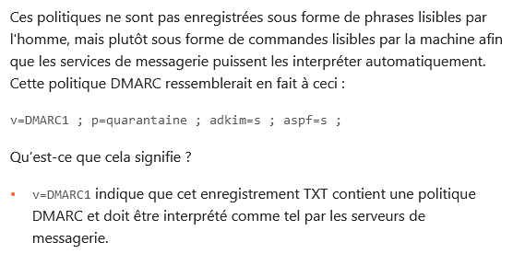
DMARC configurations en français dans le texte
v=DMARC1;p=quarantaine;pct=10
v=DMARC1;p=rejet;sp=rejet;adkim=s;aspf=s
v=DMARC1;p=aucun;sp=aucun;adkim=r;aspf=r;pct=100;fo=0;
rf=afrf;ri=86400;rua=mailto:dmarc@mailinblue.com!10m;
ruf=mailto:dmarc@mailinblue.com!10m

Slide 12
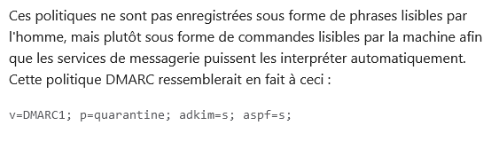
Fortunately, there tutorials do get fixed
Before (June 2023)
After (June 2024)

Slide 13
Joyriding with parked domains
Phishing e-mails spoofing someone else’s parked domains? Yes, it happens!
Their SPF: v=spf1 -all
But no DMARC record…
Owners of parked domains don’t always control the zone file contents.
Do you have parked domains?
Be sure to publish both a “null SPF” and a DMARC p=reject policy
(if you can)

Slide 14
Thanks!
Marc van der Wal
E-mail: marc.vanderwal@afnic.fr

