Slide 1
Submarine fiber-optic cable connections in the Baltic Sea vulnerabilities and threats
CDR (retired) Olli Peltonen | RIPE 90| 15.5.2025

Slide 2
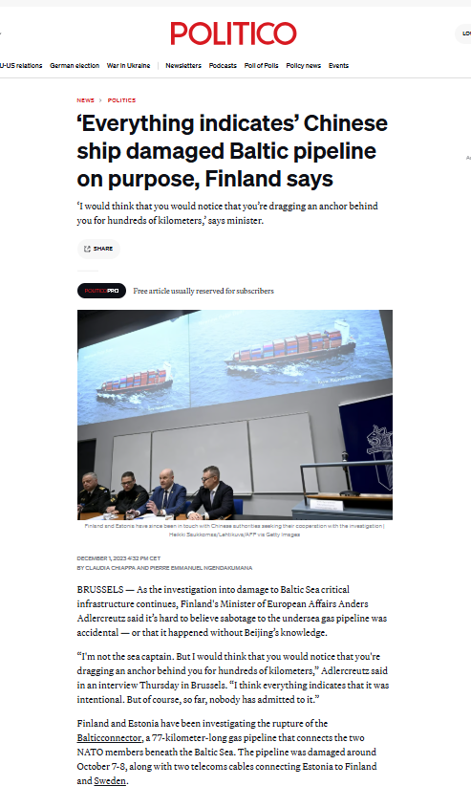
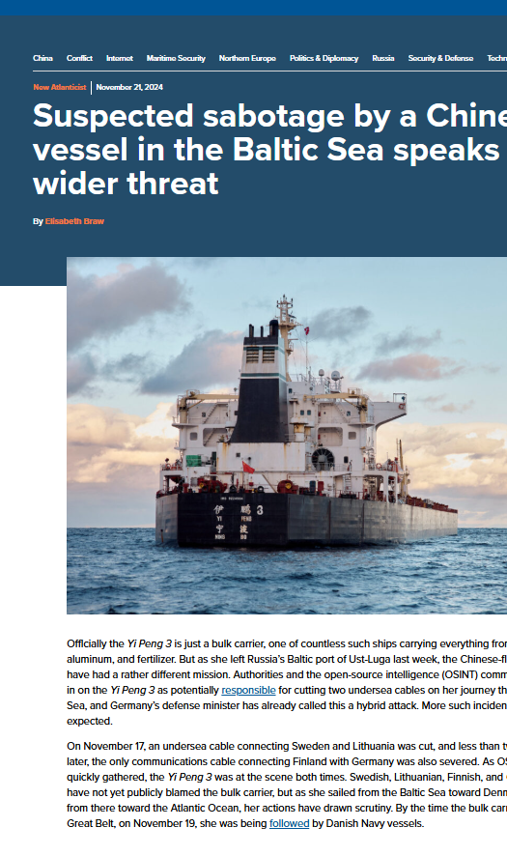
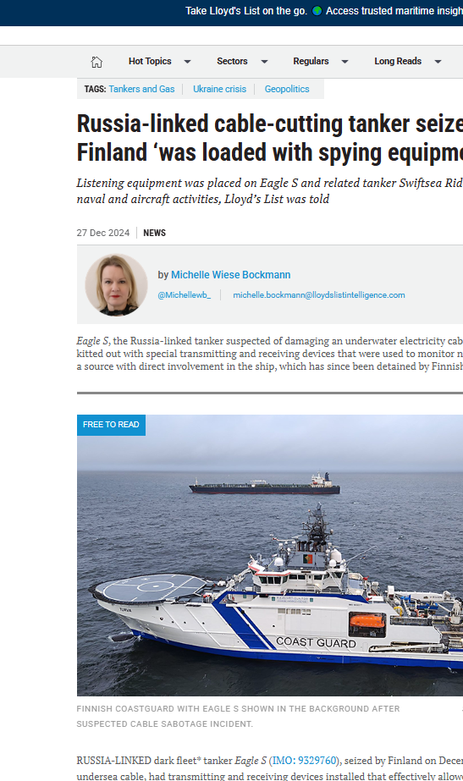
Cable sabotage in the Baltic Sea
Notes:
Let’s look closer at three widely reported incidents that have occurred in the northern Baltic Sea over the past two years.
On the night of October 7-8, 2023, the Hong Kong vessel Newnew Polar Bear dragged its anchor in the Gulf of Finland for more than 185 kilometers. The anchor broke loose after colliding with the Balticconnector gas pipeline, which runs between Finland and Estonia. This incident also damaged the undersea communication cable linking Finland and Estonia. Additionally, on the afternoon of October 7, damage was reported to the EE–S1 telecommunications cable located about 50 kilometers west of Hiiumaa, which connects Estonia and Sweden. Furthermore, the Russian Baltika submarine cable, running from the Leningrad region to Kaliningrad, was reported to have been damaged 28 kilometers from the Balticconnector gas pipeline's damage site.
On November 17, 2024, the Chinese dry cargo vessel Yi Peng 3 damaged a submarine cable owned by Arelion, which connects Sweden and Lithuania. The following day, on November 18, the C-Lion1 cable, owned by Cinia and linking Finland to Germany, was also damaged.
On December 25, 2024, the oil tanker Eagle S, owned by a UAE company and flying the flag of the Cook Islands, cut the Estlink 2 power cable and four communication cables at the Gulf of Finland, including Cinia’s C-Lion1 (again).
Experts widely agree that these actions can only be part of Russian hybrid influence strategies, and it is anticipated that we may encounter more attempts to disrupt telecommunications connections in the future.
Hybrid influencing operates in a grey area between war and peace, and these activities are typically carried out as covert operations. Marine fiber optic cables represent critical infrastructure and can also be targeted in military operations, including first strikes of the war.

Slide 3
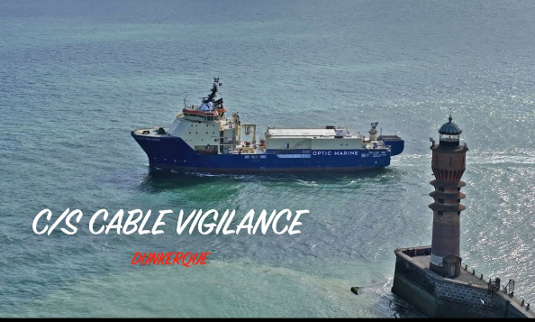
The first three cables cut by the Eagle S took about 2 weeks to repair
Copoy Oy
Consultation & Advisory
Notes:
In the most recent case, on December 25th, the Eagle S cut four telecommunications cables in the Gulf of Finland. Repairs for two of Elisa's cables were completed on January 6, and Cinia´s C-Lion1 was repaired the following day.
Cinia stated, "The repair was completed faster than initially estimated, despite the need for special equipment to be brought in from outside the Baltic Sea”. The repair vessel Cable Vigilance was in France when it was alerted to cable repair.
Most of the time required for repairs is spent moving vessels and spare parts to the damaged area. Based on the Eagle S incident, it can be concluded that the repair of the first submarine fibre optic cables takes about two weeks from the moment of damage.

Slide 4
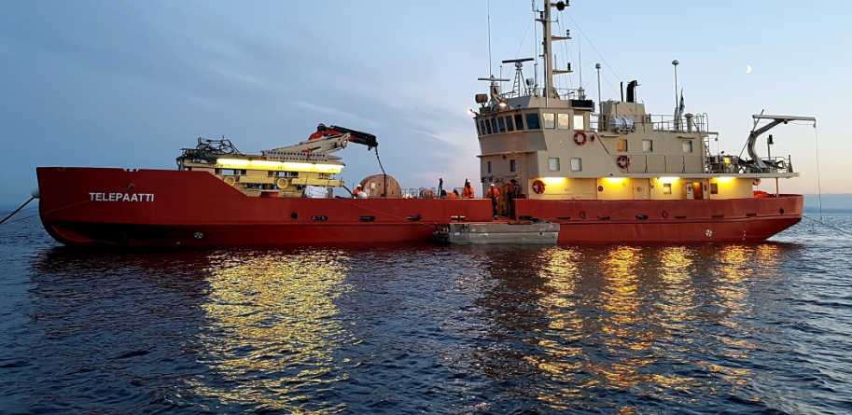
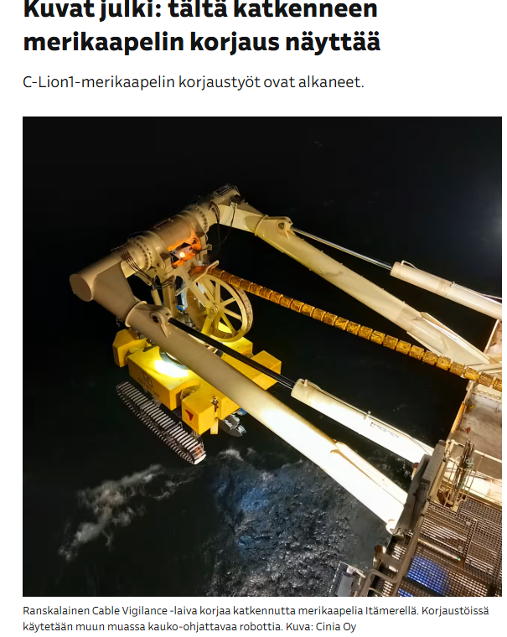
There are a few cable ships available
Simultaneous repair of several submarine cables causes a resource bottleneck for submarine cable owners
Notes:
In all those incidents I mentioned, the cable owners have used cable ships to repair the damage.
There are very few cable-laying vessels available; for instance, Finland has only one vessel dedicated to cable laying and repairs. The Telepaatti, which was responsible for repairing the cables between Finland and Estonia that were damaged by the Eagle S, primarily lays and repairs submarine cables along the Finnish coast, in the archipelago, and also in the lake regions.
When multiple submarine cables are cut and require simultaneous repairs, it creates a resource bottleneck for cable owners. For example, Cinia has contracted a French shipping company to repair the damaged C-Lion1 cable, which connects Finland and Germany.
To enhance cable repair capacity, it may be beneficial to acquire equipment specifically designed for repairing submarine cables, such as the robot shown in the picture on the right-hand side, onboard “Cable Vigilance”.
This type of equipment can be installed on multipurpose vessels, such as icebreakers, which can then be utilized as cable repair platforms when needed.

Slide 5
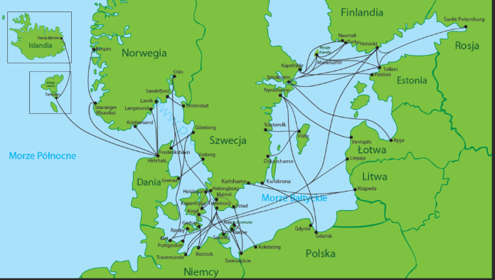
The location information of submarine cables is public
Notes:
Network reliability hinges on redundancy and the avoidance of single points of failure. The situation in the Baltic Sea has notably improved in recent decades, resulting in several mutually supportive connections. The assumption is that it’s normally unlikely that all connections will be down simultaneously.
In the Eagle S case, a vessel’s anchor severed four submarine fiber optic cables, including the C-Lion1 cable, which connects Finland and Germany. Although this incident caused some latency, services in Finland continued to function normally.
Finnish operators have been diligent in ensuring that undersea connections effectively support redundancy among themselves. In extreme situations, services can be maintained with just a few functioning offshore fiber optic cable connections.
However, by cutting off a sufficient number of telecommunications connections, a European country could be isolated from the rest of the continent for a considerable period.
The rough location information of submarine cables is publicly available. These images have appeared in newspapers. It can be assumed that professional intelligence organizations that are willing to target submarine cable connections possess detailed information about their routes.
We should also be prepared for such an unlikely scenario in which all connections are out of order.

Slide 6
The services rely on the internet – the internet relies on submarine connections
Copoy Oy
Consultation & Advisory
A significant part of cloud services and their service components are produced from data centres located at the end of submarine cable connections Even when services are provided from a nearby data center, much of the traffic is routed through Europe, often from countries like Germany or Ireland, as well as the United States Disrupting connections can have a significant impact on society and the everyday lives of citizens
Notes:
After rapid digitalization, the services entirely rely on the internet's functioning.
A significant portion of cloud services is still operated or managed from data centers located overseas. The complexity and interdependence of the system grow uncontrollably with the introduction of new services, ultimately making submarine cable connections a critical part of the infrastructure. Even when services are provided from a nearby data center, much of the traffic is routed through Europe, often from countries like Germany or Ireland, as well as the United States.
Disruptions to overseas connections can significantly impact the daily lives of citizens. If one of the services within a service package fails (like identification) and there is no routable connection to the overseas servers, many related services may cease to operate. For example, stores often cannot function without bank connections, effectively shutting down their cash registers until the connection is restored.
A service interruption lasting several days, or even two weeks, can have severe consequences. In modern society, there is no viable alternative to digital services.

Slide 7
Summary
Copoy Oy
Consultation & Advisory
Cable damage in the Baltic Sea is deliberately caused by hybrid influence We have to be prepared also for the worst-case scenario Operators and service providers should take a comprehensive look at end-user services and consider how we can improve the production, management, and routing to verify the services in the European regions, also in times of crisis.
Notes:
Deliberate Hybrid Influence causes Cable Damage in the Baltic Sea, and we should prepare ourselves also for the worst-case scenario.
Large-scale disruptions to cable connections can have a profound impact on the daily lives of citizens.
By cutting off enough connections, a European country can temporarily be isolated from the rest of the continent.
Operators and service providers must consider the potential impact of the enemy on physical infrastructure when planning the production, management, and routing of services in Europe.
In such situations, it is crucial to practice response actions together in exercises.
Please consider the comprehensive development of production, routing, and management of services, also from a regional perspective, so that we can rely on these services in times of crisis.
Thank you.

Slide 8
Submarine fiber-optic cable connections in the Baltic Sea vulnerabilities and threats
CDR (retired) Olli Peltonen | RIPE 90 | 15.5.2025

