Slide 1
NRO NC
RIPE 90 BoF
Keeping Up With the Times: Updating ICP-2
12 May 2025
Notes:
‹#›
‹#›
‹#›

Slide 2
Overview
ICP-2 Review: Background, Process and Timeline
The Principles Consultation
Introducing the draft “RIR Governance Document”
Open Discussion
‹#›

Slide 3
What is ICP-2?
Internet Coordination Policy 2
Document that provides criteria for recognizing new RIRs
Examples
Sufficiently large proposed service region
Support of local numbering community
Technical capability
https://www.icann.org/resources/pages/new-rirs-criteria-2012-02-25-en
‹#›

Slide 4
ICP-2 Timeline
(New RIRs under ICP-2)
1992 |  | RIPE NCC established
1993 |  | APNIC established
1997 |  | ARIN established
1998 |  | ICANN established
2001 |  | ICANN adopted ICP-2
2002 |  | LACNIC established
2005 |  | AfriNIC established
‹#›

Slide 5
Why revisit ICP-2?
ICP-2 is nearly 25 years old
The Internet has changed over the last quarter century
The relationships between RIRs and ICANN and between each other have changed
Need to more explicitly provide for
An RIR’s ongoing responsibilities
Potential de-recognition of an RIR that can no longer adequately provide for the needs of its numbering community
‹#›
‹#›
Notes:
‹#›
‹#›

Slide 6
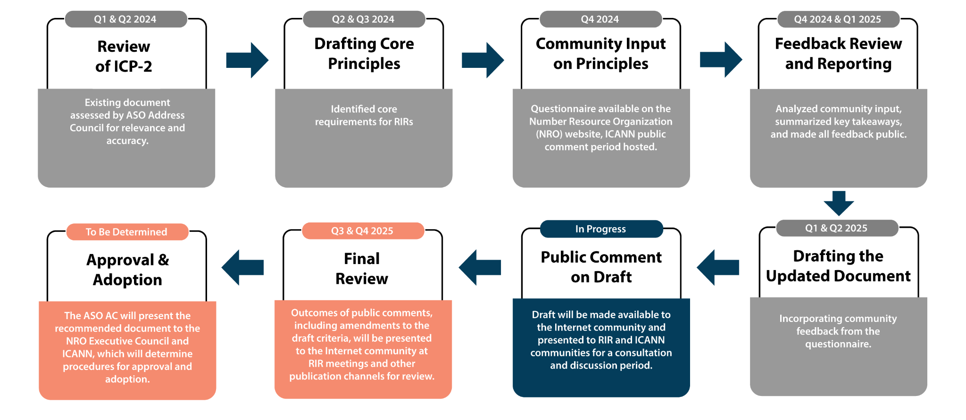
ICP-2 Review Timeline
‹#›

Slide 7
Proposed Principles to Update ICP-2
(completed)
‹#›
‹#›
Notes:
‹#›
‹#›

Slide 8
Core Principles and Consultation
The ASO AC drafted proposed principles that would form the basis of updating ICP-2. The principles were shared with the RIR and ICANN communities for feedback from 8 October to 6 December 2024.
ICANN Public Comment: 14 responses received
RIR Questionnaire: 298 responses received
The responses were analysed, and a summary report of the RIR Questionnaire was published in February 2025. Input from both processes was used to inform the drafting of the document.
‹#›

Slide 9
ICP-2 Principles Consultation Report
https://www.nro.net/policy/internet-coordination-policy-2/icp-2-principles-questionnaire-report-and-data/
‹#›
‹#›
Notes:
‹#›
‹#›

Slide 10
‹#›

Slide 11
Incorporating Community Feedback
All the comments received were reviewed and categorised:
Did they pertain to the principle itself, the phrasing of the principle or the future implementation of the principle?
The comments were clustered around the main issues they addressed e.g. the role that ICANN plays, concerns about due process, need to rehabilitate an RIR prior to a possible derecognition
These concerns were summarised and added to a working sheet:
The NRO NC discussed the concerns raised
Depending on the feedback, we decided whether it was within scope and if we wanted to address it in the draft “RIR Governance Document”

Slide 12
How We Used Community Feedback in the Draft
Clarified the role of the community - an RIR decision implies a corresponding process that is necessary according to the RIR governance model
Addressed procedural concerns about the recognition and derecognition procedures- added a provision for appeal and ICANN’s review process respectively.
Aligned the requirements with common privacy and corporate governance requirements
Elaborated where necessary to address questions about the principles
Input focused on implementation of the principles will be considered when developing implementation procedures.

Slide 13
Introducing the Draft “RIR Governance Document”
Governance Document for the Recognition, Maintenance, and Derecognition of Regional Internet Registries

Slide 14
Draft “RIR Governance Document”
https://www.nro.net/policy/internet-coordination-policy-2/rir-governance-document/
‹#›
‹#›
Notes:
‹#›
‹#›

Slide 15
The draft “RIR Governance Document” represents a comprehensive update to ICP-2, introducing detailed governance structures, operational requirements, and procedures for the full lifecycle management of RIRs, all developed through extensive community consultation. The draft document:
Clarifies scope and lifecycle management
Formalises governance structures
Strengthens operational requirements
Clarifies roles, responsibilities, and procedures

Slide 16
Clarified Scope and Lifecycle Management
Original ICP-2 (2001): Focused primarily on the criteria for the establishment of new RIRs.
RIR Governance Document (2025): Clarifies the scope to encompass the entire lifecycle of RIRs, including:
• Recognition: Criteria and processes for recognizing new RIRs.
• Operation: Ongoing obligations and requirements for RIRs to maintain recognition.
• Derecognition: Establishes procedures for the potential derecognition of RIRs that fail to meet specified criteria.

Slide 17
Formalisation of Governance Structures
Original ICP-2: Outlined principles such as neutrality, impartiality, and bottom-up policy development but lacked detailed governance structures.
RIR Governance Document: Introduces more detailed governance requirements, including:
• Member-Controlled Governance: Majority of an RIR’s governing body must be elected by its members.
• Corporate Governance: Requires RIRs to adhere to good corporate governance procedures.
• Anti-Capture Measures: Requires RIRs to implement controls to prevent any single entity or group from gaining undue influence over an RIR.

Slide 18
Strengthened Operational Requirements
Original ICP-2: Emphasized technical capabilities and the provision of registration services.
RIR Governance Document: Expands operational expectations to include:
• Audit Obligations: RIRs must undergo regular audits by external and independent auditors to ensure compliance.
• Transparency: Requires comprehensive public documentation of governance, activities, and finances.
• Continuity Planning: Mandates procedures and redundancies to ensure service continuity, including the ability for another RIR to assume services if necessary.

Slide 19
Clarification of Roles, Responsibilities, and Procedures
Original ICP-2: Provided general guidelines while only implying the roles of various organisations.
RIR Governance Document: Clearly delineates responsibilities:
• RIRs: Must initially approve any proposal to recognise or derecognise an RIR.
• ICANN: Exercises final authority to approve or reject proposals, following consultation with RIRs.
• Procedures: Specifies procedures and approval thresholds for proposals.

Slide 20
Guidance for Feedback
Please share feedback that is specific to this draft
We are particularly interested in hearing your views on the new requirements in the draft
Whether the draft provides sufficient clarity regarding the ongoing obligations of an RIR and the remediation steps if the obligations are not met
This document does not address the implementation of the RIR criteria; comments on implementation will be considered out of scope
Constructive comments are highly appreciated
‹#›
‹#›
Notes:
‹#›
‹#›

Slide 21
ICP-2 Review Timeline (reminder)
The Draft “RIR Governance Document” Consultation
14 April 2025 |  | Draft “RIR RIR Governance Document” published RIR consultations in each region and ICANN Public Comment proceeding launched
27 May 2025 |  | Public consultation closes
9-12 June 2025 |  | ASO AC will review feedback received
September 2025 |  | The revised “RIR Governance” document will be published
Q4 2025 |  | Final review and revision of updated document Begin NRO and ICANN approval and adoption process
‹#›

Slide 22
Open Discussion
‹#›

