Slide 1
Important News
Leo Vegoda
leo@peeringdb.com

Slide 2
Agenda
Organization and board election update
2024 new feature highlights
2025 development focus and roadmap

Slide 3
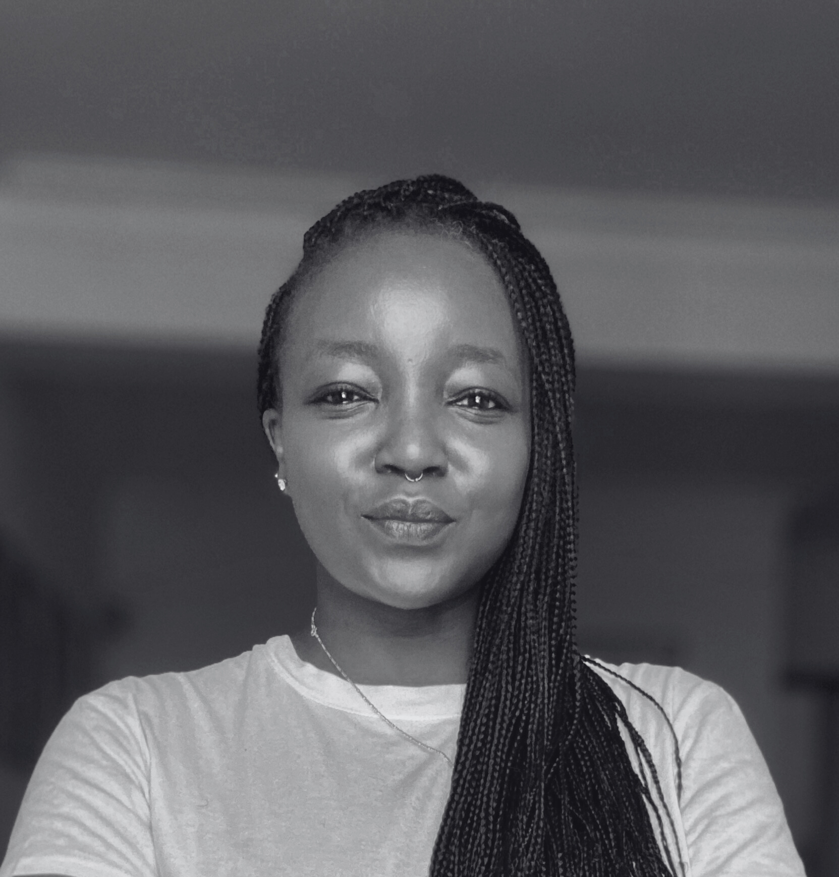
Board of Directors and Officers
Shawna Bong – Secretary and Treasurer (Officer) | Aaron Hughes – Vice President (Term Expires 2026) | Isabel Odida– Director (Term Expires 2027)
Alex Corso – Director (Term Expires 2027) | Livio Morina – Director (Term Expires 2027) | Job Snijders – Director (Term Expires 2026)

Slide 4
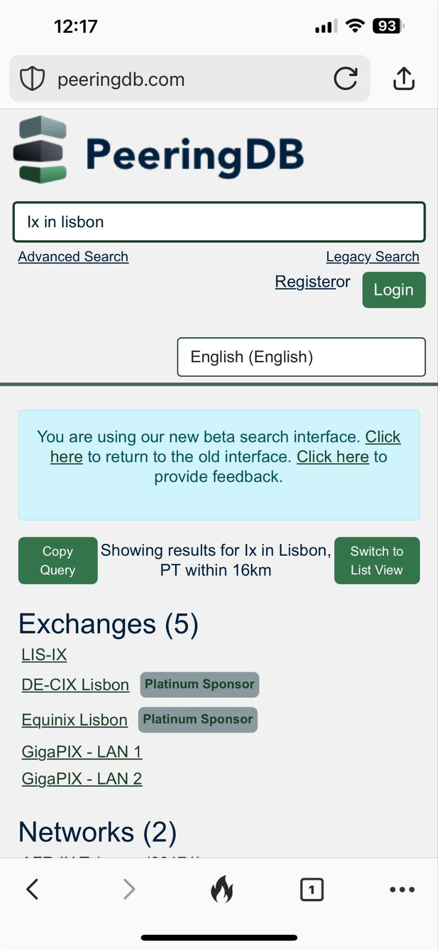
Search and data quality
Search and data quality are most important to users
Reclaimed ASNs are automatically removed
v2 search
Significant improvements, will replace legacy v1 search
HOWTO: v2 Search (https://docs.peeringdb.com/howto/v2_search/)
Anonymous search will not go away
Chose how results are displayed
Get API query formatted for several languages

Slide 5
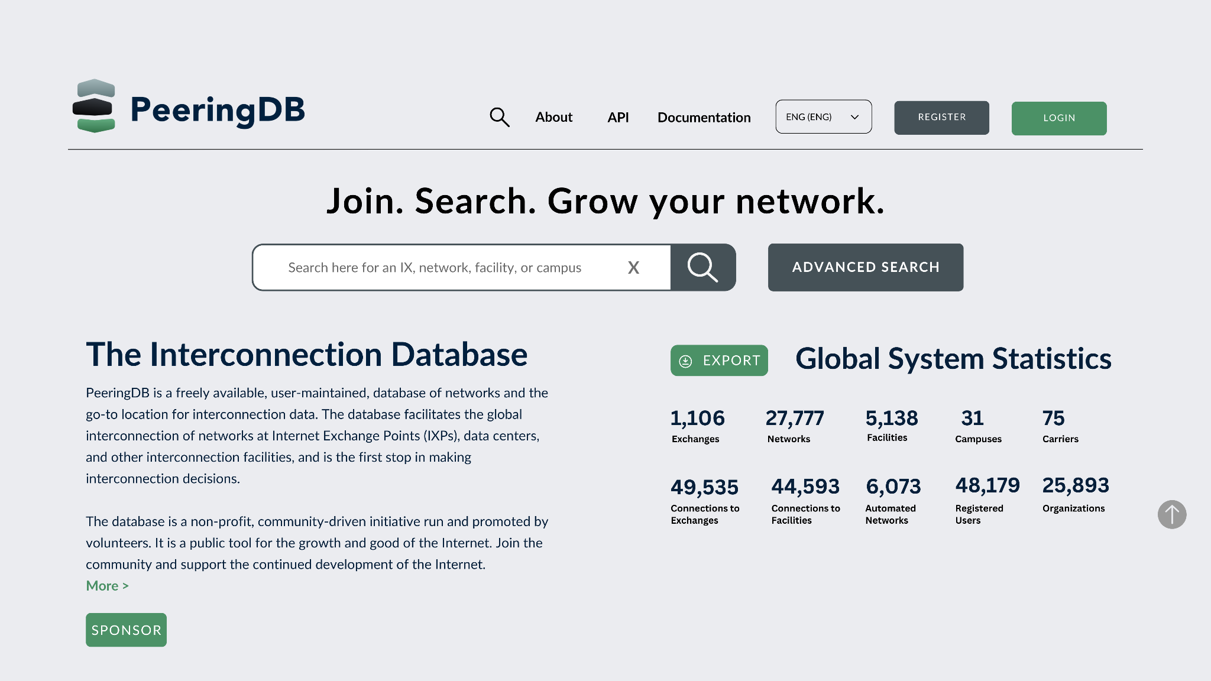
Upcoming webUI changes
We adjusted our web UI rollout process based on feedback
We previewed the new UI on separate site but got no feedback, so are doing a phased rollout:
PeeringDB volunteers
20% of users
Everyone
Users will get an “opt-out” switch in their profile and be encouraged to share feedback on what to adjust

Slide 6
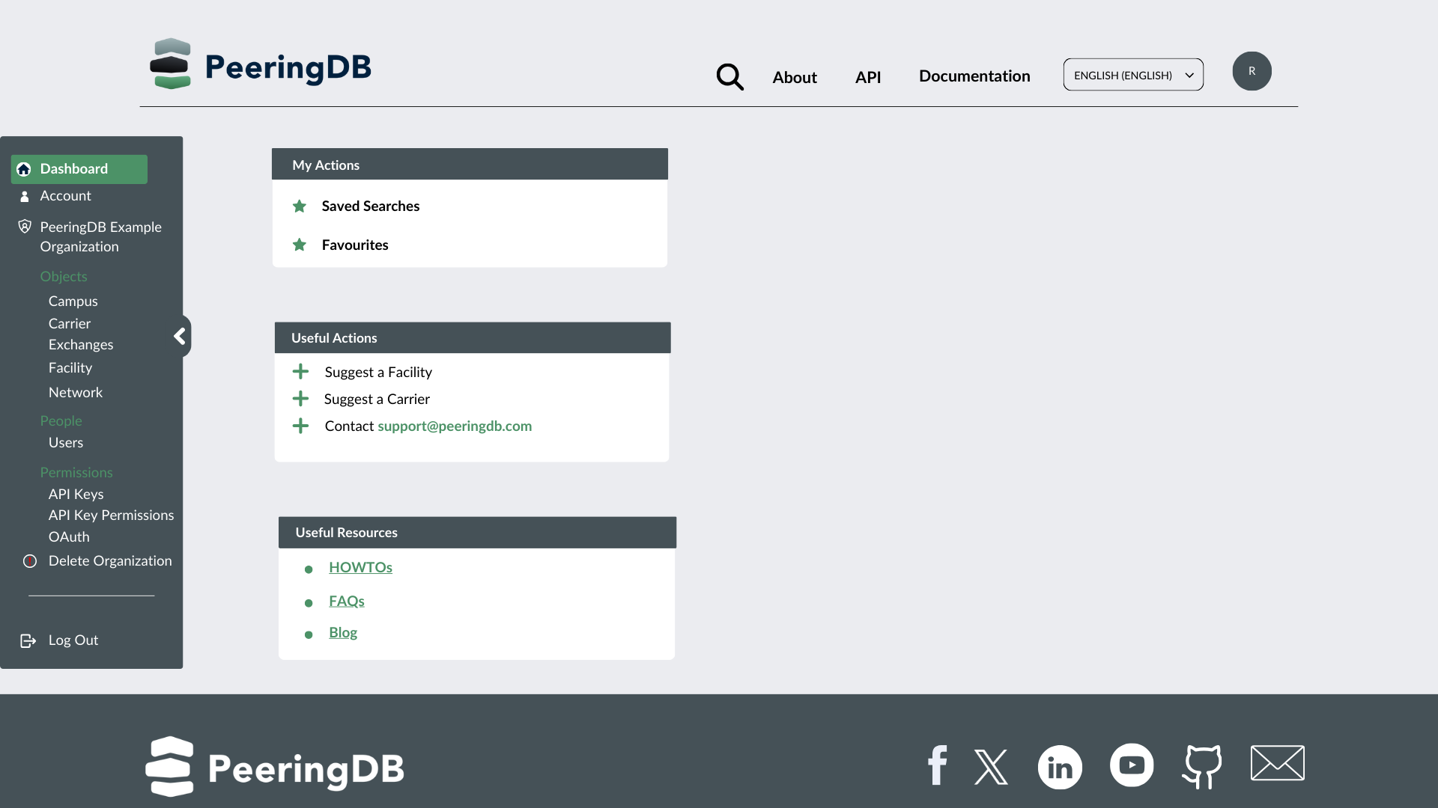
“Planned” status and notifications
We’re discussing (#1736) adding a “planned” status with a date
It would integrate with notifications
You could share a planned operational date for any object type
Others could be notified of plans they are interested in

Slide 7
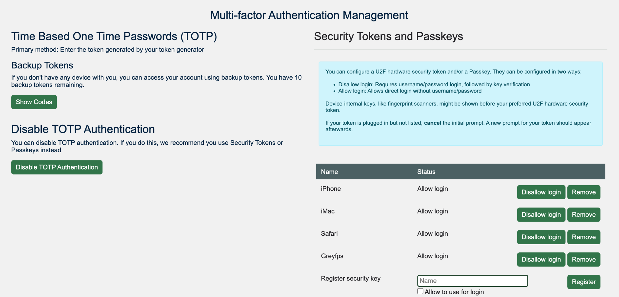
Mandatory MFA starts in July
You must use MFA to authenticate from 1 July 2025
Choices
API Keys
Email
Passkeys
TOTP
U2F hardware tokens
HOWTO Authenticate
Anonymous access is not going away

Slide 8
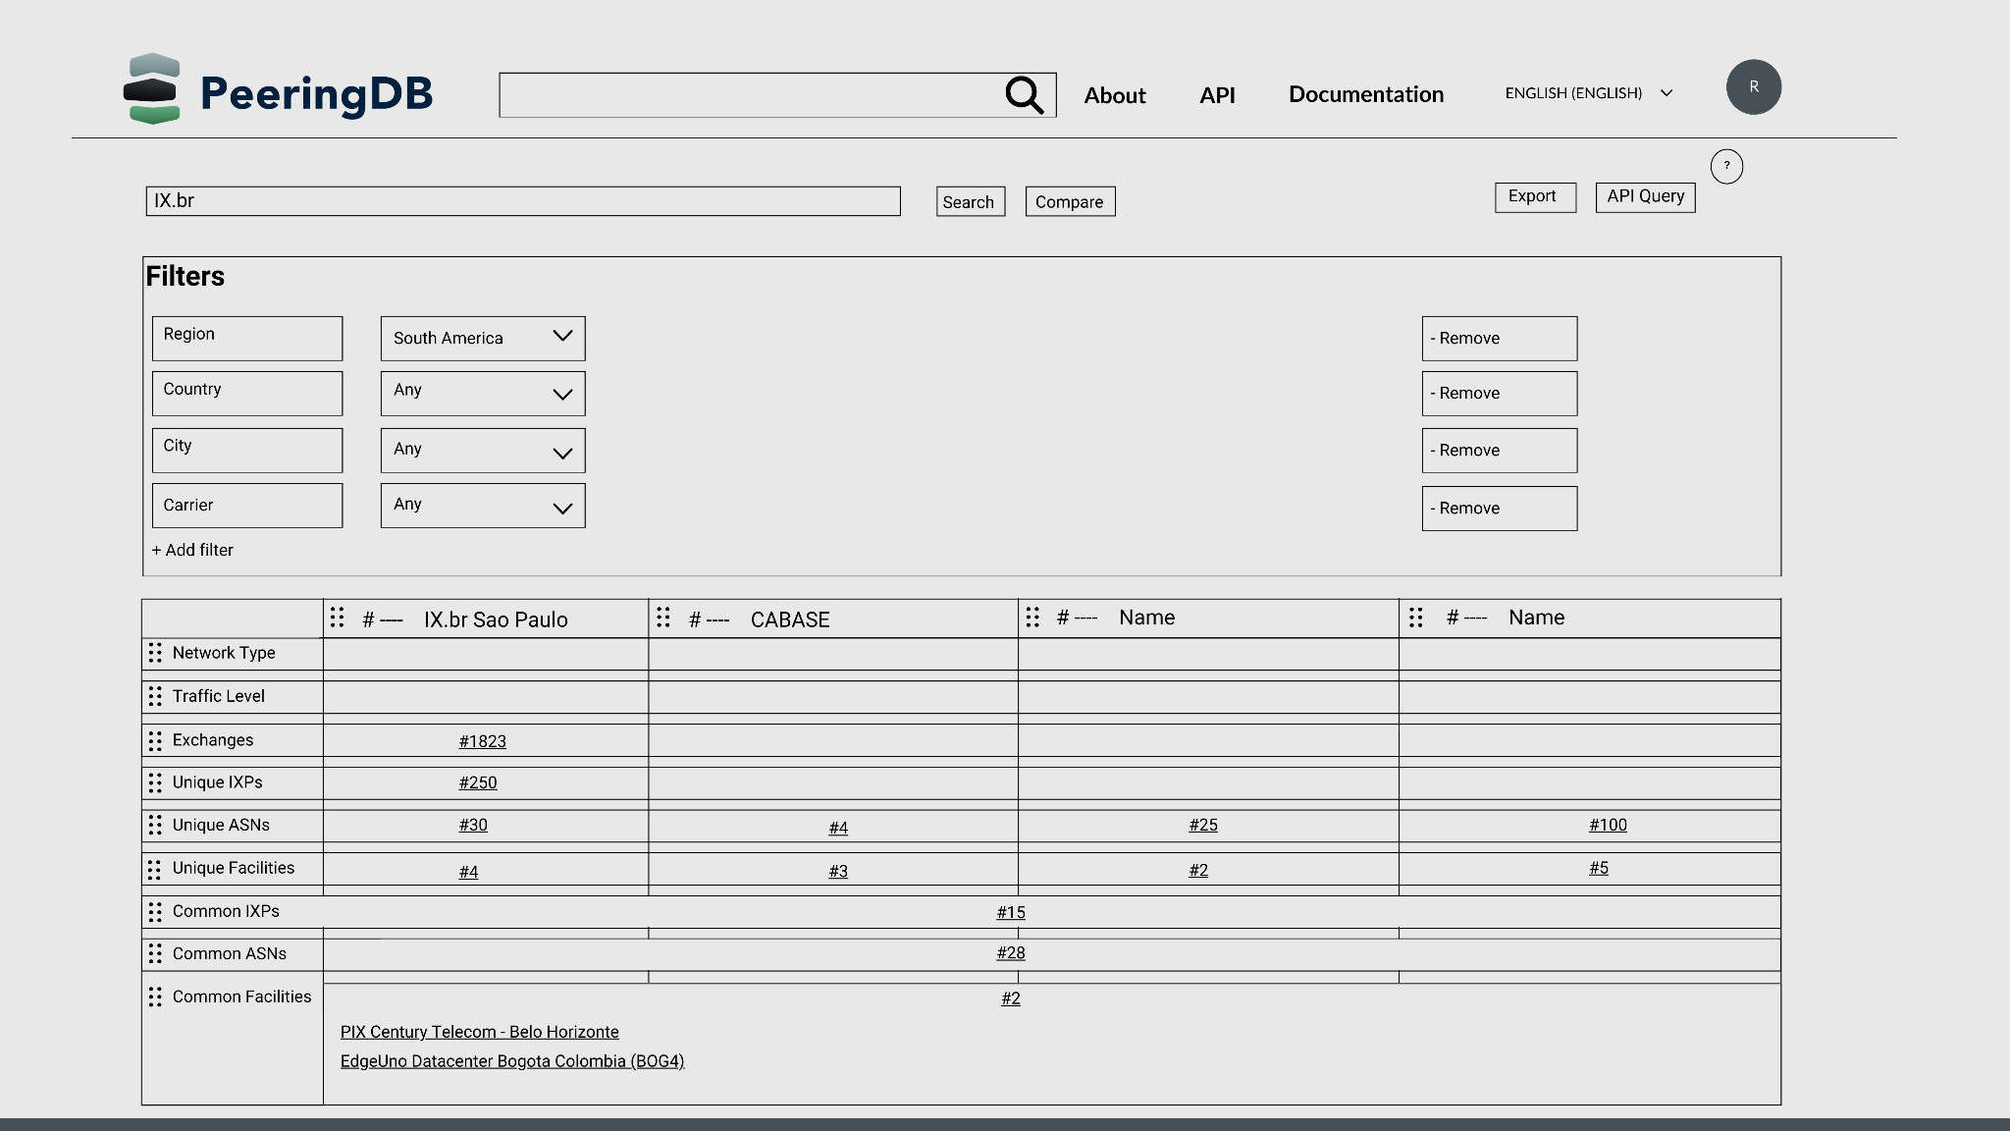
2025 Roadmap: Interconnection Analysis
Adding a web tool to help users compare interconnection opportunities at facilities
Add ASNs, add locations, view and export results

Slide 9
Thank you to our sponsors!
Diamond Sponsor
Platinum Sponsors
Gold Sponsors
Silver Sponsors
Notes:
Logo height proportions: 100%, 85%, 65%, 40%

Slide 10
Questions?

