Slide 1
Multi-stakeholder Forum on Internet Standards Deployment
Draft concept
Martin Rüdiger, DG CNECT
Goran Milenkovic, DG JRC
European Commission
RIPE90
15-May-2025
Lisbon, Portugal

Slide 2
Regulatory Background

Slide 3
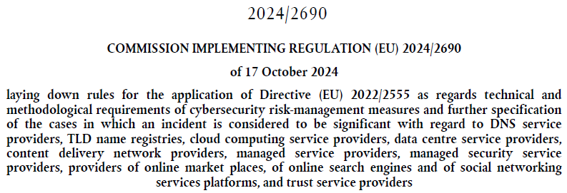
NIS2 Implementing Act (IA)
NIS2

Slide 4
Requirements
. . .

Slide 5
Recital 8

Slide 6
Objectives, tasks and outputs

Slide 7
Objectives
Key objective - guidance for relevant entities on:
best available standards, best practices
corresponding deployment techniques
optimal timeframes
Other objectives:
Contribution to achieving a high common level of cybersecurity
Fostering cooperation and collaboration
Acceleration of the deployment, broader value

Slide 8
Tasks and outputs
Tasks:
Define and agree on the rules of engagement
Identify best available standards and practices in each of the areas
Identify and analyse key challenges and recommend options for addressing them
Identify, collect, analyse and develop best deployment techniques
Identify the optimal deployment timeframes for each category, considering all the relevant variables
Develop a set of guidelines containing deployment considerations and implementation roadmap
Outputs:
Guidelines:
Network layer comm. protocols
Guidelines:
E-mail security protocols
Guidelines:
DNS security
Guidelines:
Internet routing sec. and hygiene

Slide 9
Membership, structure and organisation

Slide 10
Stakeholder Landscape
Potential members:
NIS2 stakeholders – relevant entities
EU Telcos
Equipment vendors
MESSEU
community
EUIBAs and national public administration entities
RIPE community
ICAAN community
MANRS community
IETF community
…

Slide 11
Structure and organisation
Coordination Group
Forum chair
WS1:
Network layer comm. protocols
WS2:
E-mail security protocols
WS3:
DNS Security
WS4:
Internet Routing
WS1 chair(s)
WS2 chair(s)
WS3 chair(s)
WS4 chair(s)
TEG
TEG
TEG
TEG
Technical Editorial Group
Plenary meetings
WS meetings
Coordination group meetings
TEG working sessions
Collaboration platform

Slide 12
Planning and timelines

Slide 13
Indicative timelines
Meetings
Kick-off plenary
WS meeting 1
WS meeting 2
WS meeting 3
WS meeting 4
WS meeting 5
WS meeting 6
Closing plenary
A1
A2
Activities
A3
A4
A5
Q3 2025
Q4 2025
Q1 2026
Q2 2026
Q3 2026
Q4 2026
Q1 2027
Q2 2027
Milestones
M1: Forum established
M2: Draft guidelines
M3: Final guidelines
A1
Initiation – kick-off, establishment of WS and rules of procedures
A2
Identification of standards and best practices
A3
Analysis of implementation challenges and identification of deployment techniques
A4
Development of guidelines
A5
Consultations, finalization of the guidelines, closure

Slide 14
Thank you! Questions?
ruediger.martin@ec.europa.eu
goran.milenkovic@ec.europa.eu

