Slide 1
IPv6-mostly experiences at 2 industry events
Éric Vyncke, Distinguished Engineer, Global Technology Standards, Cisco
Warren Kumari, Director, Internet Standards, Google, IETF NOC member
Slide content by Joe Clarke, Cisco, Cisco Live & IETF NOC member
GenAI graphics by Gemini

Slide 2
IPv6-mostly ?
In IPv6-Mostly networks, 2 classes of hosts
IPv6-Only capable: do not use IPV4 at all
Not capable: use dual-stack or IPv4-only
Goal:
Foster IPv6 adoption
Lower IPv4 address consumption
Until 100% are IPv6-only capable

Slide 3
IPv6-Mostly in 1 Slide
IPv6-only capable hosts
Rely on client-level address translation (CLAT), IPv6 prefix from the PREF64 RA to do translation of IPv4 addresses to v6
Decline to request IPv4 address if DHCPv4 server replies to DHCPv4 option 108 RFC 8925 “IPv6-Only Preferred Option for DHCPv4”
https://datatracker.ietf.org/doc/draft-ietf-v6ops-6mops/ by Nick Buraglio , Ondřej Caletka , Jen Linkova
Notes:
Nick Buraglio , Ondřej Caletka , Jen Linkova

Slide 4
The Explorers
Several other explorers of this route
Jen Linkova @ Google
Ondřej Caletka for RIPE network since RIPE-85 October 2022 !
David Stockdale, Imperial College London with 20.000 students, see https://www.ipv6.org.uk/wp-content/uploads/2024/10/08_IPv6-Mostly_at_Imperial.pdf

Slide 5
Cisco Live
Amsterdam, February 2025
20.000 attendees
Technical sessions and exhibition by Cisco for its customers
Cisco NOC has months to prepare and do very careful planning (including contingency plans)
Default SSID was IPv6-mostly
Public IPv6 space, private IPv4

Slide 7
Edge Design
2x ASR 1002-HX for NAT44 and Native IPv6
2x ASR 1002-HX for NAT64 only
/26 of V4 public per NAT pool
Each unit BGP peered to Venue
1x 10Gb/s connectivity to Venue
2x 40Gb/s to core

Slide 8
NAT64 Design
Aspiring for 100% IPv6 inside the network
Legacy
Internet
NAT64 Translator
ASR-1002HX
DNS64
Umbrella virtual appliances
CLAT & DHCP Option 108
IPv4 Traffic
83.97.13.0/24
IPv6 Traffic
64:ff9b::/96

Slide 9
NAT64 More Popular than Expected Segmenting your IPv4 space between NAT44 and NAT64 is tricky
Didn’t really know how popular NAT64 would be over NAT44 edge.
Ultimately, not enough addresses in NAT64 pool and too many in NAT44
Changed translation expiry timers to resolve, added more IP’s out of hours.
Additionally, some split tunnel VPNs policies didn’t like CLAT

Slide 10
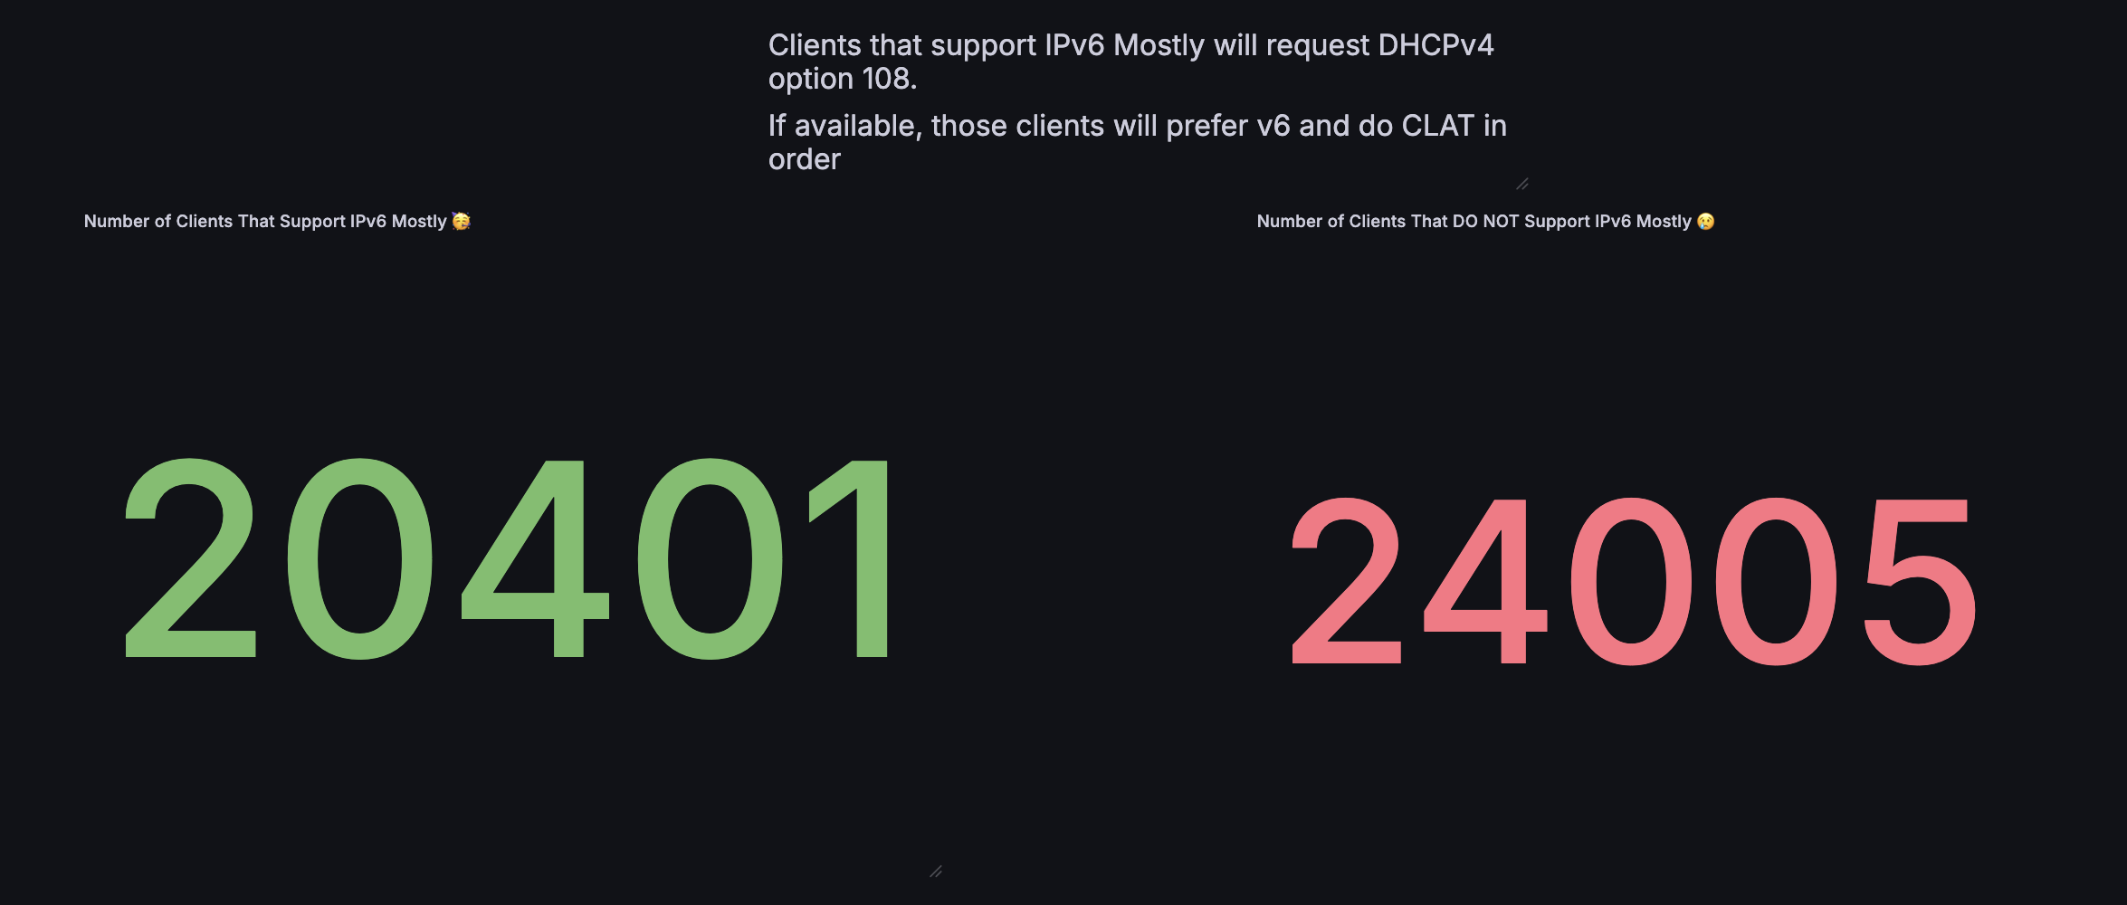
Main SSID v6 Mostly Support

Slide 12
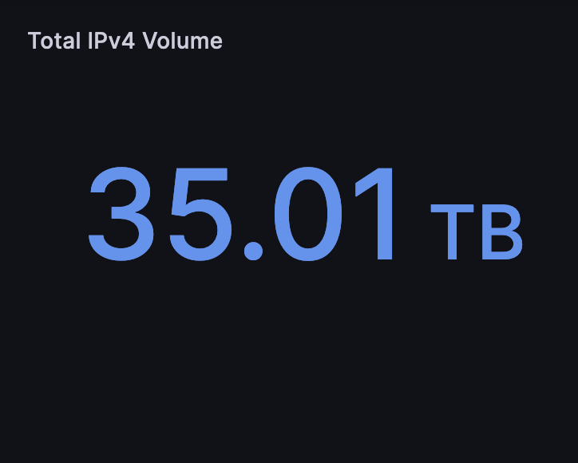
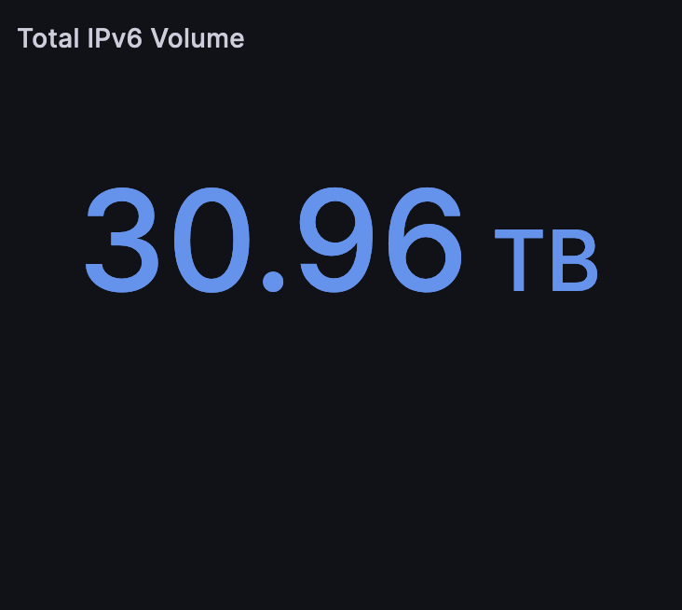
44.2%
2024

Slide 13
Total Traffic To The Internet…
20,000 attendees over five days

Slide 14
IETF 122
Bangkok, March 2025
764 onsite registered participants
Typical geek audience
Default SSID is dual-stack
Plan for IETF-123 IPv6-Mostly ;-)
”ietf-ipv6-mostly” widely advertised and used by many
Public IPv4 and IPv6 space

Slide 15
Ipv6-mostly Components

Slide 16
All Was Good for MacOS and phones, but...

Slide 19
Real Life Experiment With Engineers
Discovery: MacOS SSH forced to an IPv4 host address. This didn’t work. But Tommy Pauly @ Apple was told and hacked up a fix while at the meeting ☺
“Great environment to deploy such features because when things go wrong, the right people are in the room to fix the problems !” (Quote: Joe Clarke, IETF NOC)

Slide 20
IPv6-Mostly Summary
If you pay attention, it is not hard at all
Network operations and debugging are different => ! Learning curve
Issues & limitations:
Split-tunnel VPN (esp. MacOS)
Slack weirdness
Some corporate MDM (for DNS64)
Microsoft Windows current lack of support for CLAT & RFC 8925 are still dual-stack hosts
Notes:
(

