Slide 1
Building a Secure Test Environment for an IXP
Marta Burocchi - Network Engineer
RIPE90 - Lisbon

Slide 2
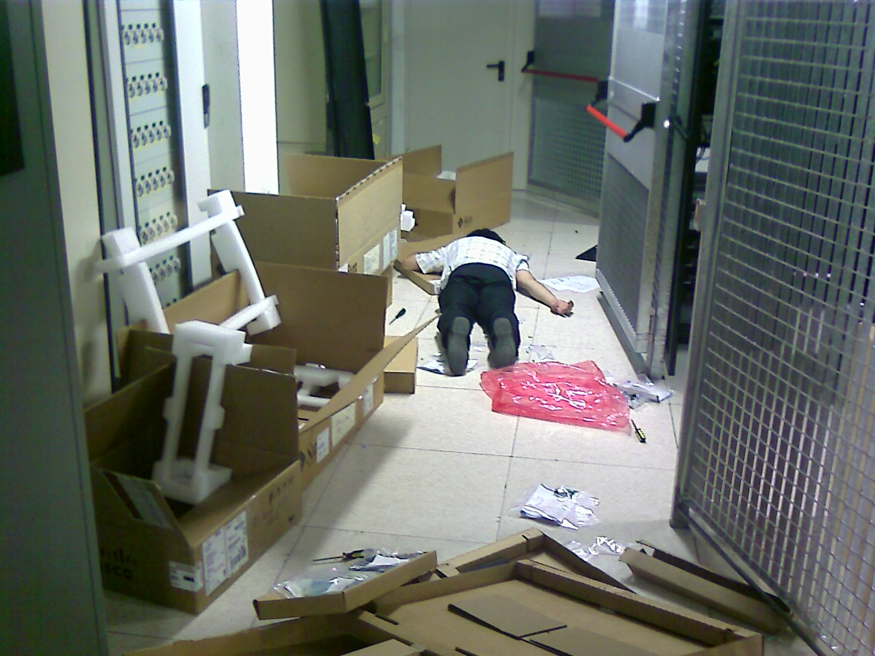
Do you know when you make a small change
in the production configuration...
…and everything breaks?
*Please note this is a real life Namex picture
- courtesy of Francesco Ferreri / Namex Archives

Slide 3
The Idea
The idea comes from a very practical need

Slide 4
The Idea
The idea comes from a very practical need
Create a secure, live pre-production environment that mirrors the real peering LAN:
To validate members’ configurations
To test our services before deploying them to production

Slide 5
The Evolution of The Idea
Namex needs a test environment

Slide 6
The Evolution of The Idea
Namex needs a test environment
The collaboration with Kathara’s Team starts

Slide 7
The Evolution of The Idea
Namex needs a test environment
The collaboration with Kathara’s Team starts
🎀 Namex Digital Twin is born: a faithful replica of the Namex Peering LAN and services 🎀

Slide 8
Fun Fact
If you google Kathara and you choose “images”...

Slide 9
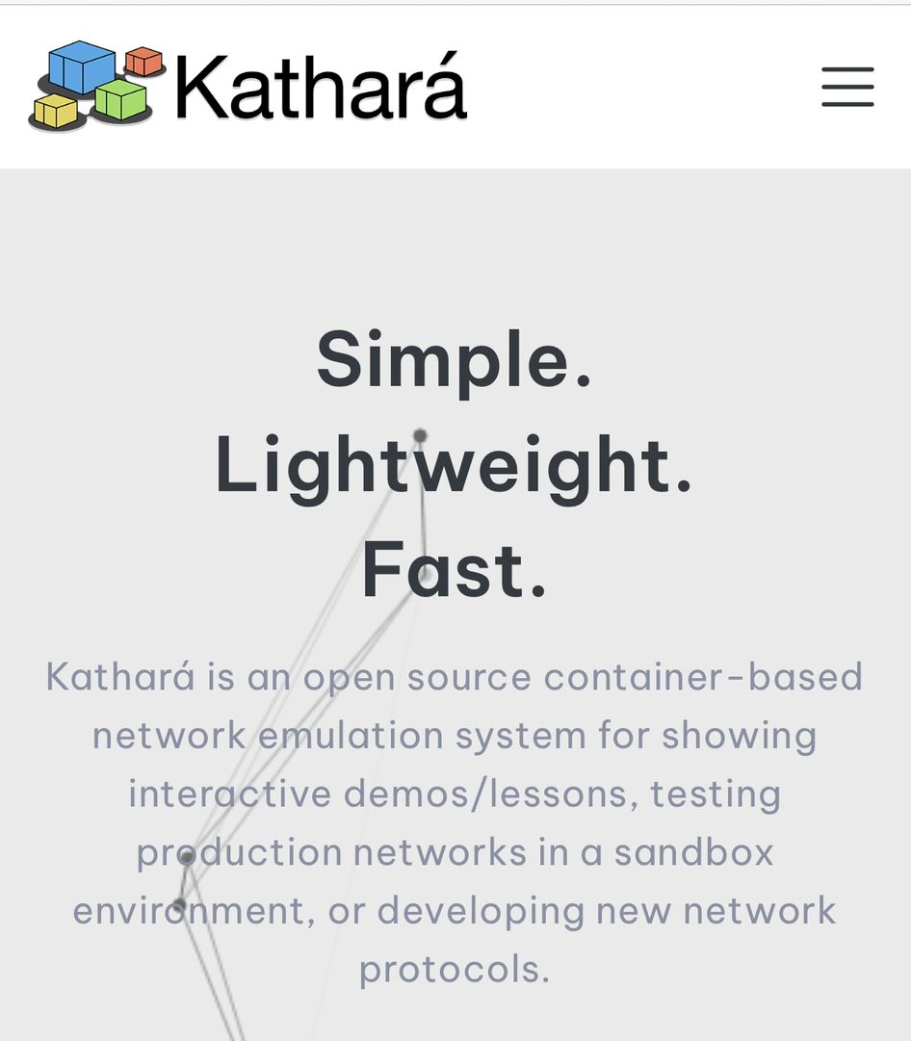
Fun Fact
If you google Kathara and you choose “images”...

Slide 10
Namex Digital Twin
What? A faithful replica of the Namex Peering LAN with the same members, Route Servers, IP addressing and even MAC addresses
How? Members and Route Servers from the Peering LAN are emulated as dedicated Kathará devices
Where? On a pre-production environment (quarantine VLAN)

Slide 11
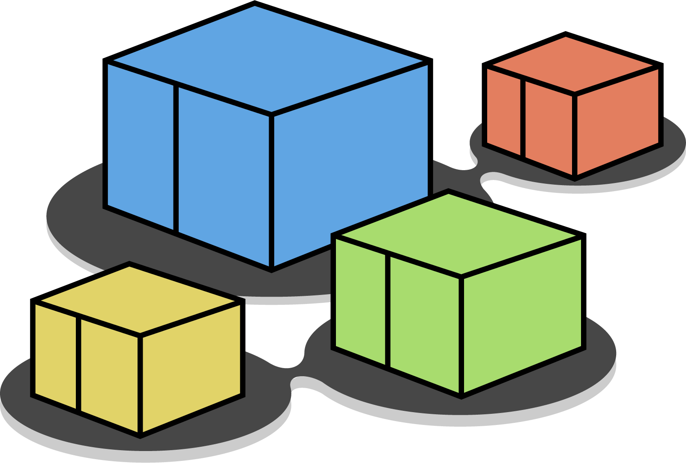
The Architecture
Container Engine
Kathará
Digital Twin Manager
Config Files
Namex Digital Twin

Slide 12
Digital Twin is a Snapshot of the Real LAN
The virtual environment is synchronized with the production network, using real-time data
List of all the peers on the Peering LAN
Dumps of the actual Route Servers’ RIBs (v4/v6)
Digital Twin Manager
Manages the lifecycle of the Digital Twin
Namex Digital Twin
Real Route Servers’ configuration files
Notes:
To keep our digital twin accurate it is synchronized with the production network

Slide 13
Digital Twin is a Snapshot of the Real LAN
The output is a faithful replica of the peering LAN
One Kathará device for each peer
One Kathará device for each Route Server
Digital Twin Manager
Manages the lifecycle of the Digital Twin
Namex Digital Twin
The virtual peering LAN
Notes:
To keep our digital twin accurate it is synchronized with the production network

Slide 14
Digital Twin: Use Cases
New members can connect their router to the quarantine VLAN and safely test and tune their BGP setup without affecting the production network
New members can use the Digital Twin to test their configurations according to the Route Servers’ policies in a safe sandbox
NOC can validate Route Servers’ configurations changes or new services before deploying them to the production environment
Notes:
Since it mirrors the real setup we can simulate how changes will behave in production

Slide 15
Extending the Digital Twin
The Digital Twin can be extended to support more features and use cases:
Quarantine Dashboard
RPKI Validation
ASPA Testing
Traffic Generation
ROSE-T (MANRS Compliance)
Quarantine Dashboard

Slide 16
Extending the Digital Twin
The Digital Twin can be extended to support more features and use cases:
Quarantine Dashboard
RPKI Validation
ASPA Testing
Traffic Generation
ROSE-T (MANRS Compliance)
Quarantine Dashboard

Slide 17
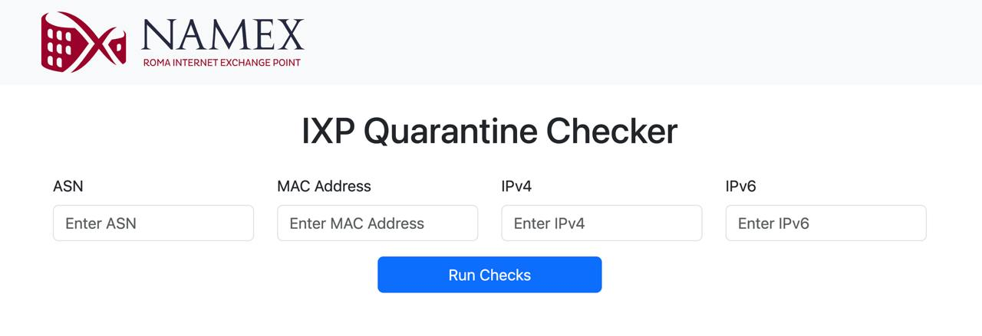
Quarantine Dashboard
New members can test their configuration compliance to our technical rules
Immediate feedback helps members fixing issues before going into the production network

Slide 18
Quarantine Dashboard Architecture
Kathará
Container Engine
Frontend Quarantine
Backend Quarantine
Digital Twin Manager
Namex Digital Twin
Config Files
Notes:
Backend che gestisce una parte dei controlli e affida agli altri componenti alcuni i test che non potrebbero essere eseguiti senza il digital twin

Slide 19
Checks Performed
Connectivity Tests (ping/ping6, MTU, proxy ARP)
BGP Checks (established sessions, prefix limit check, default route advertisement, private prefix advertisement, next hop validation, AS path consistency, announcement consistency)
Unauthorized Traffic Detection (neighbour discovery protocols, internal routing protocols, or router advertisements)
Security Tests (open ports for DNS, NTP, SNMP)
These checks confirm that configurations are correct when they are performed
Note that router configurations may change and unwanted traffic needs continuous monitoring
Notes:
Some of these tests — like basic connectivity or open port checks — could be performed without the Digital Twin. But others, such as realistic BGP behavior rely on it to reproduce‬ real-world conditions

Slide 20
Checks Performed: Connectivity Tests
ping/ping6: Tests basic connectivity using ICMP ping, ensuring that the peer can reach other devices on the network using IPv4/IPv6
Proxy ARP: Verifies that Proxy ARP is disabled on the interface to avoid unwanted routing of packets, ensuring that each peer handles only the traffic intended for them
MTU: Checks the MTU settings to make sure that packet sizes are correctly handled

Slide 21
Checks Performed: BGP Checks
Established Sessions: verify the BGP session between the peer and the Route Server is properly established
Prefix Limit Check: Ensure that the number of prefixes advertised by the peer does not exceed the allowed limit
Default Route Advertisement: Check if the peer is announcing a default route (0.0.0.0/0 for IPv4 or ::/0 for IPv6)
Private Prefix Advertisement: Verify that the peer is not announcing private prefixes that should not be routed through the IXP
Next Hop Validation: Ensure that the next hop of advertised prefixes corresponds to the peer's router IP, as assigned by the IXP
AS Path Consistency: Confirm that the AS-PATH of the prefixes they advertise starts with the ASN of the peer

Slide 22
Checks Performed: Unauthorized Traffic Detection and Security Tests
Unauthorized Traffic Detection: Monitor traffic for 1 minute to detect any unauthorized traffic types such as neighbour discovery protocols, internal routing protocols, or unsolicited router advertisements
Security Tests: are conducted to detect open ports for DNS, NTP, and SNMP

Slide 23
Digital Twin Scalability
Currently emulating:
~220 members
4 Route Servers (2 for IPv4, 2 for IPv6)
Hardware specs:
Memory: 32GiB
Processors: 4 cores
⚙️ Designed to scale with Namex’s growth
For large IXPs, the full network can be deployed using the distributed emulation feature supported by Kathará

Slide 24
Conclusions
The Digital Twin provides a secure and isolated testing ground to support the development of new services
The Quarantine Dashboard provides a sandbox to validate members’ compliance with technical rules and services in the onboarding phase
The Dashboard is just one of many applications we can imagine:
RPKI Validation, ASPA Testing, Traffic Generation, ROSE-T, etc.
You can read more about our experience on RIPE Labs
Notes:
digital twin è la base per costruire futuri servizi orientati all ambiente di preproduzione ISP (rpki, generazioni di traffico, RoseT, ASPA, blackhole community RS), IXP supporto al testing nello sviluppo di nuovi servizi dell IX la dashboard di quarantena è solo uno dei possibili

Slide 25
How To Build your Digital Twin?
The Kathará IXP Digital Twin is open source
You can contact the developers team at contact@kathara.org
is building its Digital Twin too!
…who’s next?
Repository

Slide 27
What is Kathará?
A container-based network emulator
Based on Docker containers
Can run on Kubernetes to scale up the emulation in a cluster
Open-source project born at Roma Tre University
Over 100K downloads
500+ stars
Widely adopted for academic teaching and research
Used in more than 35 different courses, 25 universities and 14 countries
Several publications and research framework based on Kathará

Slide 28
Why Kathará?
Lightweight
Python APIs
Scalable
Minimal resource usage
Simple programming interface
Docker on single host
Fast startup
Easy to extend
K8s on a cluster

Slide 29
Contacts
Lorenzo Ariemma
lorenzo@kathara.org
Tommaso Caiazzi
tommaso@kathara.org
Mariano Scazzariello
mariano@kathara.org
Website
github.com/KatharaFramework/Kathara
linkedin.com/company/kathara
contact@kathara.org

Slide 30
Kathará Development Association
No-profit organization for maintaining the Kathará Framework ecosystem:
High quality tools for researcher and network developers
Many publications based on Kathará
Collaborations with industry for fostering innovation
High quality computer networks education materials
Many universities choose Kathará
Open-source projects for the networking community
IXP Digital Twin
ROSE-T (MANRS Compliance)
More to come!

Slide 31
Support Kathará
Believe in open networking and innovation?
Got ideas or want to collaborate with us?
We’d love to hear from you: contact@kathara.org

Slide 32
Q&A

