Slide 1
TwinGuard: An Adaptive Digital Twin for Real-Time HTTP(S) Intrusion Detection and Threat Intelligence
Yuanyuan Zhou, Anna Maria Mandalari
Ryu Kuki, Takayuki Sasaki, Katsunari Yoshioka

Slide 2
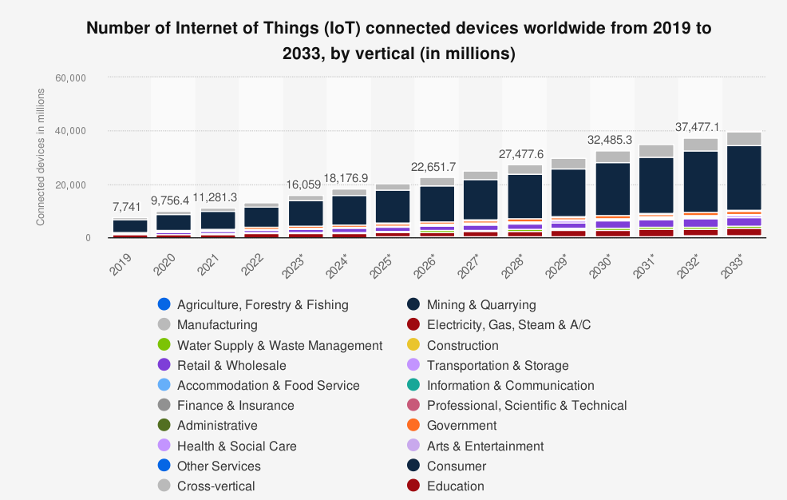
Motivation
IoT devices are widely deployed across critical infrastructure domains
- Modern IoT Challenges Demand New Defences
Traditional IDS struggle with evolving, obfuscated threats
Resource constraints on IoT and edge devices limit the feasibility of heavy-weight security solutions
Limited labelled data in real world settings makes supervised detection difficult
Real-time, adaptive, and explainable intrusion detection is urgently needed
Figure source: Transforma Insights. “Number of Internet of Things (IoT) Connected Devices Worldwide from 2019 to 2033, by Vertical (in Millions) .” Statista, Statista Inc., 10 May 2024, https://www.statista.com/statistics/1194682/iot-connected-devices-vertically/

Slide 3
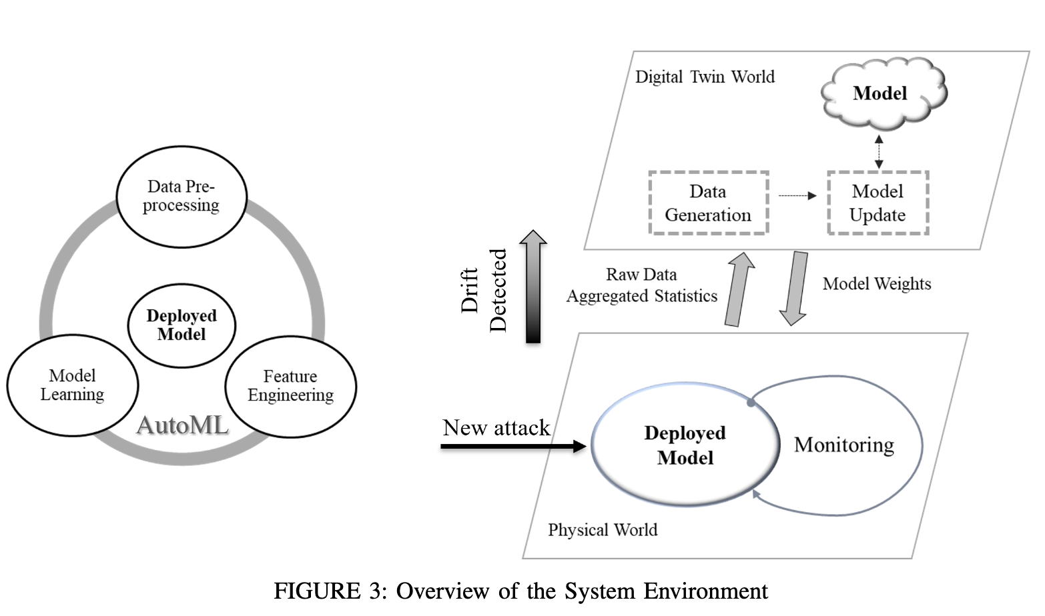
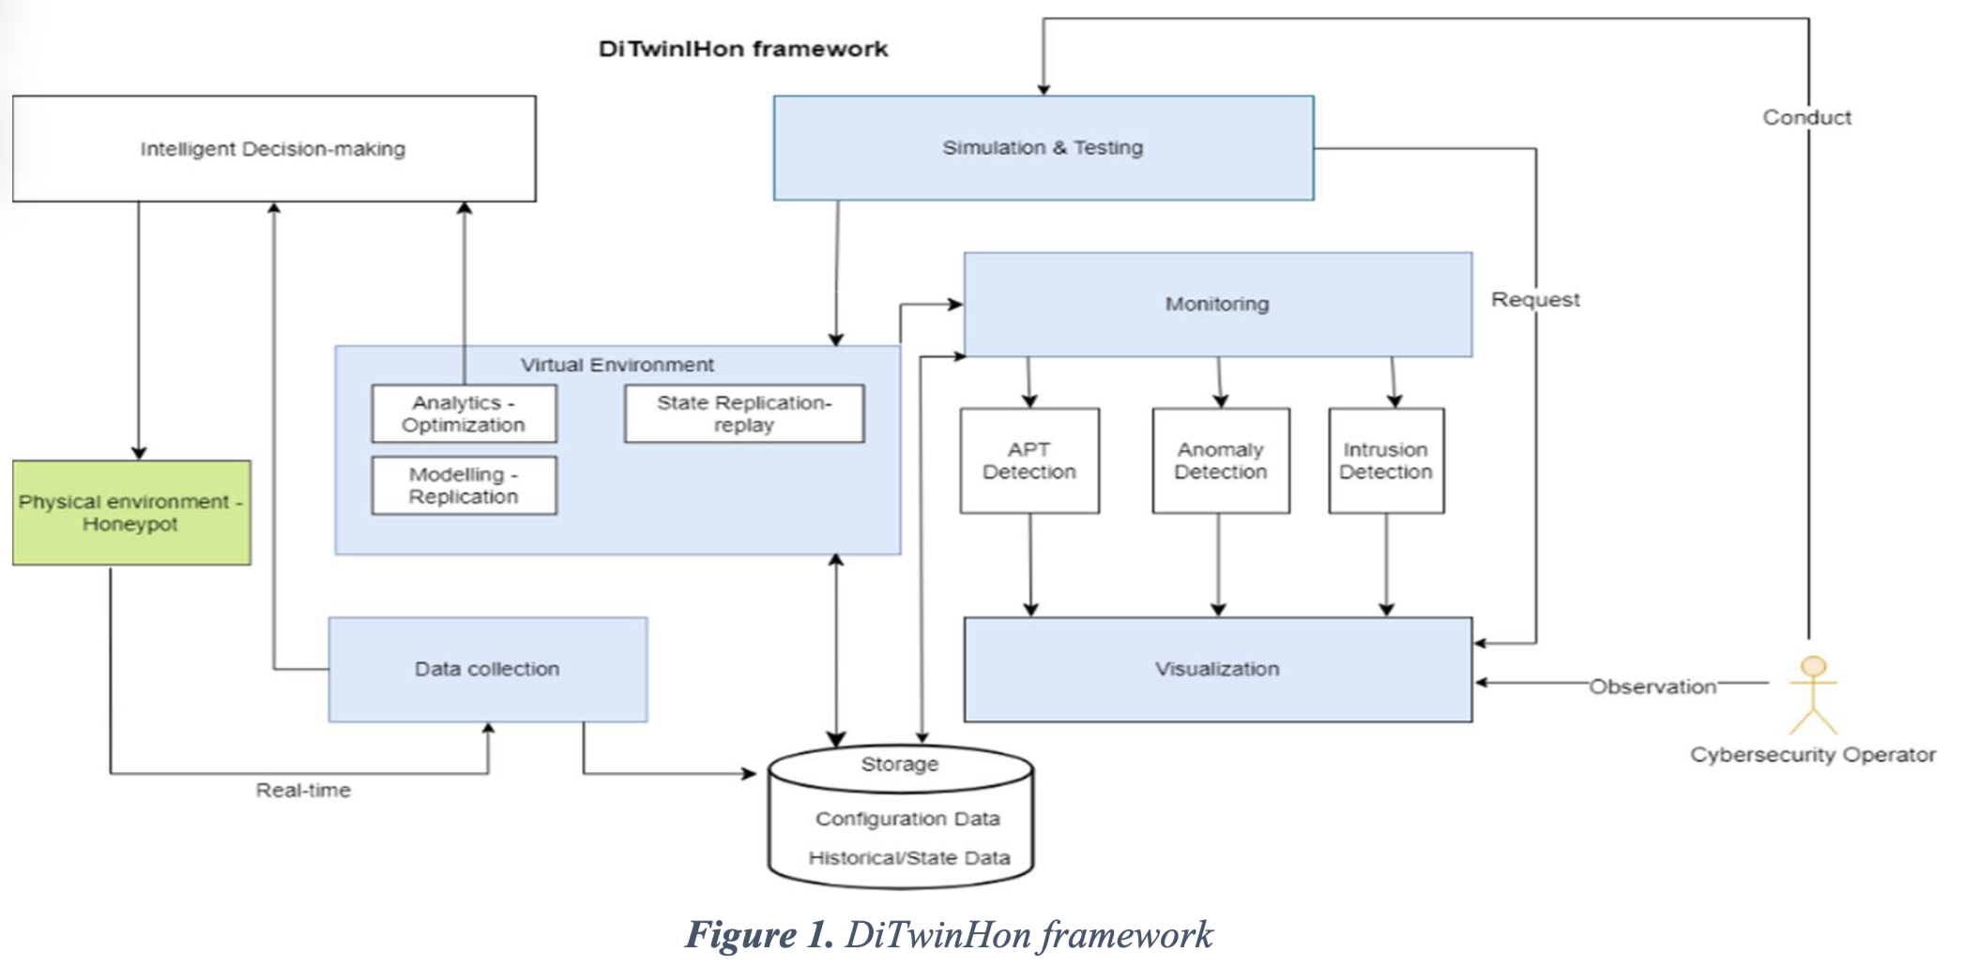
Previous Work
Focus | Papers | Method | Contribution
Digital twins in cybersecurity | Rajab et al (2024) | data generation based on new attacks | proposed an DT based AutoML pipeline to enhance intrusion detection
 | Nintsiou et al(2023) | Honeypot behaviour optimization | combines digital twin technology with honeypots to enhance Honeypot Behaviour
Rajab et al (2024)
Nintsiou et al(2023)
Digital twin concepts are widely applied in Industrial Control System (ICS) security, rarely web-based attacks.
Prior work targets physical systems or network-layer threats, and focus on data generation
No existing system uses real-time honeypot data to detect application-layer attacks adaptively.

Slide 4
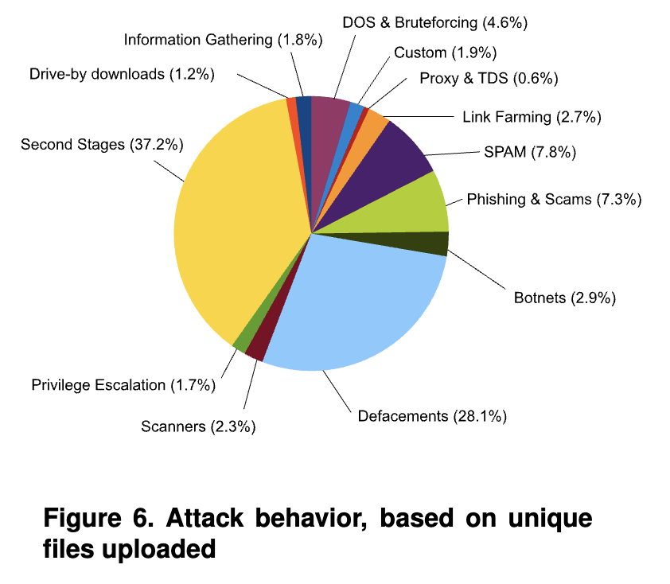
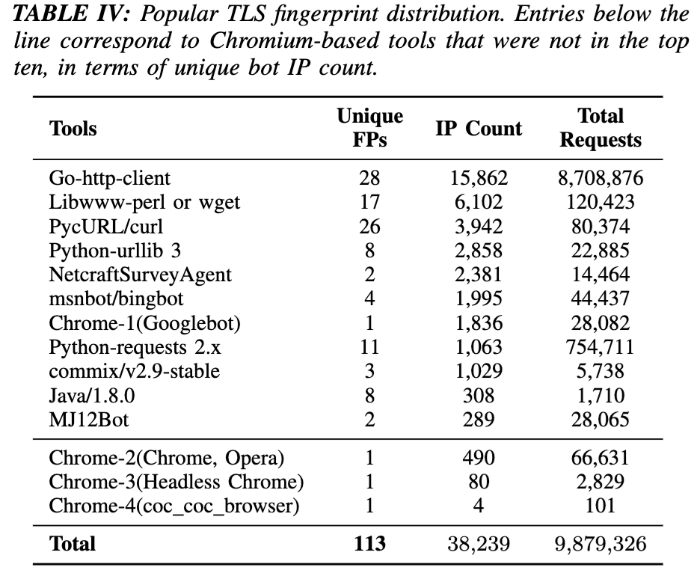
Previous Work
Focus | Papers | Method | Contribution
Wild Web Attack Analysis | Canali et al. (2013) | Real-world honeypot attack sessions with multi-stage workflow analysis | 13 post-exploitation types (e.g., web shells, IRC bots, spam)
 | Li et al. (2021) | Honeysite-based bot & HTTP threat study | Categorizes traffic (scanning, credential stuffing, exploits); highlights fingerprinting limits of UA strings
Existing taxonomies are often limited to specific attack categories.
Prior fingerprinting work mostly focuses on source identification.
We analyze the intrusions from the wild and give the profiling based on behavioral characteristics and taxonomy validation

Slide 5
Introduction
Digital Twin Framework
mirrors real attacker behaviour: captured by honeypots
using a virtual model that learns and adapts over time
Core Mechanisms
structured sequence modelling
ML classification
semantic profiling
TwinGuard Properties
Modular
Lightweight
Extensible

Slide 6
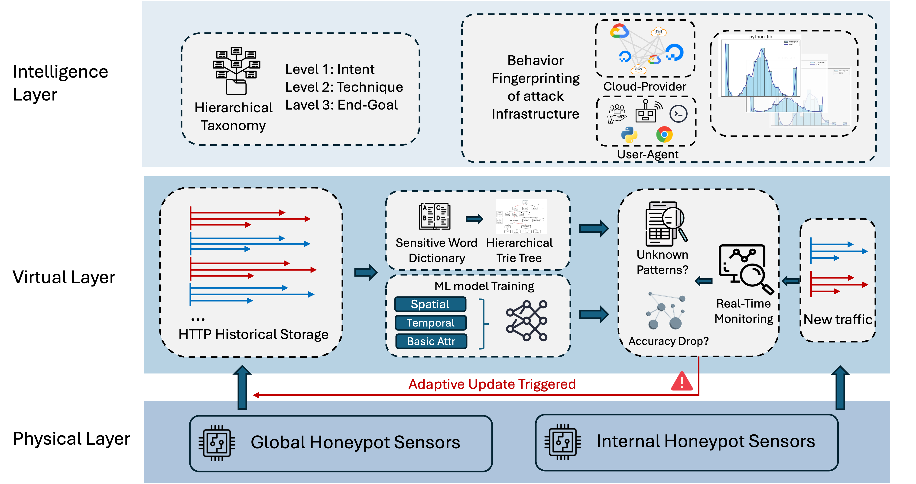
TwinGuard Design
- Hierarchical Labelling
- Attacker Fingerprinting
- Reveals what, where, and how threats evolve
- Trie-Based Path Model matching
- Keyword dictionary for Granularity Reduction
- ML Classifiers for IDS
- Sliding-Window retraining Mechanism
- Capture Real-world HTTP(S) attacks

Slide 7
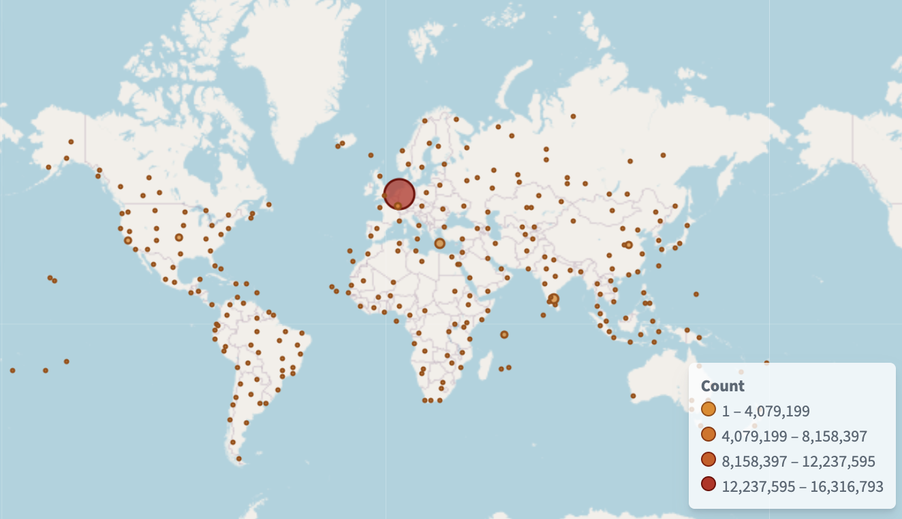
Physical Layer – Honeypot Networks and Data Acquisition
Primary Honeypot Network
3,377,335 HTTP(S) session records
ProxyPot
200+ sensors deployed
2025-03-15
2025-04-09
2025-03-26
2025-03-31
Internal Honeypot Network
847,869 HTTP requests
To test generalization
under heterogeneous input
X-POT
19 sensors deployed
70% of fields align with our primary schema

Slide 8
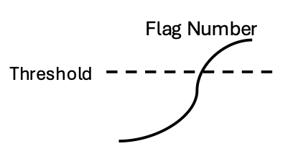
Virtual Layer – Real-Time Monitoring and Adaptive Detection
Trie Monitoring
interpretable view of structured request paths by aggregating common behaviour patterns
Trie Tree
Path Match
Unknown Rate
ML models
Geneal IDS
Accuracy Drop
Adaptive Engine
Detection
Monitoring
Sensitive Word Extraction
configurable frequency threshold (default= 20)
Structured Path Representation
Path Match
Unknown Flag++

Slide 9
Virtual Layer – Real-Time Monitoring and Adaptive Detection
Machine learning classifiers
general-purpose intrusion detection component
Feature Engineering
Basic HTTP Attributes
Content Embeddings
Encoding and MIME Indicators
Temporal Features
Spatial Features
Trie Tree
Path Match
Unknown Rate
ML models
Geneal IDS
Accuracy Drop
Adaptive Engine
Detection
Monitoring
Classifier Implementation
Random Forest
XGBoost

Slide 10
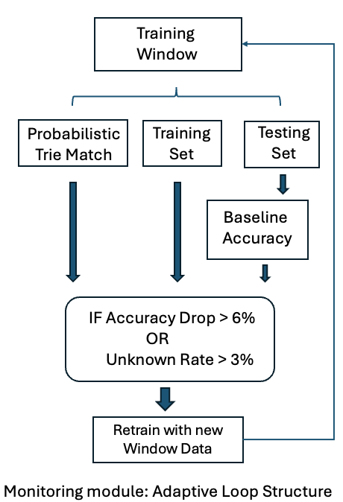
Virtual Layer – Real-Time Monitoring and Adaptive Detection
Sliding Window Mechanism
continuously monitors performance degradation and structural novelty within the HTTP(S) traffic stream
Classification:
Scan
Attempt
Intrusion-Control
Stable Periods:
both classifiers drops by less than 6.0%
the unknown pattern rate under 3.0%
Labeling Criteria:
Intrusions are labelled using rule-based matching of structured request paths, payload content, and endpoint semantics.
If a spike in unknown patterns occurs without existing labels, we check if new labelling is needed to maintain detection accurate.

Slide 11
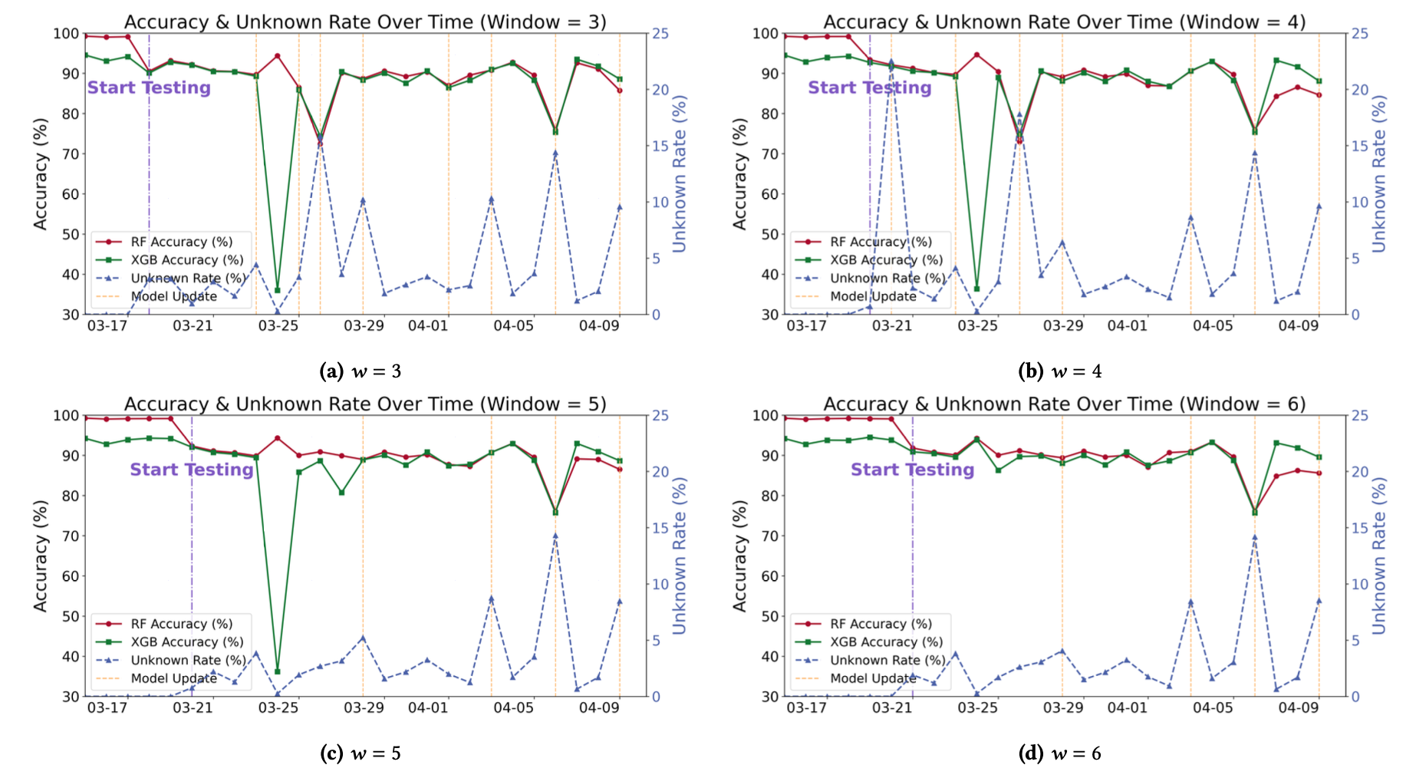
Virtual Layer – Real-Time Monitoring and Adaptive Detection
Accuracy and Unknown Rate Dynamics
Smaller Windows
Fast Reaction
Frequent Updates
Higher Volatility
Larger Windows
Stable Accuracy
Fewer Updates
Lower Unknown Rate
𝑤 = 6 strikes a balance between the model utility and stable performance
Notes:
Updates are initiated when a surge in unknown patterns coincides with a drop in accuracy. Smaller windows offer higher responsiveness to anomalies but exhibit greater volatility, while larger windows enable more stable and consistent adaptation.

Slide 12
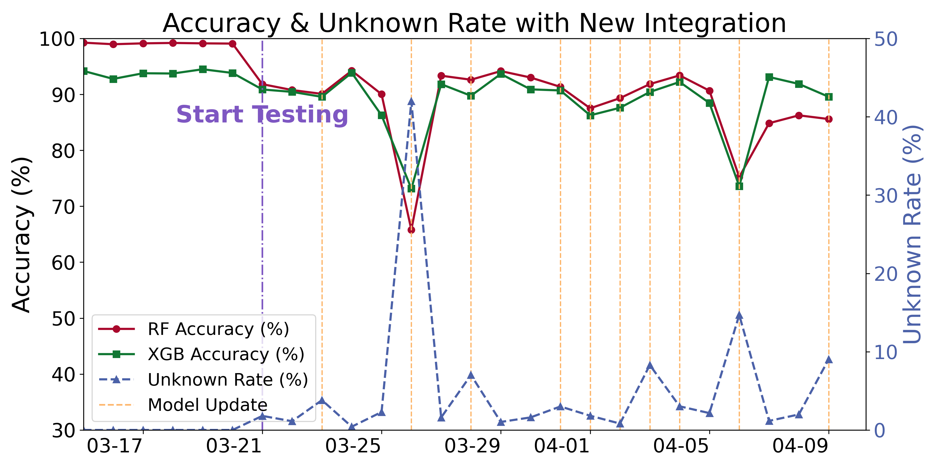
Virtual Layer – Real-Time Monitoring and Adaptive Detection
Adaptive ability with the integration of X-POT
Adaptation to a new honeypot (X-Pot) source under window size 𝑤 = 6.
A surge in unknown sequences and an accuracy drop is observed upon integration, followed by recovery after retraining.

Slide 13
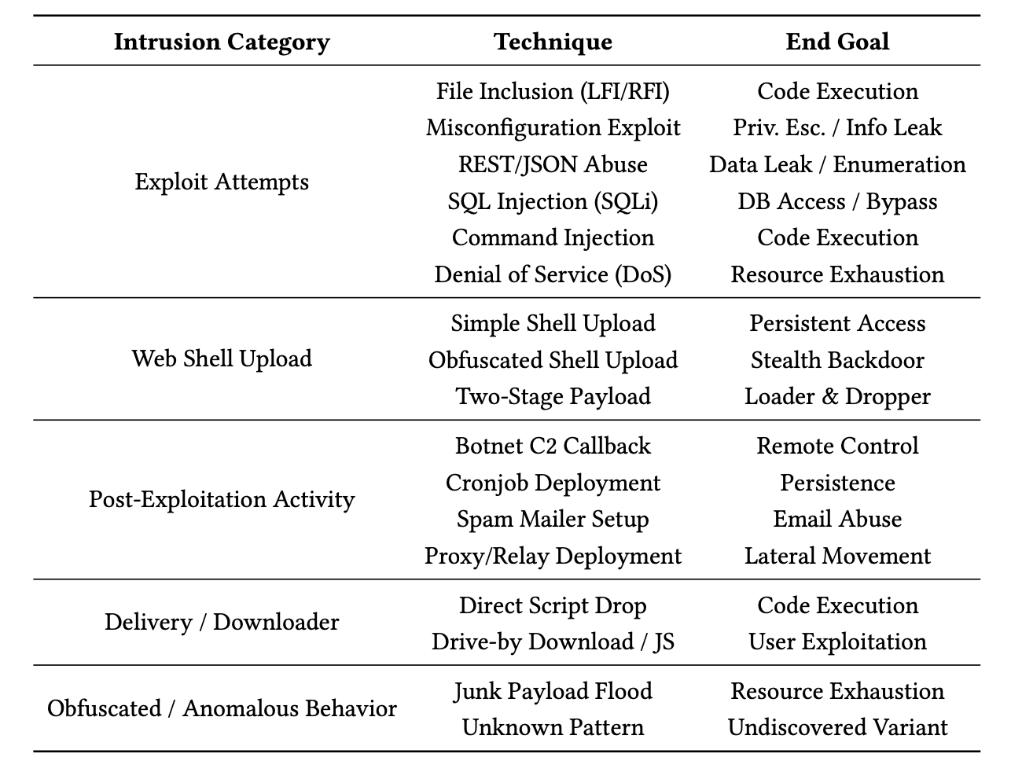
Intelligence Layer: Intrusion Labelling and Attacker Attribution
Hierarchical Pattern-Based Intrusion Labelling
Hierarchical taxonomy structure:
Level 1: Parent Category (e.g., Exploit, Downloader) ~high-level intent
Level 2: Subtypes (e.g., SQLi, Command Injection). ~how it’s done
Level 3: End Goals (Execution, Leak, etc.). ~why the attacker is doing it

Slide 14
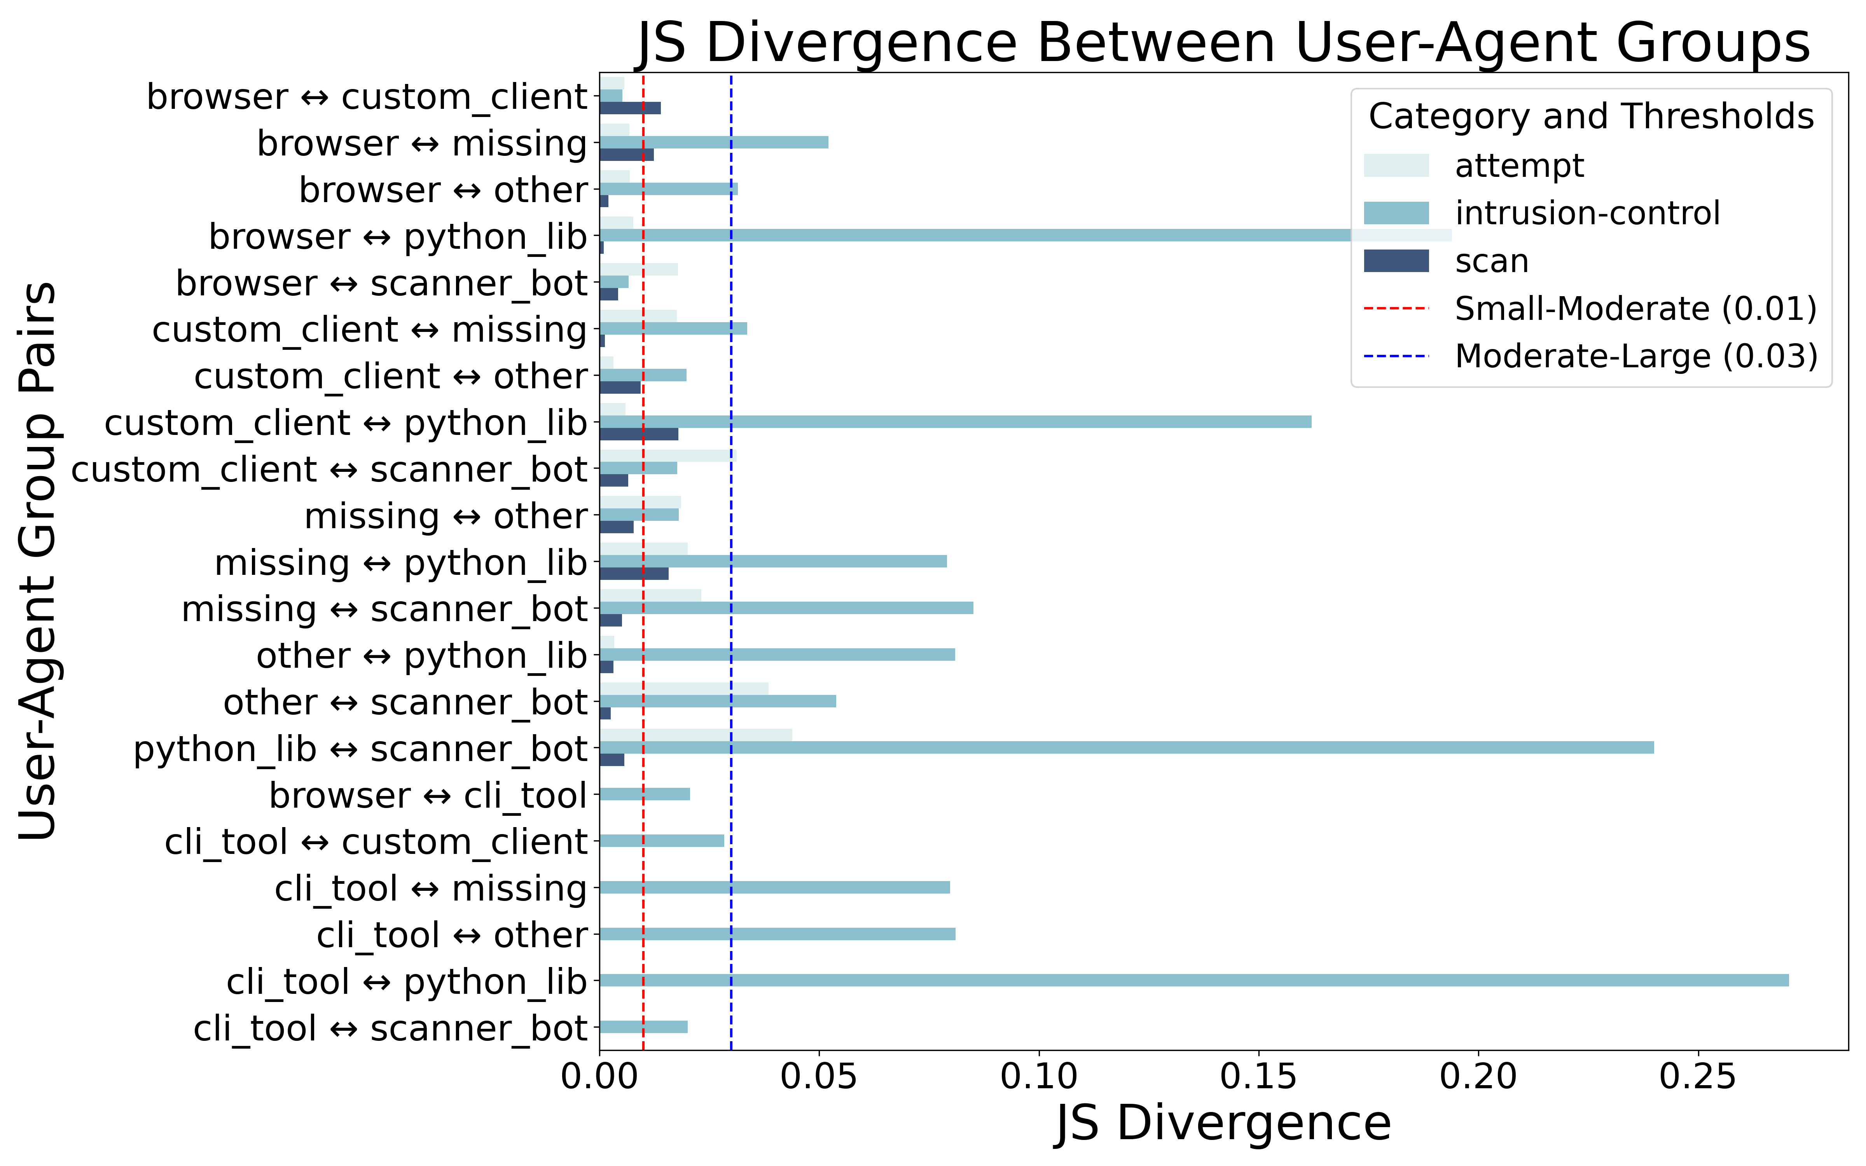
Intelligence Layer: Intrusion Labelling and Attacker Attribution
Attacker Behavioural Fingerprinting
Feature distributions are visualized using histograms and kernel density estimates (KDE)
User-Agent
The x-axis represents different HTTP session features, and the y-axis indicates their normalized values across sessions.
Diverse behaviour across UA groups, especially in intrusion-control.
High divergence observed between scanner bot, python library , indicates distinct attack behaviours.
Notes:
fingerprint vectors by averaging all normalized session features, which include HTTP methods, status codes, headers, metadata, and URI embeddings.
Diverse behaviour across UA groups, especially in attempt and intrusion-control.
High divergence observed between scanner_bot, python_lib, and other user-agent groups → indicates distinct attack behaviours.
Scan category has lowest divergence among UAs → scanning tools exhibit standardized behaviour.
Overall low divergence → attack behaviour is largely consistent across cloud platforms.
Cloud C shows slight divergence in intrusion-control attacks.
Impact is minimal — cloud provider has limited influence on attack diversity.

Slide 15
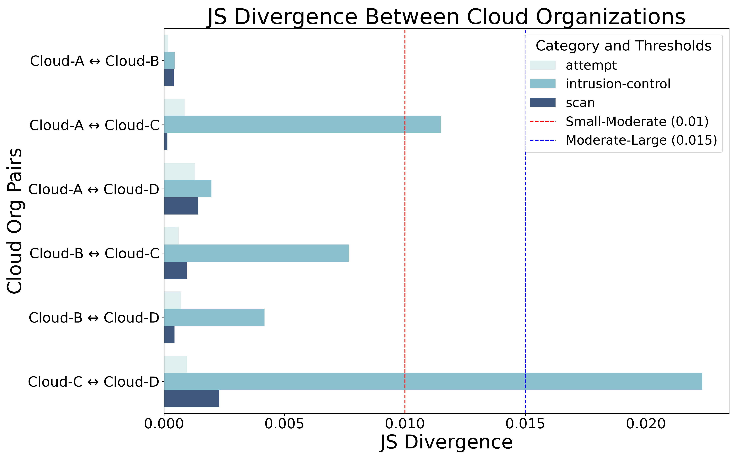
Intelligence Layer: Intrusion Labelling and Attacker Attribution
Attacker Behavioural Fingerprinting
Cloud Provider
Overall low divergence → attack behaviour is largely consistent across cloud platforms.
Cloud C shows slight divergence in intrusion-control attacks.
Impact is minimal → cloud provider has limited influence on attack diversity.
Notes:
fingerprint vectors by averaging all normalized session features, which include HTTP methods, status codes, headers, metadata, and URI embeddings.
Diverse behaviour across UA groups, especially in attempt and intrusion-control.
High divergence observed between scanner_bot, python_lib, and other user-agent groups → indicates distinct attack behaviours.
Scan category has lowest divergence among UAs → scanning tools exhibit standardized behaviour.
Overall low divergence → attack behaviour is largely consistent across cloud platforms.
Cloud C shows slight divergence in intrusion-control attacks.
Impact is minimal — cloud provider has limited influence on attack diversity.

Slide 16
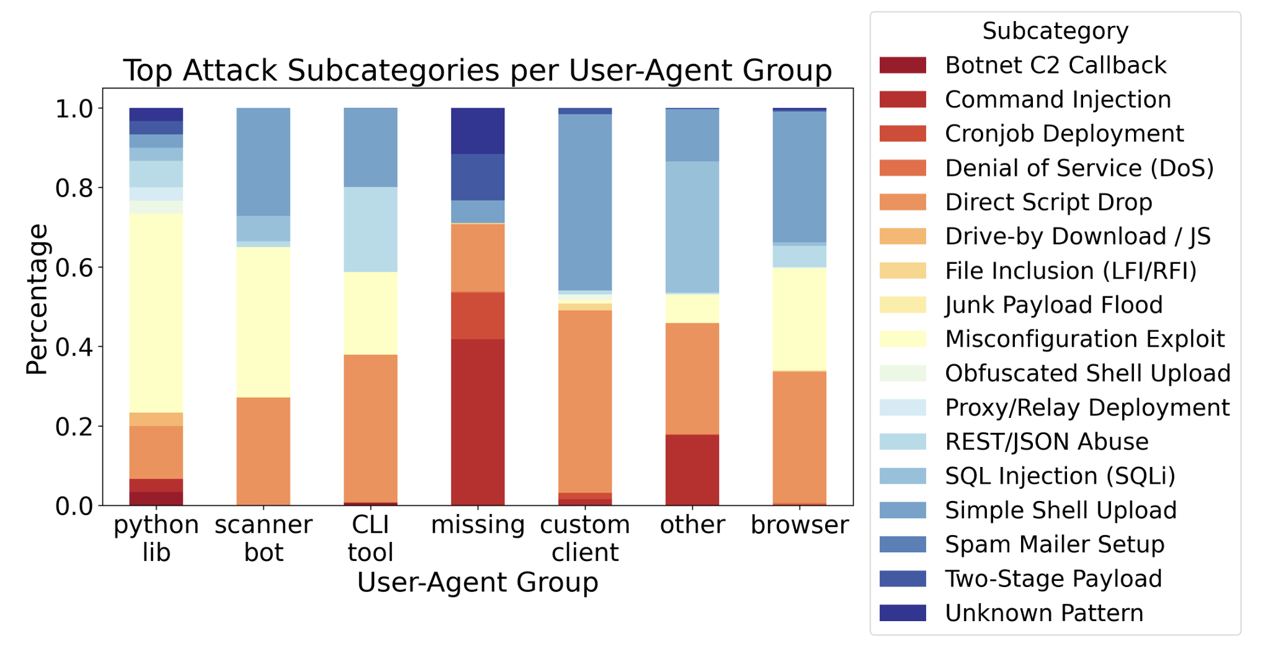
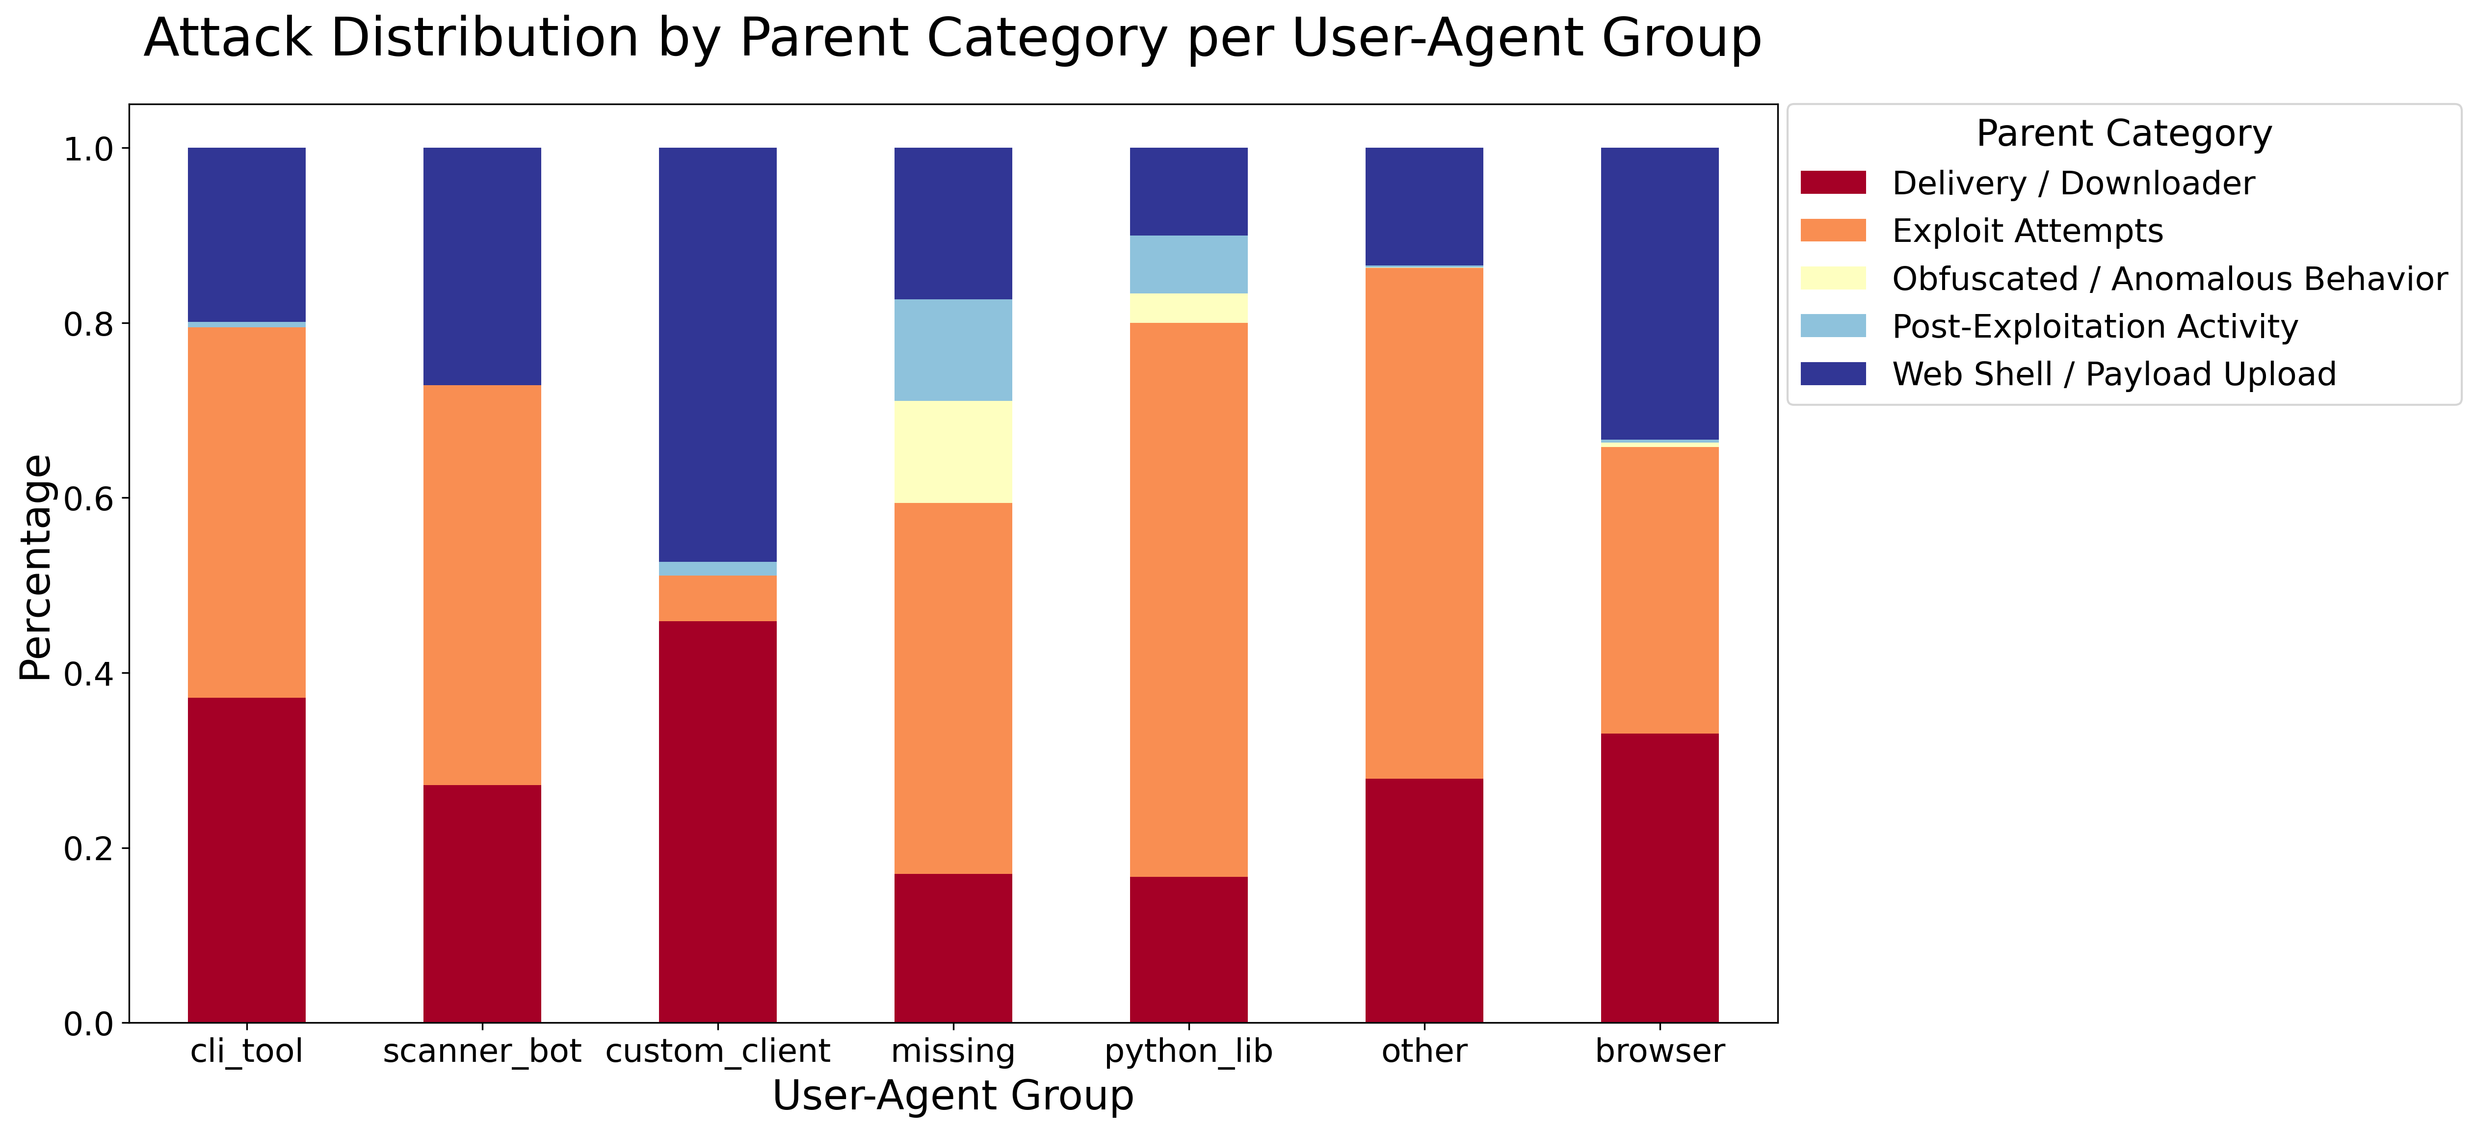
Intelligence Layer: Intrusion Labelling and Attacker Attribution
User-Agent
Browser and CLI tool sessions are concentrated in broad categories like exploit attempts and web shell uploads, reflecting traditional probing behaviour.
python libraries and scanner bots demonstrate greater technique diversity, especially in misconfiguration exploits and file inclusion (LFI/RFI).
The missing and other categories display highly irregular distributions, suggesting spoofed or unstable automation strategies.
Notes:
Browser and CLI tool sessions are concentrated in broad categories like exploit attempts and web shell uploads, reflecting traditional probing behaviour.
python libraries and scanner bots demonstrate greater technique diversity, especially in misconfiguration exploits and file inclusion (LFI/RFI).
The missing and other categories display highly irregular distributions, suggesting spoofed or unstable automation strategies.

Slide 17
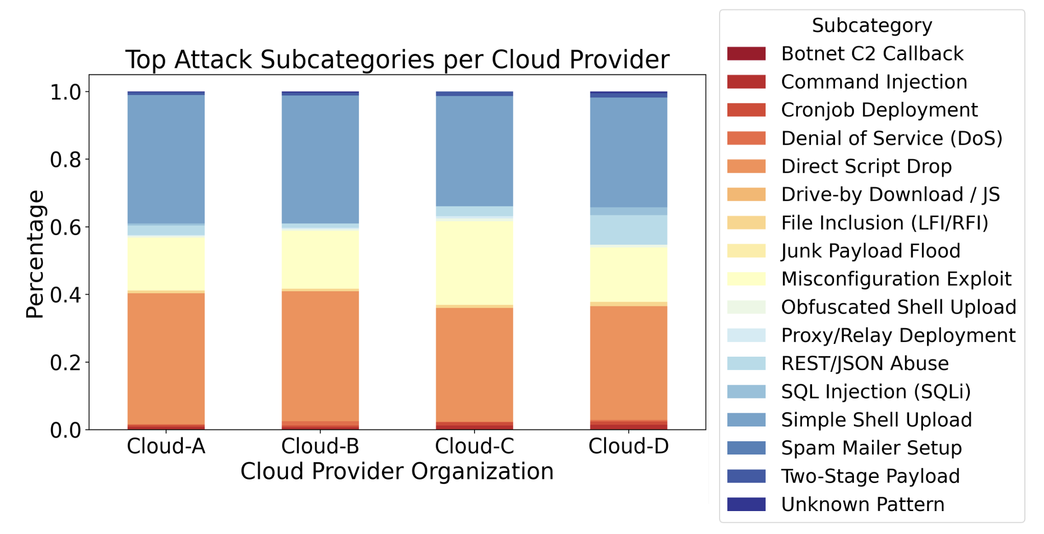
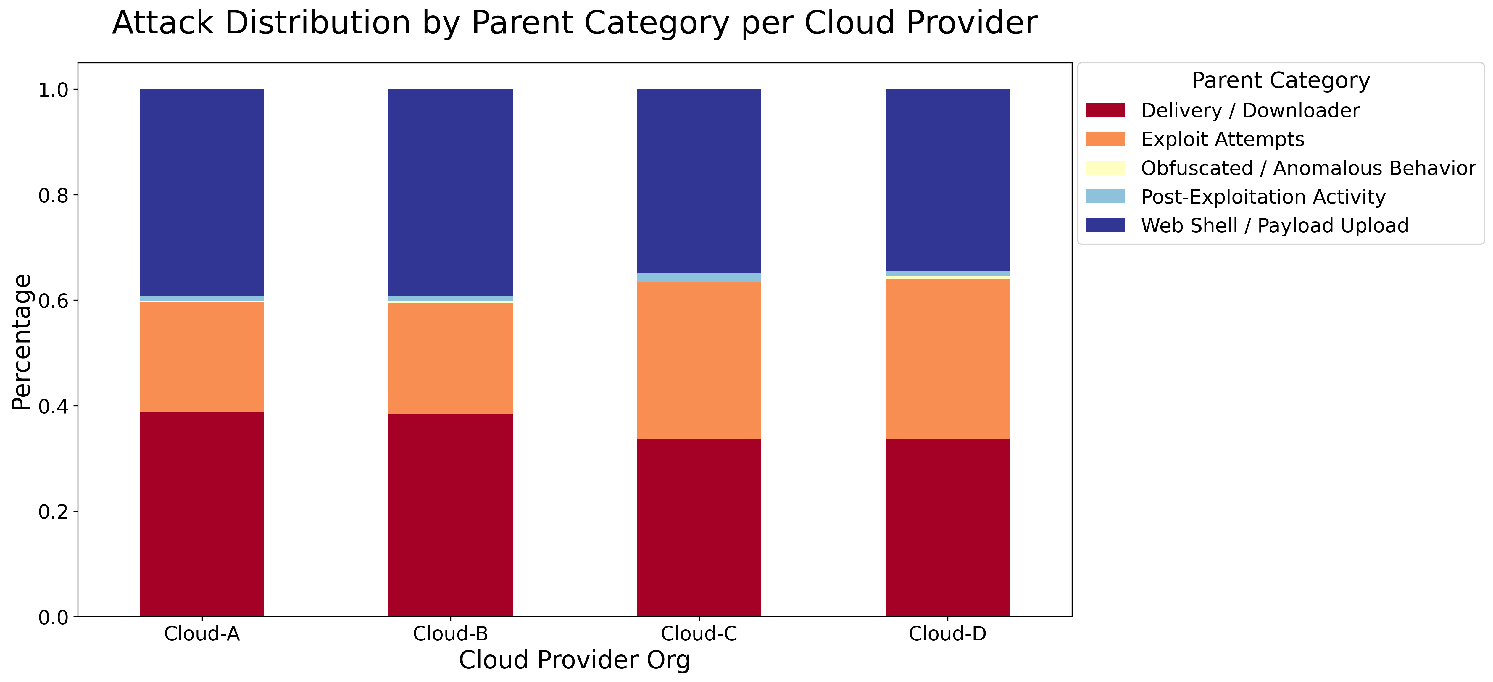
Intelligence Layer: Intrusion Labelling and Attacker Attribution
Cloud Provider
Shared Attack Focus: All cloud providers show similar dominance in script drops & shell uploads, matching low JS divergence.
Minor Exploit Variations: Slight shifts (e.g., more SQLi on Cloud-D, misconfiguration on Cloud-C) don’t alter overall behaviour.
Confirms cloud-based attacks are likely templated and automated, regardless of provider.

Slide 18
Conclusion
High Accuracy & Responsiveness
Maintains >90% accuracy during stable periods
Dual classifiers + sequence monitoring (Trie) ensure robustness
Adaptive Retraining Triggered by Novelty
Strong negative correlation between unknown rate and accuracy
42% spike in unknowns + 30% accuracy drop mitigated in 1 update cycle
Real-World Deployment with Diverse Traffic
Processes traffic from heterogeneous honeypot sources
Demonstrates adaptability across environments
Behavioral Intelligence
Reveals diverse attacker behaviour across user-agent types
Cloud-based traffic shows consistent patterns → shared tooling
Notes:
Dataset: 4+ million HTTP(S) sessions over 26 days.
90%+ accuracy during stable periods.
Rapid recovery from up to 42% unknown sequence surges after retraining.
Strong correlation between unknown pattern surges and accuracy drops.
Diverse behaviours across different user agent groups, cloud providers show consistent attacker behaviours (shared toolchains).

Slide 19
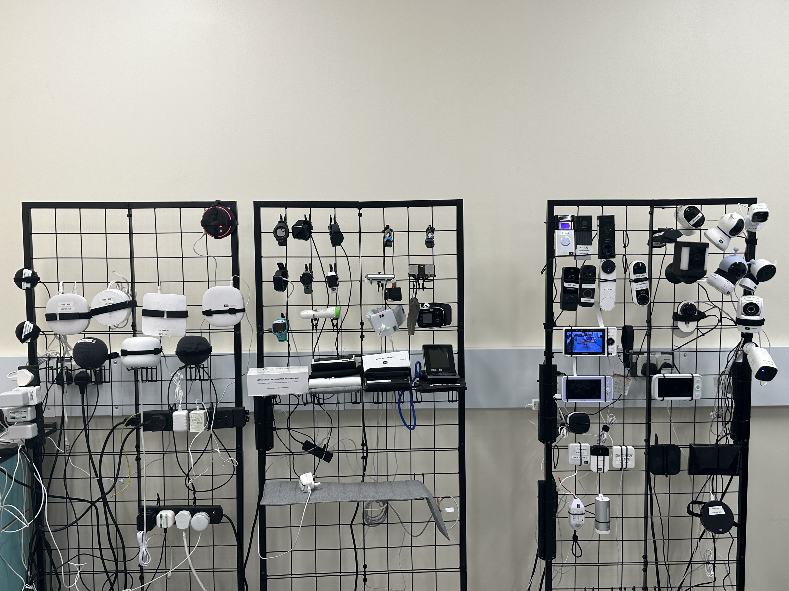
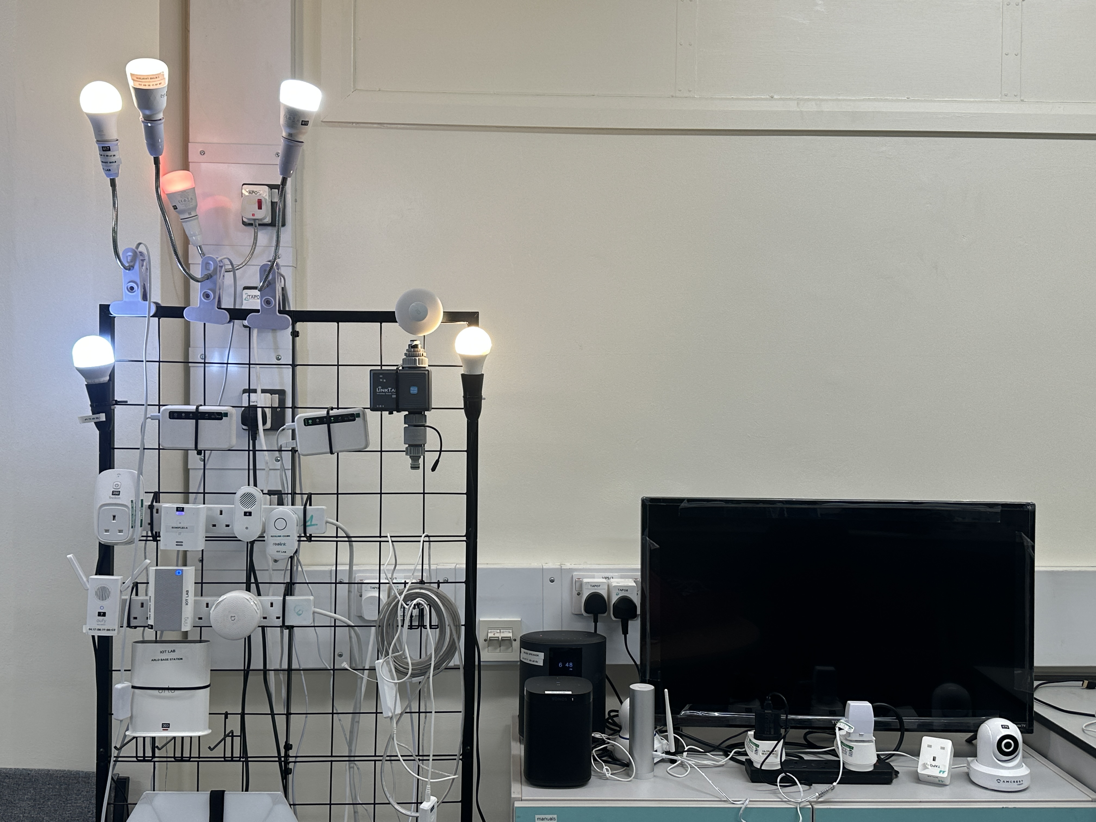
Future Work
Real-World Deployment & Evaluation
Transition from honeypot-only testing to real production environments
Expand Protocol Coverage
Move beyond HTTP(S) to include protocols like SSH, FTP, and DNS
Enable Continuous Streaming
Integrate TwinGuard with live traffic pipelines, from time-bounded snapshots to fully real-time monitoring
Lightweight IoT Deployment
Deploy TwinGuard on IoT gateways and edge devices; Test responsiveness and overhead in resource-constrained settings
Notes:
Implications:
Deployment in IoT and edge environments.
Supports adaptive defence without centralized retraining.
Limitations:
Focused only on HTTP(S) traffic.
Evaluation limited to honeypot data (not live production).

Slide 20
Follow us:
https://safenetiot.github.io/
https://www.youtube.com/watch?v=0fg0acuRbUA
Contact:
yuanyuan.zhou.23@ucl.ac.uk
Notes:
“That wraps up my presentation on TwinGuard. This research comes from our lab, SafeNetIoT, based at UCL, and is carried out in collaboration with the Global Cyber Alliance.
You can learn more about our work through the links and QR code on the screen.
Thank you for listening — I’m happy to take any questions!”

Slide 21
Appendix

Slide 22
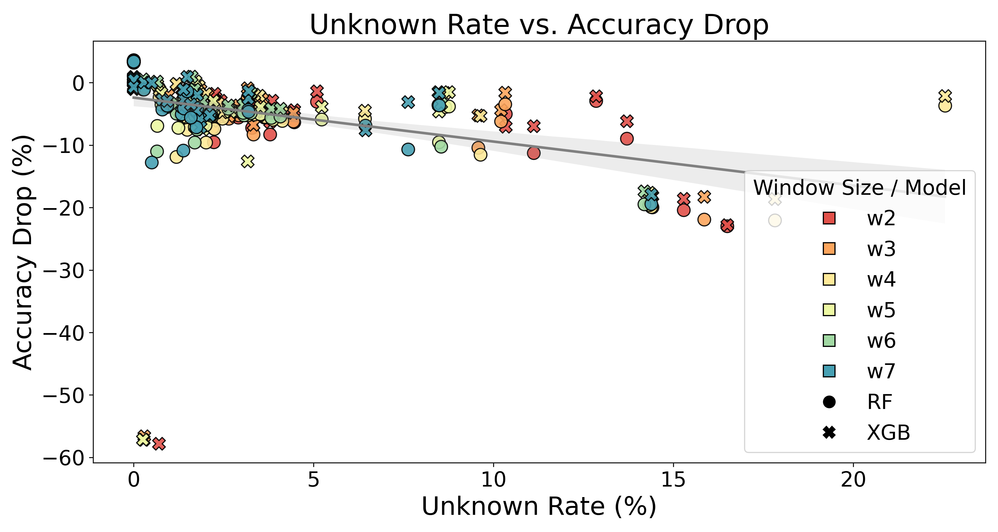

Slide 23
